Slide 1
Medical Knowledge for Behavioral Health Providers
Miller

Slide 2
What Do You See?
What Do You Do?
Does It Work?

Slide 3
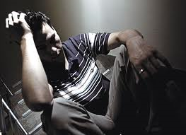

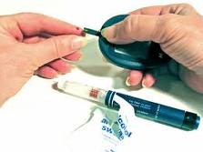

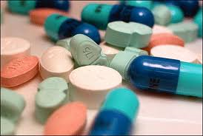

A story
Notes:
John has struggled off and on with depression. Recently, he has gotten worse and begun to avoid leaving his house even for work. He has stopped working out and starting gaining

Slide 4
Asthma
Chronic Pain
Hypertension
Diabetes

Slide 5
The Biggies
Medications (side effects and interactions)
The “basic” vitals
  Height/weight
  BP
The most common “medical” conditions and what you can do
Diagnoses and underlying physiological processes
What might be, but is not a “mental health” condition

Slide 6
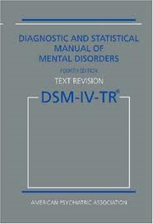
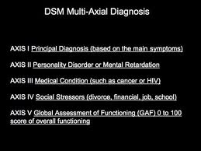

Psychological factors affecting medical conditions
Notes:
The essential features of the diagnosis are the presence of
a general-medical condition and psychological factors adversely
affecting its course and treatment or constituting
health risks and stress-related physiological responses.

Slide 7
A Whole Bunch of Numbers
If you have a mental health diagnosis, higher likelihood you have physical symptoms or medical diagnosis (vice versa too)
20-40% patients in primary care reporting fatigue suffer from depression
Patients with mental health diagnosis often have longer hospital stay
Depression and anxiety associated with increased use of medical services

Slide 8
The bumper sticker
Distilling down

Slide 9
BUT, what we do works
Psychological interventions lead to
  Decrease in medical utilization
  Saving money
  Increased recovery time (post surgery)
  Less readmission rates
  Improved mental AND medical outcomes

Slide 10
A few examples
Get specific Miller

Slide 11


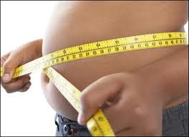


Major depressive disorder affects approximately 14.8 million American adults, or about 6.7 percent of the U.S. population age 18 and older in a given year
Cardiovascular Disease is the leading cause of death in United States; approximately 60.8 Americans experience some for of CVD

Slide 12
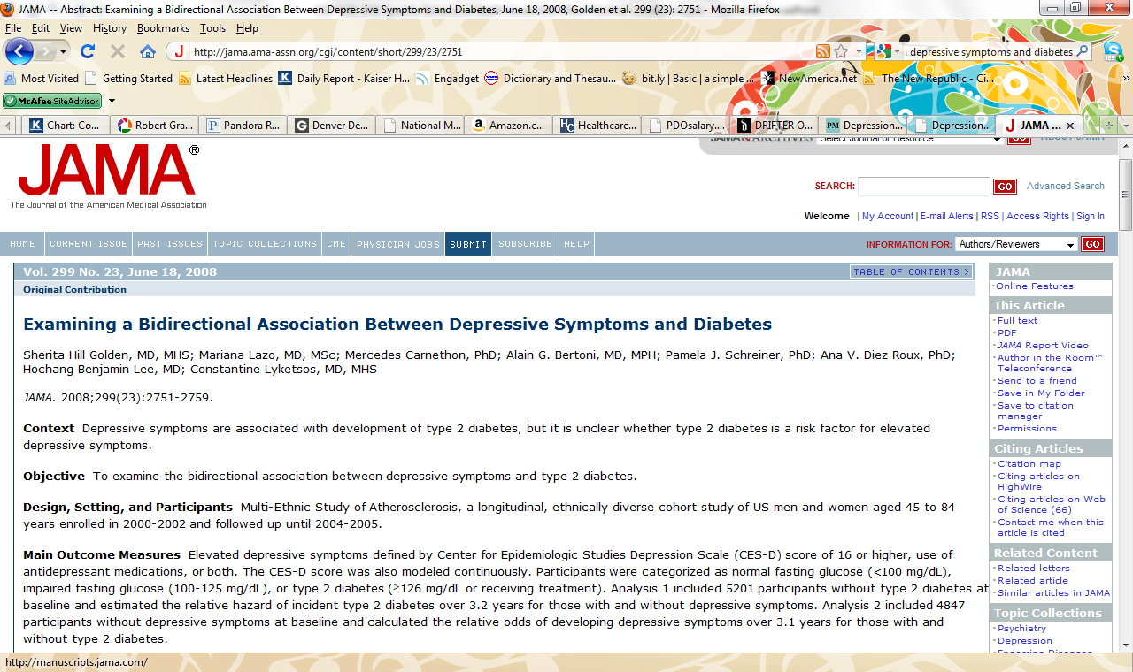
Approximately 10% to 15% of patients diagnosed with diabetes mellitus meet DSM-IV criteria for major depression (Anderson, Freedland, Clouse, & Lustman, 2001; Katon et al., 2004 )
Conclusions A modest association of baseline depressive symptoms with incident type 2 diabetes existed that was partially explained by lifestyle factors. Impaired fasting glucose and untreated type 2 diabetes were inversely associated with incident depressive symptoms, whereas treated type 2 diabetes showed a positive association with depressive symptoms.

Slide 13
Then there is that “stress” thing
Stress affects health primarily through:
  Direct physiological mechanisms
    Decreased resistance to disease (greater incidence of infectious disease)
    Trigger for cardiovascular events
    Can alter metabolic activity in diabetes
  Alteration of health related behaviors
    Cessation of healthy habits
    Increase in smoking status
Notes:
75% of the general population experiences at least "some stress" every two weeks (National Health
Interview Survey).
Half of those experience moderate or high levels of stress during the same two-week period.
Millions of Americans suffer from unhealthy levels of stress at work. (A study several years ago
estimated the number to be 11 million--given events since that time, this number has certainly more
than tripled--studies in Sweden, Canada, and other Westernized countries show similar trends.)
Stress contributes to heart disease, high blood pressure, strokes, and other illnesses in many
individuals.
Stress also affects the immune system, which protects us from many serious diseases.
Stress also contributes to the development of alcoholism, obesity, suicide, drug addiction, cigarette
addiction, and other harmful behaviors.
Stress in society is so prevalent that the U.S. Public Health Service has made reducing stress one
of its major health promotion goals.

Slide 14
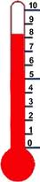
Arguably the most under utilized tool
Stress leads to non- adherence of treatment regimens AND diagnosis and symptomatology can lead to psychological distress (Lustman, 1988; Wells, Golding, & Burnam, 1988; Wilkinson, 1991)
Another two way street

Slide 15
Let the fun begin
Deep breath

Slide 16
Medical Terminology (prefixes)
hyper - above; excessive
hypo - deficient; below; under; less than normal
a – no; not; without
ab – away from

Slide 17
Medical Terminology (meds)
prn – as needed
bid – twice a day
q | every (e.g. q6h = every 6 hours)
qd | every day
qh | every hour
q4h, q6h.... | every 4 hours, every 6 hours etc.
qid | four times a day
QNS | quantity not sufficient
qod | every other day
Qs/Qt | shunt fraction
Qt | total cardiac output

Slide 18
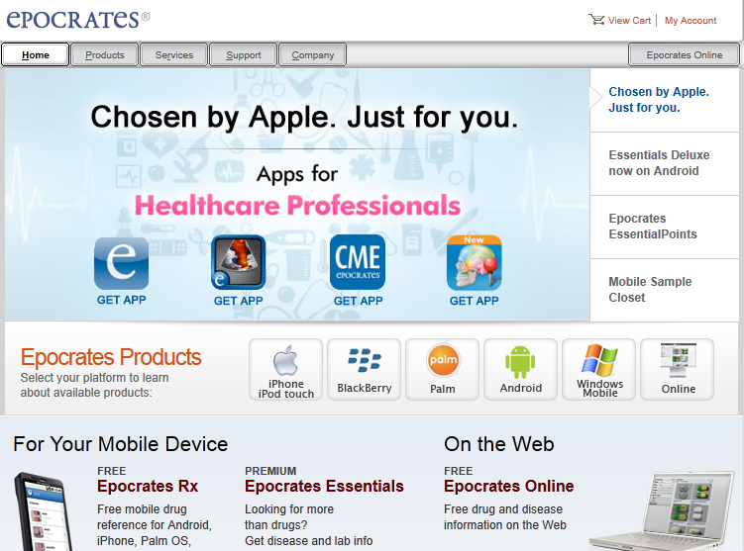
What you need

Slide 19
“But doc, Smoking makes me feel relaxed”
And how could we forget…

Slide 20
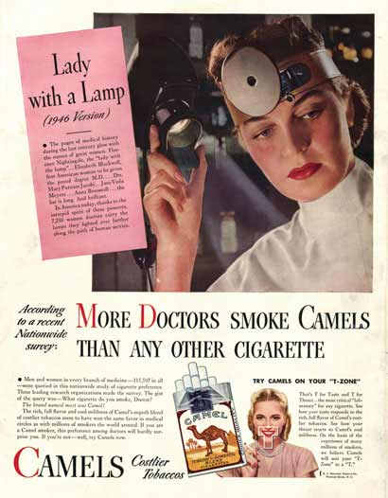
Smoking
1946

Slide 21
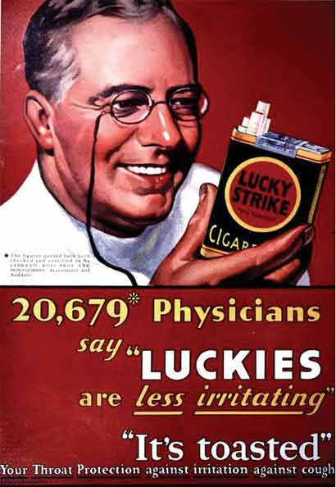
~1950

Slide 22
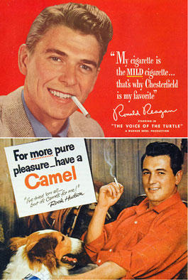
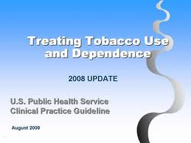

Tobacco Use Common
80% of individuals with severe mental illness report using some form of tobacco (Ziedonis & Williams, 2003)
44% of all cigarettes consumed by individuals with a mental illness or substance abuse disorder (Lasser et al., 2000)

Slide 23
Nicotine dependence has been well documented among individuals diagnosed with schizophrenia (88%), mania (70%), major depression (49%), and anxiety disorder (47%) (Hughes, Hatsukami, Mitchell, & Dahlgren, 1986)
To complicate these mental health diagnoses, withdrawal from tobacco use can aggravate and increase emotional lability (Glassman, 1993; Wetter et al., 1998)

Slide 24
Among current smokers, the most common current (within the last 30 days)
mental health diagnoses are (Lasser, 2000):
Alcohol abuse
Major Depressive Disorder
Anxiety disorders: simple phobias and social phobias
Substance Abuse
Notes:
Meaning you likely have seen one of these patients recently

Slide 25

The Five A’s
Ask
Advise
Assess
Assist
Arrange

Slide 26
Tobacco Use: What Works*
High Efficacy:
Behavioral Methods:
  Face to face counseling (e.g., Lancaster et al, 2005)
  Telephone counseling (e.g., Quitlines; Stead et al., 2006)
  Computer-tailored interventions
Marginal Efficacy:
  Self-help materials (e.g., books/videos; Lancaster et al, 2005)
“Ineffective:”
  Acupuncture (White et al., 2006)
  Hypnosis (Abbot et al., 1998)
*Everyone has an Aunt Susie

Slide 27
The importance of physiology
Level of Nicotine
NRT
Time

Slide 28
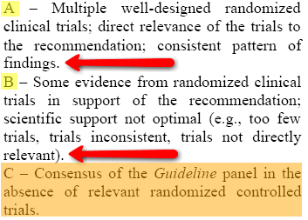
Examination of the Evidence

Slide 29
Intervention: Pharmacotherapy
First-line medications:
  Bupropion SR
    Bupropion SR is an efficacious smoking cessation treatment that patients should be encouraged to use (Strength of Evidence – A)
    Can be used in combination with other nicotine replacement therapies
    Available exclusively for smoking cessation (Zyban) or depression (Wellbutrin)
    Estimated abstinence rate: 30.5

Slide 30
Intervention: Pharmacotherapy
First-line:
  Nicotine Gum (Strength of Evidence – A)
    Estimated abstinence rate: 23.7 13 studies
  Nicotine Inhaler (Strength of Evidence – A)
    Estimated abstinence rate: 22.8 4 studies
  Nasal Spray (Strength of Evidence – A)
    Estimated abstinence rate: 30.5 3 studies
  Nicotine Patch (Strength of Evidence – A)
    Estimated abstinence rate: 17.7 27 studies
Notes:
Gum – 4mg vs 2mg

Slide 31
Intervention: Pharmacotherapy
Second-line:
  Clonidine (Strength of Evidence – A)
    Estimated abstinence rate: 25.6 5 studies
  Nortriptyline (Strength of Evidence – B)
    Estimated abstinence rate: 30.1 2 studies
Notes:
Gum – 4mg vs 2mg
Nortriptyline given B because of limited studies

Slide 32
Intervention: Pharmacotherapy
Not Recommended:
  Antidepressants other than Bupropion SR and Nortriptyline
  Anxiolytics/Benzodiazepine/Beta-Blockers
  Silver Acetate
  Mecamylamine
Notes:
Gum – 4mg vs 2mg
Nortriptyline given B because of limited studies

Slide 33
What is being done?
In 2000, 1.3.% of smokers making a quit attempt used a behavioral treatment - 21.7% used a pharmacologic treatment (Cokkinides et al., 2005)
Shiffman et al., 2008 found that behavioral treatments are rarely used without medication (2.9%), while medications are often used without behavioral treatments (26.3%)

Slide 34
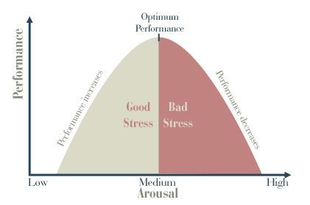
The Role of Stress
Why take away the Pt only way of coping with stress?
Stress management important prior to a quit attempt
Yerkes-Dodson, 1908

Slide 35
Assessment
Arguably the most important element in cessation remains the assessment
The Art of Scaling: 0-10 Assessment Tool
  On a scale of 0-10, how important is it that you quit smoking?
  On a scale of 0-10, how confident are you in your ability to quit smoking?

Slide 36
Insomnia

Slide 37
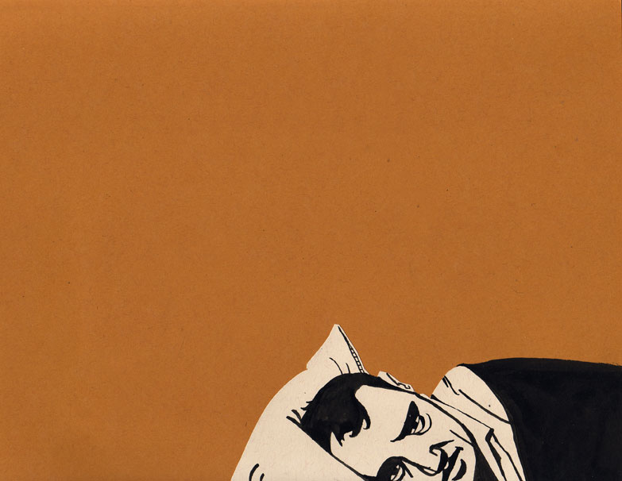
The best cure for insomnia is to get a lot of sleep.
- W. C. Fields

Slide 38
Chronic Insomnia Prevalence
~10-15% (Costa et al., 1996, Morin et al., 1994)
Direct costs - $13.9 billion a year (Walsh, 2004)
More frequently seen in
  Women
  Older Pt
  Pt with chronic medical dx
  Pt with psychiatric disorders
May follow episodes of acute insomnia

Slide 39
Definitions
Insomnia – difficulty with the initiation, maintenance, duration, or quality of sleep that results in the impairment of daytime functioning, despite adequate opportunity and circumstance for sleep (Silber, 2005, Morin et al., 1999, Costa et al., 1996)

Slide 40
Chronic Insomnia Consequences
Enter Primary Care
  Pt often initiate treatment on their own
  Insomnia often unrecognized
  Not always Pt presenting problem

Slide 41
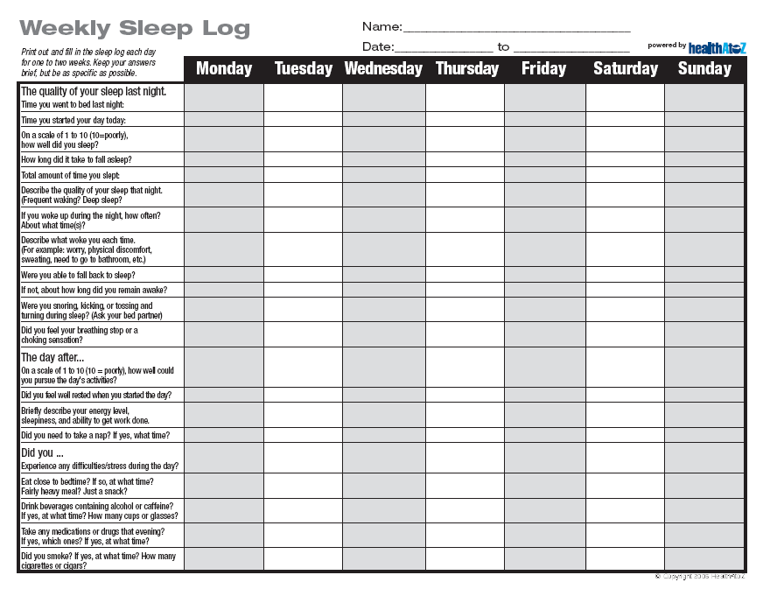
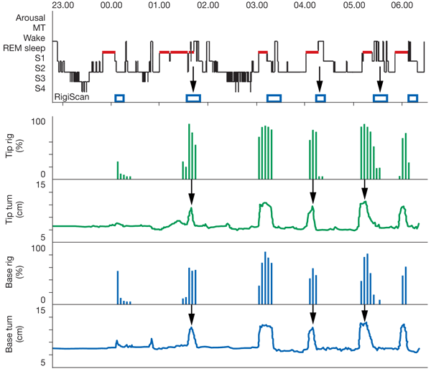
Assessment
Take a careful history
  Bed partners are an excellent source of information (e.g., Sleep Apnea)
Sleep diary
Polysomnography
  Rarely needed unless suspicion of periodic limb movement, possible sleep disorder breathing problem, or insomnia does not respond to typical treatment

Slide 42
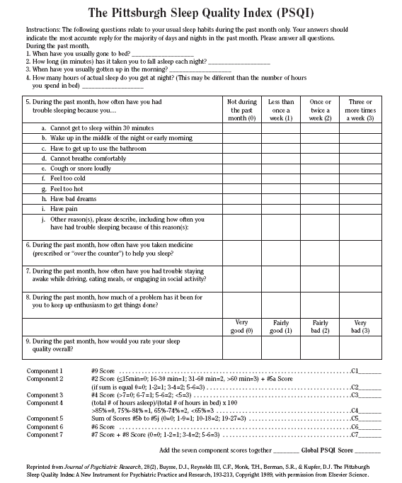
Assessment Tools
The Pittsburgh Sleep Quality Index (PSQI; Buysse et al., 1989)
  Measures the quality and patterns of sleep in adults
  It differentiates “poor” from “good”
  Measures seven areas:
    subjective sleep quality
    sleep latency
    sleep duration
    habitual sleep efficiency
    sleep disturbances
    use of sleeping medication
    daytime dysfunction
  Scoring of answers is based on a 0 to 3 scale, whereby 3 reflects the negative extreme on the Likert Scale. A global sum of “5” or greater indicates a “poor” sleeper.

Slide 43

Treatment?
2
4
5
3
6
1

Slide 44
Treatment
Medicinal
* Multiple options varying in efficacy
Behavioral
  *IMPORTANT NOTE: Try first before combining with medicinal trial – studies have shown this reduces the long-term benefit of CBT

Slide 45
CBT
Addresses several factors that often perpetuate insomnia (Silber, 2005)
RCT have demonstrated efficacy in treating primary insomnia – meta analyses (Morin et al., 1994; Murtagh et al., 1995)
~50% of Pt show clinical improvement (Epsie et al., 2001)
BHC in primary care treat insomnia well (Goodie, Isler, Hunter & Peterson, 2009)

Slide 46
Types of CBT
Stimulus-control therapy
  Sleep and sex
  Go to bed only when sleepy
  20 minute rule; repeat
  Regular sleep time
  No napping

Slide 47
Types of CBT
Sleep-restriction therapy
  Reduce/Increase time in bed
Relaxation therapy
  PMR
  Biofeedback
  Guided imagery
  Meditation
Teachable?
Notes:
While these are quite teachable, sometimes in primary care we are pressed for time and these become more difficult to teach quickly. CBT in general can often be taught much faster than some of these techniques.

Slide 48
CBT
Cognitive therapy
  Change beliefs, attitudes about sleep (e.g., “But Doc, I know it is medically necessary to obtain over 8 hours of sleep”)
Cognitive
Physical
Behavior
Environment
Emotions
Notes:
How much sleep do you need? This is discrepant amongst all patients. I only need about 5-6 hours, while my wife needs 8.

Slide 49
CBT
Sleep Hygiene
  Pets (“Scruffy only covers my face once in a while.”)
  Smoking (“It just relaxes me.”)
  Alcohol (“All I need is one glass of wine!”)
  Bed Partner (“I swear, if only John wouldn’t snore like a chainsaw, I would sleep better.”)
  Exercise (“The only time I have to exercise is right before I go to bed – or I just don’t have time to exercise.”)
  Other Environmental Cues (“Falling asleep with the news on isn't a problem is it?”)
YOU CAN’T EDUCATE IF YOU DON’T ASSESS

Slide 50

Pharmacologic Therapies
Classes
  Benzodiazepines
  Benzodiazepine-receptor agonists
  Sedating antidepressants
Data to support use
  No studies extend beyond six months

Slide 51





Pharmacologic Therapies
zolpidem (Ambien)
zaleplon (Sonata)
eszopiclone (Lunesta)
ramelteon (Rozerem)
sedating antidepressants

Slide 52
Pharmacologic Therapies
Bottom Line
Short-acting agents have greatest effect on sleep latency
Agents with intermediate or long-acting have greatest effect on total sleep time

Slide 53
Pharm vs. CBT
CBT vs. triazolam (Halcion - benzo w/ short half-life; McClusky et al., 1991)
  Compared to CBT Shorter sleep latency w/ triazolam at 2 weeks, but equal latencies at 4 weeks
CBT vs. zolpidem (Ambien - non-benzo; Jacobs et al, 2004)
  CBT superior throughout
  Follow up at 4-6 weeks after medication d/c and CBT completed showed sustained benefit of only CBT

Slide 54
Pharm vs. CBT
CBT w/ RXP vs. CBT alone (Morin et al., 1999; Jacobs et al., 2004; Hauri, 1997)
  10-24 months f/u improvements are maintained for CBT alone, but not for combined therapy
  Explanation?
  Pt less committed to learning and practicing CBT skills if they can control insomnia w/ medications

Slide 55

More Evidence
AASM –EBP (non-pharmacologic tx for insomnia) the following were recommended:
  Stimulus-control
  PMR
  CBT
Insufficient evidence exists to support the use of the following interventions alone:
  sleep hygiene education
  Imagery training
  Cognitive therapy
What about me?

Slide 56
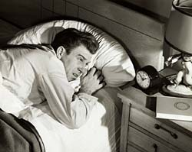
Take Home Message
Assess, Assess, Assess
Identify secondary causes first
CBT first then meds
Medication helpful in short-term (limited studies >6 months)
Insomnia is treatable

Slide 57
Resources
http://www.aasmnet.org/
http://www.absm.org/PDF/ICSD.pdf
http://www.absm.org/
http://www.sleepfoundation.org
http://www.sleepforkids.org/

Slide 58
Chronic Pain
Ouch

Slide 59

American Pain Society
Chronic pain
Defined as pain that lasts six months or longer, well past the normal healing period one would expect for its protective biological function.
50 million
76 million
(15%-20% Children)
$100 billion per year
Need

Slide 60
Definitions
    Occurs in 15-20% of US population annually
    Only 1 out of 4 postsurgical patients are adequately treated
Acute pain
is usually indicative of tissue damage, and it is
characterized by momentary intense noxious
sensations (i.e., nociception)
Chronic pain
is defined as pain that lasts
six months or longer, well past the normal
healing period one would expect for its
protective biological function
    50 million sufferers in US
    40% with moderate to severe pain cannot get relief
Recurrent pain
refers to intense, episodic
pain, reoccurring for more than three months.
Recurrent pain episodes are usually brief (as
are acute pain episodes); however the
reoccurring nature of this type of pain makes
it similar to chronic pain in that it is very
distressing to patients.

Slide 61
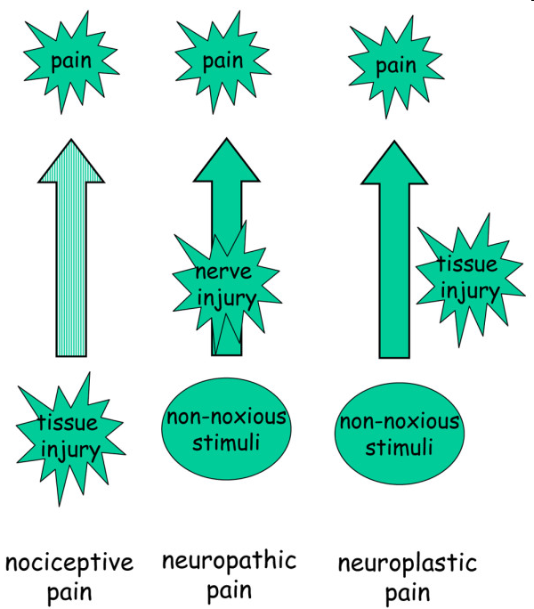
Nociceptive pain
  Ongoing activation of nociceptors in response to noxious stimuli (injury, disease, inflammation)
    Visceral
    Somatic
      Superficial
      Deep
Neuropathic pain
  Caused by aberrant signal processing in the CNS due to trauma, inflammation, metabolic diseases, infection, tumors, toxins, etc.
    Allodynia
    Hyperalgesia
Notes:
Nociceptive pain is triggered by tissue injury and activates unmodified nociceptive neurons (light arrow) inducing acute pain. In contrast, normally innocuous stimuli produce pain in neuropathic and neuroplastic conditions in consequence of sensitized nociceptive pathways (dark arrows). Note: Idiopathic pain omitted from figure. (Adapted from [3].)
Kidd et al. Arthritis Research & Therapy 2007 9:214 doi:10.1186/ar2147

Slide 62
 | Acute Pain | Chronic Noncancer Pain | Chronic Cancer Pain
Duration | Hrs - days | Months - yrs | Unpredictable
Associated pathology | Present | Often little or none | Usually present
Prognosis | Predictable | Unpredictable | Inc pain with possibility of disfigurement or fear of dying
Associated problems | Uncommon | Depression, anxiety | Many, especially fear of loss of control
Social effects | Minimal | Profound | Profound
Treatment | Analgesics | Multimodal; largely behavioral | Multimodal; drugs play major role

Slide 63

Treatment Options
Acute Pain
  Provide rapid and effective relief
  Treat the cause
Chronic Pain
  Reduce pain to a level that is appropriate for the patient
  May not be able to eliminate
  Improve functioning and quality of life
  Manage comorbidities
  Address psychosocial issues

Slide 64
Diabetes
How sweet

Slide 65
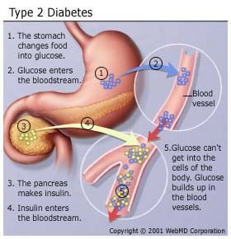
What is Type 2 Diabetes?
A Chronic endocrinological disorder characterized by abnormalities in glucose metabolism due to abnormalities in the production and/or utilization of the hormone insulin (Gonder-Frederick, Cox, & Ritterband, 2002)

Slide 66
Type I vs Type II
T1DM: (insulin dependent) ~5% (think born with it, onset usually during youth age)
  Body has insufficient production of insulin (a protein hormone) that helps metabolize carbs
T2DM: (non-insulin dependent) 90-95%
Gestational diabetes (2-5%) disappears after pregnancy

Slide 67
T2DM Statistics
Chronic illnesses such as diabetes account for approximately 80% of the deaths in Western countries (Maes, Leventhal, and DeRidder, 1996)
Diabetes is the 7th leading cause of death in the United States (Centers for Disease Control and Prevention, 2002)
Diabetes affects approximately 17 million Americans
(American Diabetes Association, 2001)
Direct and indirect costs related to diabetes range from 57$ to 98$ billion dollars (American Diabetes Association, 1998)
T2DM is strongly related to obesity (80%), age, and over 2/3 have a first or second cousin with the disease (Haffner, 1998)
Additionally, Haffner (1998) found that the risk for T2DM is higher in minority groups, but T1DM is higher in Caucasians

Slide 68
Blood pressure and the heart
Thump thump

Slide 69
Blood Pressure
Systolic
Diastolic
<130 Normal
130-139 High Normal
140-159 Hypertension
160-179 (stage II)
>180 (stage III)
<85
85-89
90-99
100-109
>110

Slide 70
Mental health diagnoses complicate medical diagnoses – address both
Summary

Slide 71
Benjamin.miller@ucdenver.edu

