Slide 1

CDHS Office of Behavioral Health
Fiscal Year 2017-18 Capacity
Invoicing and Fiscal Compliance
March 9, 2017

Slide 2
Introductions
Elsa Henry, Accounting Manager, Office of Behavioral Health-Community Programs elsa.henry@state.co.us 303.866.7168
Becca Lembke, Contracts Manager, Office of Behavioral Health – Community Programs rebecca.lembke@state.co.us 303.866.7511
Celeste White, Fiscal Compliance Specialist, Office of Behavioral Health- Community Programs celeste.white@state.co.us 303.866.7509

Slide 3
Presentation Overview
Payment Terms
Capacity Model and Inclusion of Special Studies Codes
New Template for FY 18 Budgets
Invoicing the Office of Behavioral Health
Capacity Invoice
New Invoice Summary Form
Supporting Documentation
Fiscal Compliance Guidelines

Slide 4
Links to Forms and Guidelines
OBH website link – https://sites.google.com/a/state.co.us/cdhs-behavioral-health/ More to come
OBHpayment@state.co.us – email address for all payment requests.
Federal Office of Management and Budget (OMB)
Title 2 → Subtitle A → Chapter II → Part 200
Uniform Administrative Requirements, Cost Principles, and Audit Requirements for Federal Awards
http://www.ecfr.gov/cgi-bin/text-idx?SID=ff450ef7b2b3098bd5474dd05b875b46&mc=true&tpl=/ecfrbrowse/Title02/2chapterII.tpl

Slide 5
Payment Terms
The Contractor shall invoice monthly for services
No later than the 20th of the month following service provision.
MSOs will submit the capacity rollup by the 1st day of the second month following service provision.
The Contractor shall utilize the invoice template(s) provided by OBH.
All payment requests shall be submitted electronically to: OBHpayment@state.co.us
Requests for payment received after September 10th for the
previous state fiscal year cannot be processed by OBH.

Slide 6
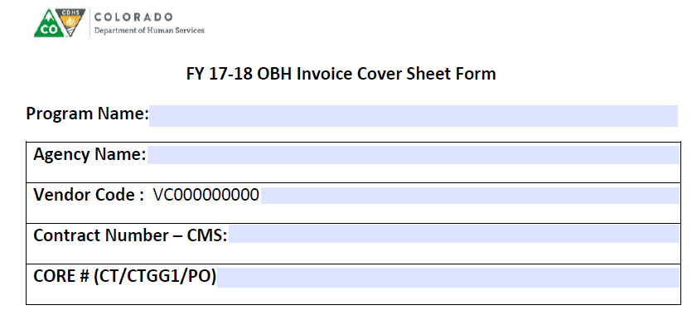
FY 2017-18
The OBH Invoice Cover Sheet will be pre-populated with your agency’s information.

Slide 7
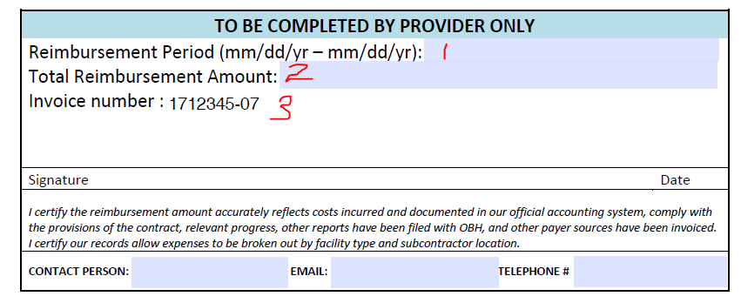
Your agency’s fiscal staff will complete three areas on the form and sign the form each month: 1. Reimbursement Period, 2. Total Reimbursement Amount, and 3. Invoice Number

Slide 8
Invoicing OBH
One invoice per email – Confirmations / Easier Tracking
Submitted monthly by CMHC, MSO, or Crisis Provider
Maintain all provider and location specific details for audit trail for subcontractors and/or multiple locations
Crisis Providers will need to complete a tab for each of the four modalities

Slide 9
FY18 Budget Template
OBH will email the template to all providers
The template will be used for all capacity contracts/amendments with OBH
The Expense Detail Tab is where you document your expenditures that will rollup to the Monthly Invoice Summary
The Budget Narrative is designed for your agency to provide narrative explanations of your expenses as documented by your agency’s budget category or chart of accounts

Slide 10
Capacity Model
Special Studies Code must appear on encounter files for both .hip and .nm1 files
Capacity Model Budgets - use the new template for all contract budgets submitted for FY18
Do not include payment from OBH in the revenue offsets, unless it is from a different contract/program.
Your expenses should reflect a break-out by your sub-contractors/ location.

Slide 11
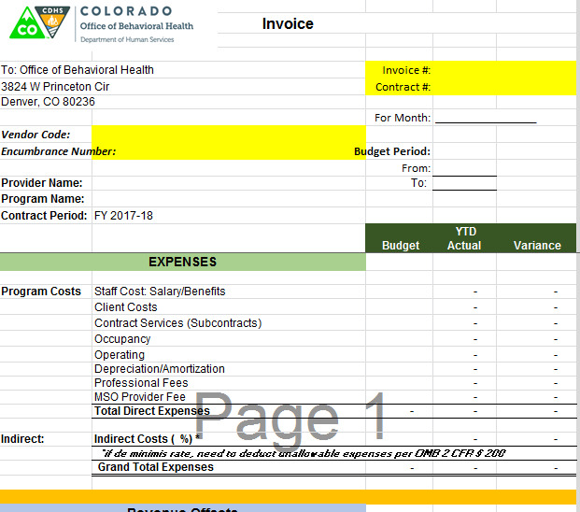
Invoicing OBH - Invoice Sample (1)

Slide 12
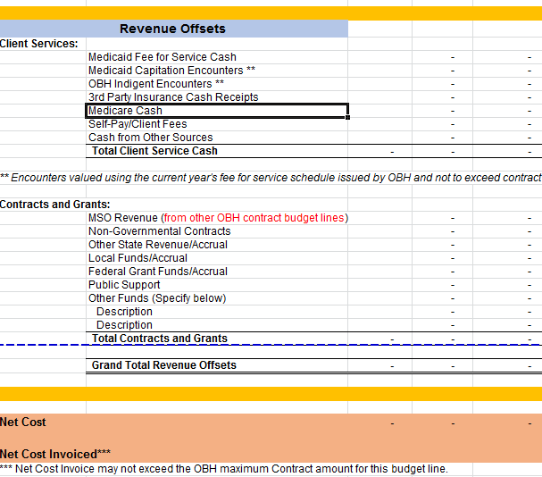
Invoicing OBH - Invoice Sample (2)

Slide 13
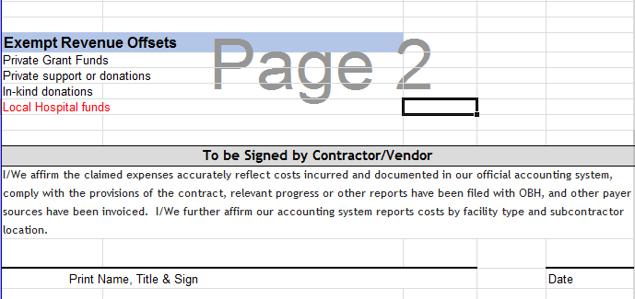
Invoicing OBH - Invoice Sample (3)

Slide 14
Invoicing OBH - Utilizing Indirects
Any non-Federal entity that has never received a negotiated indirect cost rate may elect to charge a de minimis rate of 10% of modified total direct costs (MTDC), which may be used indefinitely.
Utilizing the de minimus indirect rate of 10%
Need to deduct out unallowable expenses per OMB 2 CFR 200.
Deductions include subcontracts over $25,000.
e.g. $100,000 requires deduction of $75,000,
only can charge indirect on $25,000,
rent, equipment, and capital expenses

Slide 15
Invoicing OBH - Utilizing Indirects
Utilizing a federally approved or state approved indirect rate
Apply indirect rate to direct costs in compliance with the basis on which the rate was approved
Costs must be consistently charged as either indirect or direct costs, but may not be double charged or inconsistently charged as both
If you select the State or Federal approved rate your agency must submit the approval documentation to the OBH contracts team
If you receive State only dollars award through the RFP the rate cited in the procurement applies to the entire term of the award

Slide 16
Invoicing OBH - Revenue
The invoice line labeled “Contracts and Grants” should not include the revenue from the specific capacity payment for which you are currently invoicing OBH
That line is only for other contract revenue from OBH
The contract line for which you are invoicing is listed at the bottom in the Net Cost Invoiced line

Slide 17

Invoicing OBH – Supporting Documentation
The Expense Detail tab and Budget Narrative tab are designed to rollup to the Monthly Invoice Tab (see below)

Slide 18
Invoicing OBH – Supporting Documentation (cont.)
At minimum, all three tabs shall be submitted to the obhpayment@state.co.us email, with the OBH Invoice Cover Sheet with each billing
The invoice shall be submitted in Excel format
The Expense Detail tab should detail:
The type of personnel,
And the % FTE for all staff

Slide 19
Fiscal Compliance
Must be in line with the following criteria
OMB Uniform Administrative Requirements, Cost Principles and Audit Requirements for Federal Awards (2 CFR Chapter II Part 200)
The Feds want to pay their fair share of the costs.
Costs must be
Allowable – justifiable and not disallowed
Reasonable – pass the “prudent person” or “9 News sniff test”
Necessary – for the benefit of the award/program
Allocable – directly tied to the award or fairly split among programs that benefit
Consistent – for example, can’t pay a higher salary because it’s paid by federal funds
Not included as a match
Net of applicable credits – Medicaid or other payer sources
Adequately documented – Fulfill the need without being burdensome

Slide 20
What defines an allowable cost?
OMB Super-Circular
Grant & Program Rules
State Statutes & Fiscal Rules
A & A Guidelines
Your written
P+Ps
Contract Terms & Conditions

Slide 21
Adequate Documentation
Definition of Adequate:
Able to fulfill a need or requirement without being abundant
Allowable Attributes
Necessary
Reasonable
Allocable
Consistent
Administrative
Burden

Slide 22
Thank you

Slide 23
Office of Behavioral Health, Community Programs:
Contracts Manager
Email: rebecca.lembke@state.co.us Phone: 303-866-7154
Office of Behavioral Health, Community Programs:
Accounting Manager
Email: elsa.henry@state.co.us Phone: 303-866-7154
Office of Behavioral Health, Community Programs:
Fiscal Compliance Specialist
Email: celeste.white@state.co.us Phone 303-866-7509

