Slide 1
CBHC and the
Tech Innovation Network

Slide 2
Tech Innovation Network
A first of its kind network of clinical, community and industry partners, all working together to advance the use of technology to improve people's mental health

Slide 3
Partnerships to Drive Development
End User Organizations
Inpatient/Outpatient Mental Health
Businesses
Schools/Universities
Police/Fire Departments
Corrections/Prisons
Hospitals
Non-Profit Organizations
Primary Care
Technology Developers
AR/VR
Web-Based Interventions
Apps
Diagnostic Tools
Devices
Artificial Intelligence
Wearables
Notes:
2nd Bullet:
--deploy effective products,
--ensure adoption, and
--evaluate sustainability and financial viability.
Industry = Tech development teams creating the programs/products)
End users = You! As domain experts related to what facilitates getting support/feeling better/improved quality of life/workflow considerations
Implications of vendor relationships:
--Overwhelmed by # of vendor requests and confusion around the value of the solution;
--Tight technology budgets and lack of time to understand options and make informed decisions, which ones have initial evidence;
--Tension and distrust between industry and non-profit/public sector world;
--Half-baked or early state solutions (navigating the norms and how to play with industry, etc.

Slide 4
The Power of Virtual Reality

Slide 5
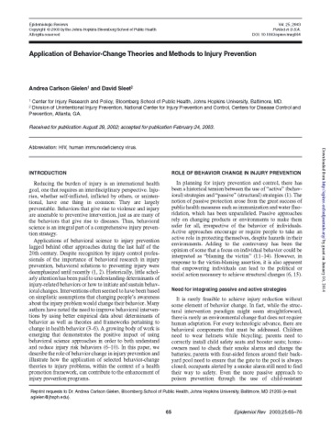
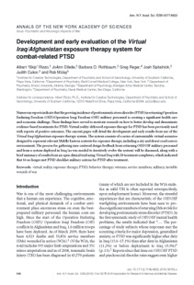
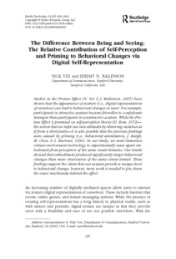
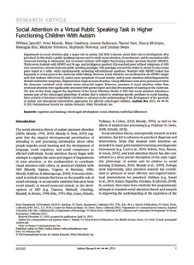
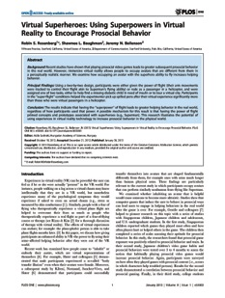
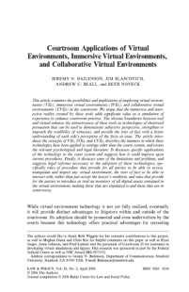
Landscape is Primed for Adoption
Thirty years of research
Treatment for many conditions
Equipment improvements and lower costs
Significant investment in new applications

Slide 6
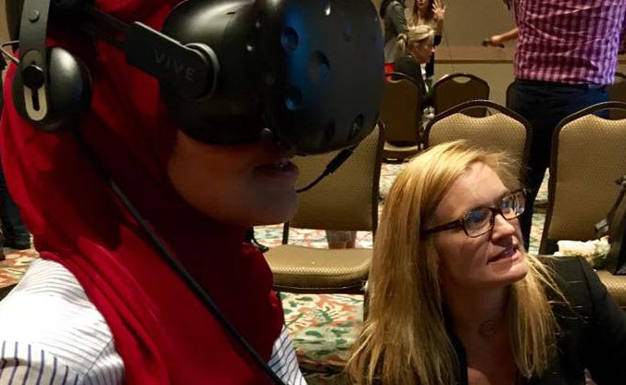
VR in Mental Health

Slide 7
VR in Mental Health

Slide 8
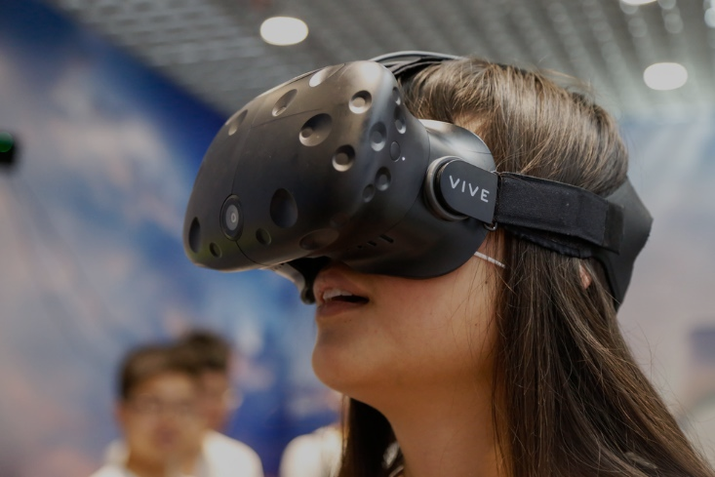
VR is Being Successfully Used to Address
a Variety of Mental Health Challenges

Slide 9
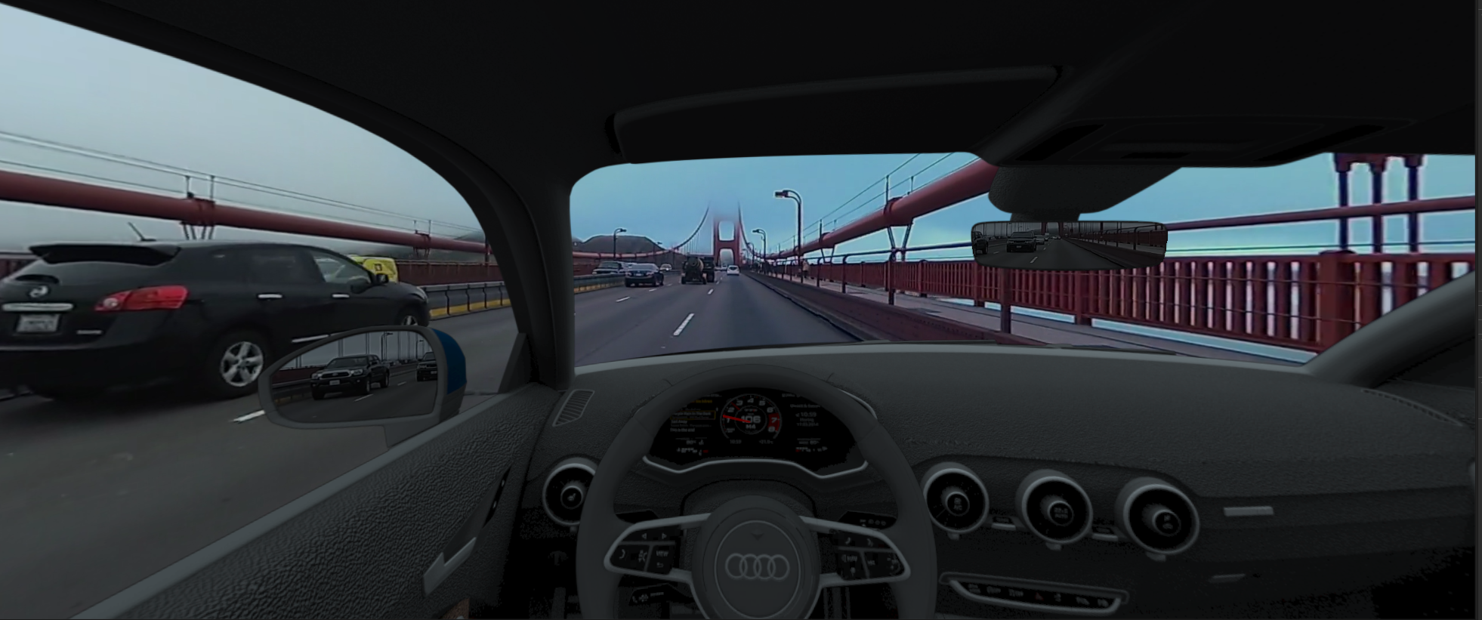
Exposure Therapy for Phobias

Slide 10
Post-Traumatic Stress

Slide 11
Addiction Recovery

Slide 12
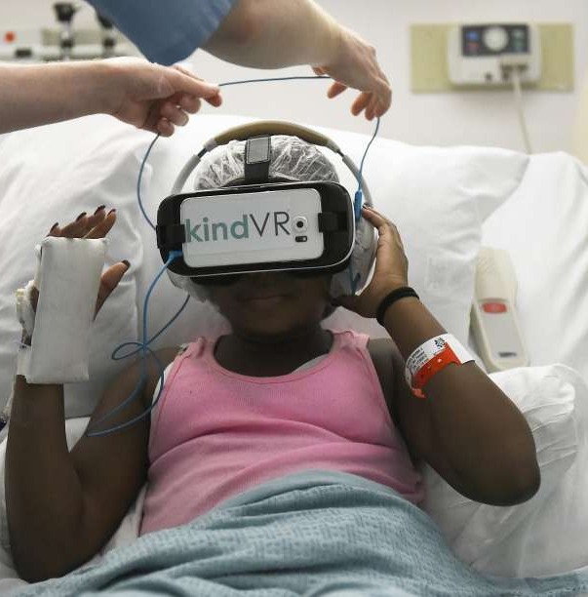
Acute Pain
Notes:
SNOWLAND
28-44% PAIN REDUCTION – ON PAR WITH OPOIDS IN SOME CASES
DEVELOPED IN 2012 – STILL NOT EVERYWHERE

Slide 13
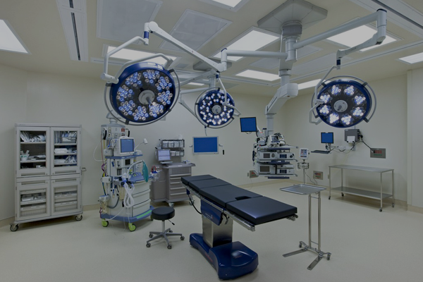
Pre-Surgery Stress Inoculation
Notes:
SCHOOL OF DENTISTRY

Slide 14
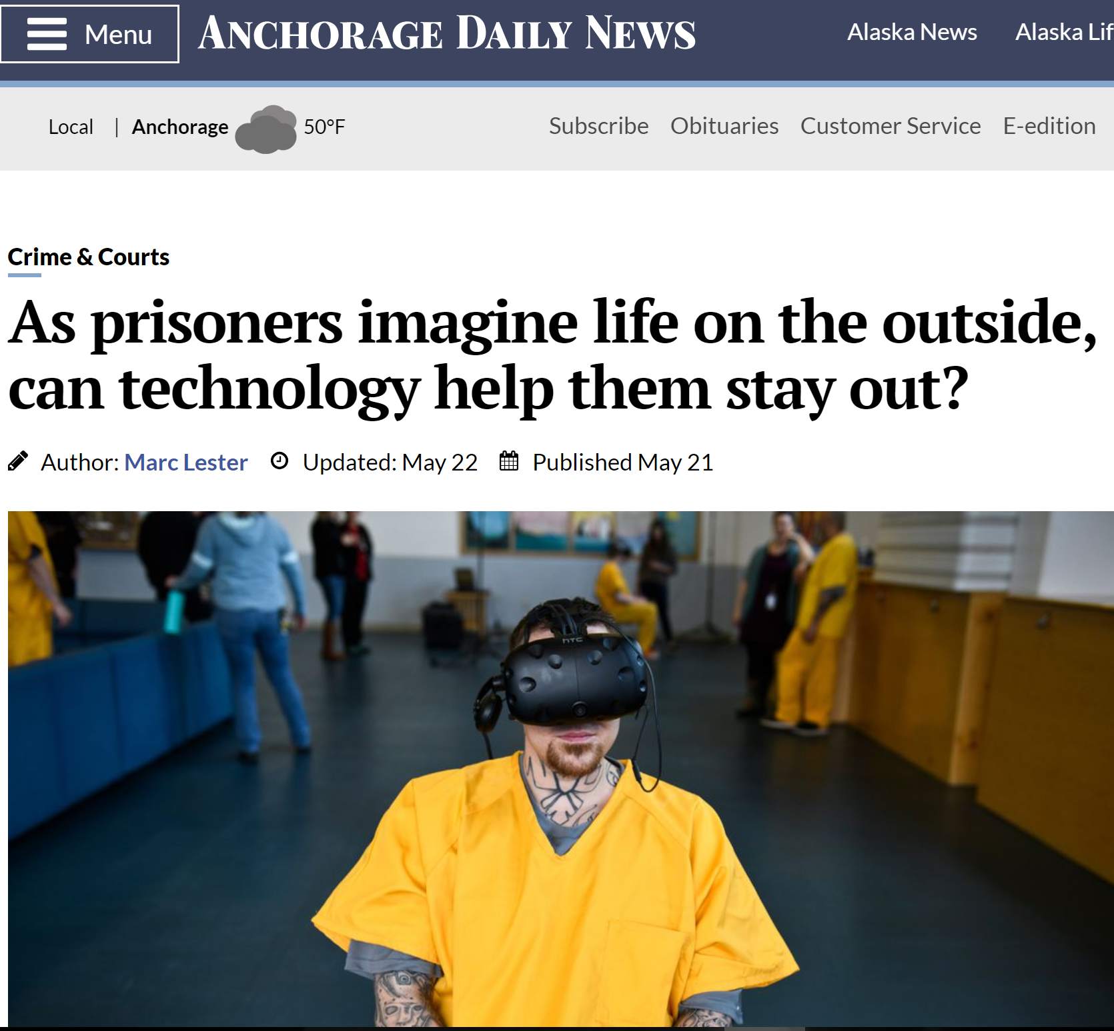
VR in Corrections

Slide 15
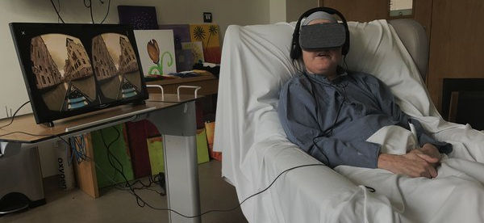
Palliative and Hospice Care

Slide 16
Life Skills | Mindfulness | Training

Slide 17
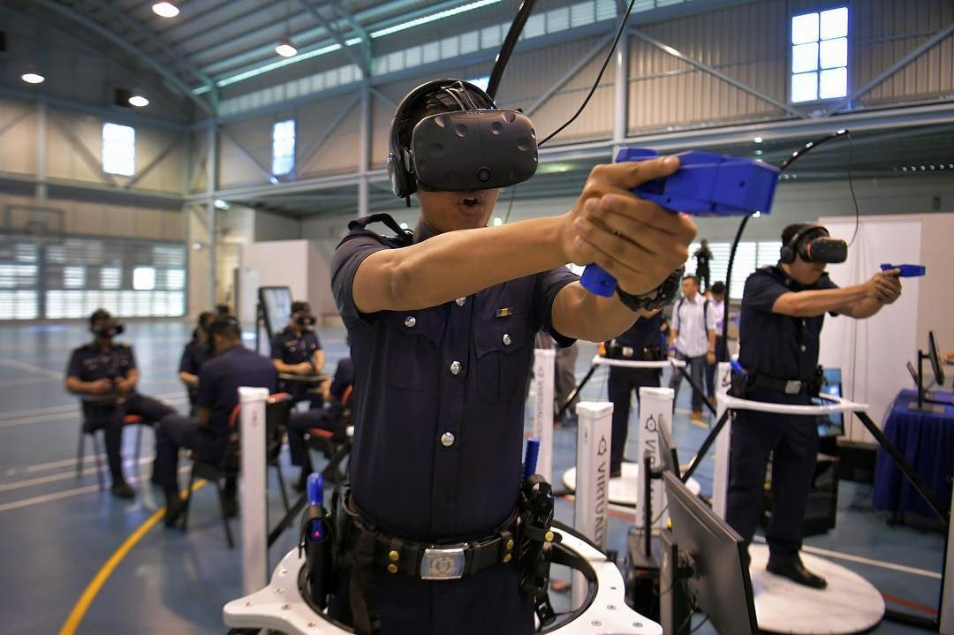
VR Potential for Those Who Help Us

Slide 18
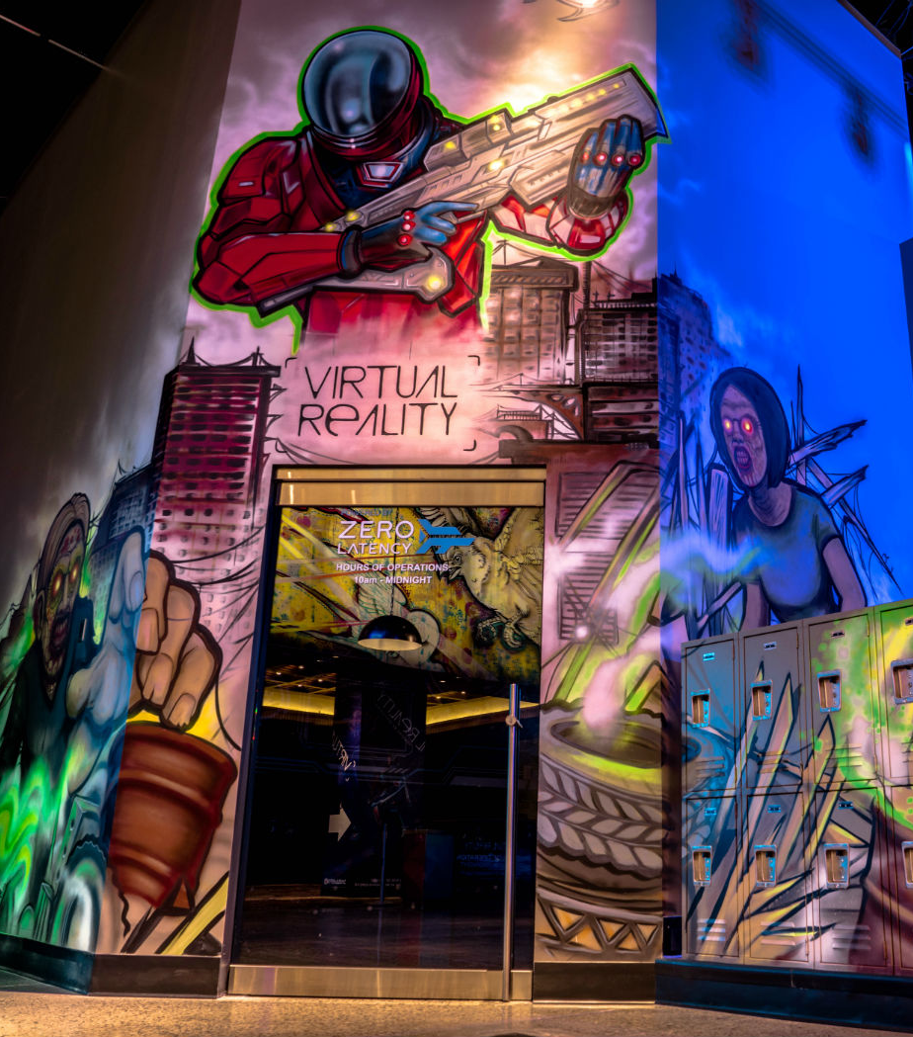
Obstacles to Widespread Adoption
Perception of VR as entertainment only
Rapidly evolving hardware
Research gaps
Much software still in development
Regulatory concerns
Notes:
2nd Bullet:
--deploy effective products,
--ensure adoption, and
--evaluate sustainability and financial viability.
Industry = Tech development teams creating the programs/products)
End users = You! As domain experts related to what facilitates getting support/feeling better/improved quality of life/workflow considerations
Implications of vendor relationships:
--Overwhelmed by # of vendor requests and confusion around the value of the solution;
--Tight technology budgets and lack of time to understand options and make informed decisions, which ones have initial evidence;
--Tension and distrust between industry and non-profit/public sector world;
--Half-baked or early state solutions (navigating the norms and how to play with industry, etc.

Slide 19
TIN: Founding Principles
Behavioral health professionals and patients must drive VR solutions
VR solutions cannot replace essential human factors
The TIN will ultimately lead to the development of VR solutions that are effective, scalable and commercially successful
Notes:
2nd Bullet:
--deploy effective products,
--ensure adoption, and
--evaluate sustainability and financial viability.
Industry = Tech development teams creating the programs/products)
End users = You! As domain experts related to what facilitates getting support/feeling better/improved quality of life/workflow considerations
Implications of vendor relationships:
--Overwhelmed by # of vendor requests and confusion around the value of the solution;
--Tight technology budgets and lack of time to understand options and make informed decisions, which ones have initial evidence;
--Tension and distrust between industry and non-profit/public sector world;
--Half-baked or early state solutions (navigating the norms and how to play with industry, etc.

Slide 20
The TIN: Diverse Partners

Slide 21
CMHCs in the TIN
Mindfulness for workplace wellness
Some moving to patient use
Public speaking practice, social skills, job-preparedness, care transition
Creativity | Use Cases
Notes:
Mindfulness in ATUs, crisis units,

Slide 22
Working with Tech Partners
CMHCs are leaders across the TIN in beta-testing products from tech partners in exposure therapy, voice analytics, and assessment
Notes:
Southeast and Aurora with Limbix
Mindsprings with Ellipsis
Cliexa possibly in the future

Slide 23
For example…
Notes:
Southeast and Aurora with Limbix
Generaly feedback: Usability like volume button doesn’t work, butterfly murder video isn’t a good message for kids, travel section (3-5 second bursts that could negatively impact someone with a fear of heights, suggestion: put in a balcony railing or people next to the user so it doesn’t feel like they are floating), need a female narrator option for individuals affected by domestic violence

Slide 24
For example…
Notes:
Mindsprings

Slide 25
Where do we go from here?
Notes:
Mindsprings

Slide 26
http://mentalhealthinnovation.org
@mentalhealthinnovation

