Slide 1
A Tale of Two Campaigns Laurie Stolen Larimer County Behavioral Health Director

Slide 2
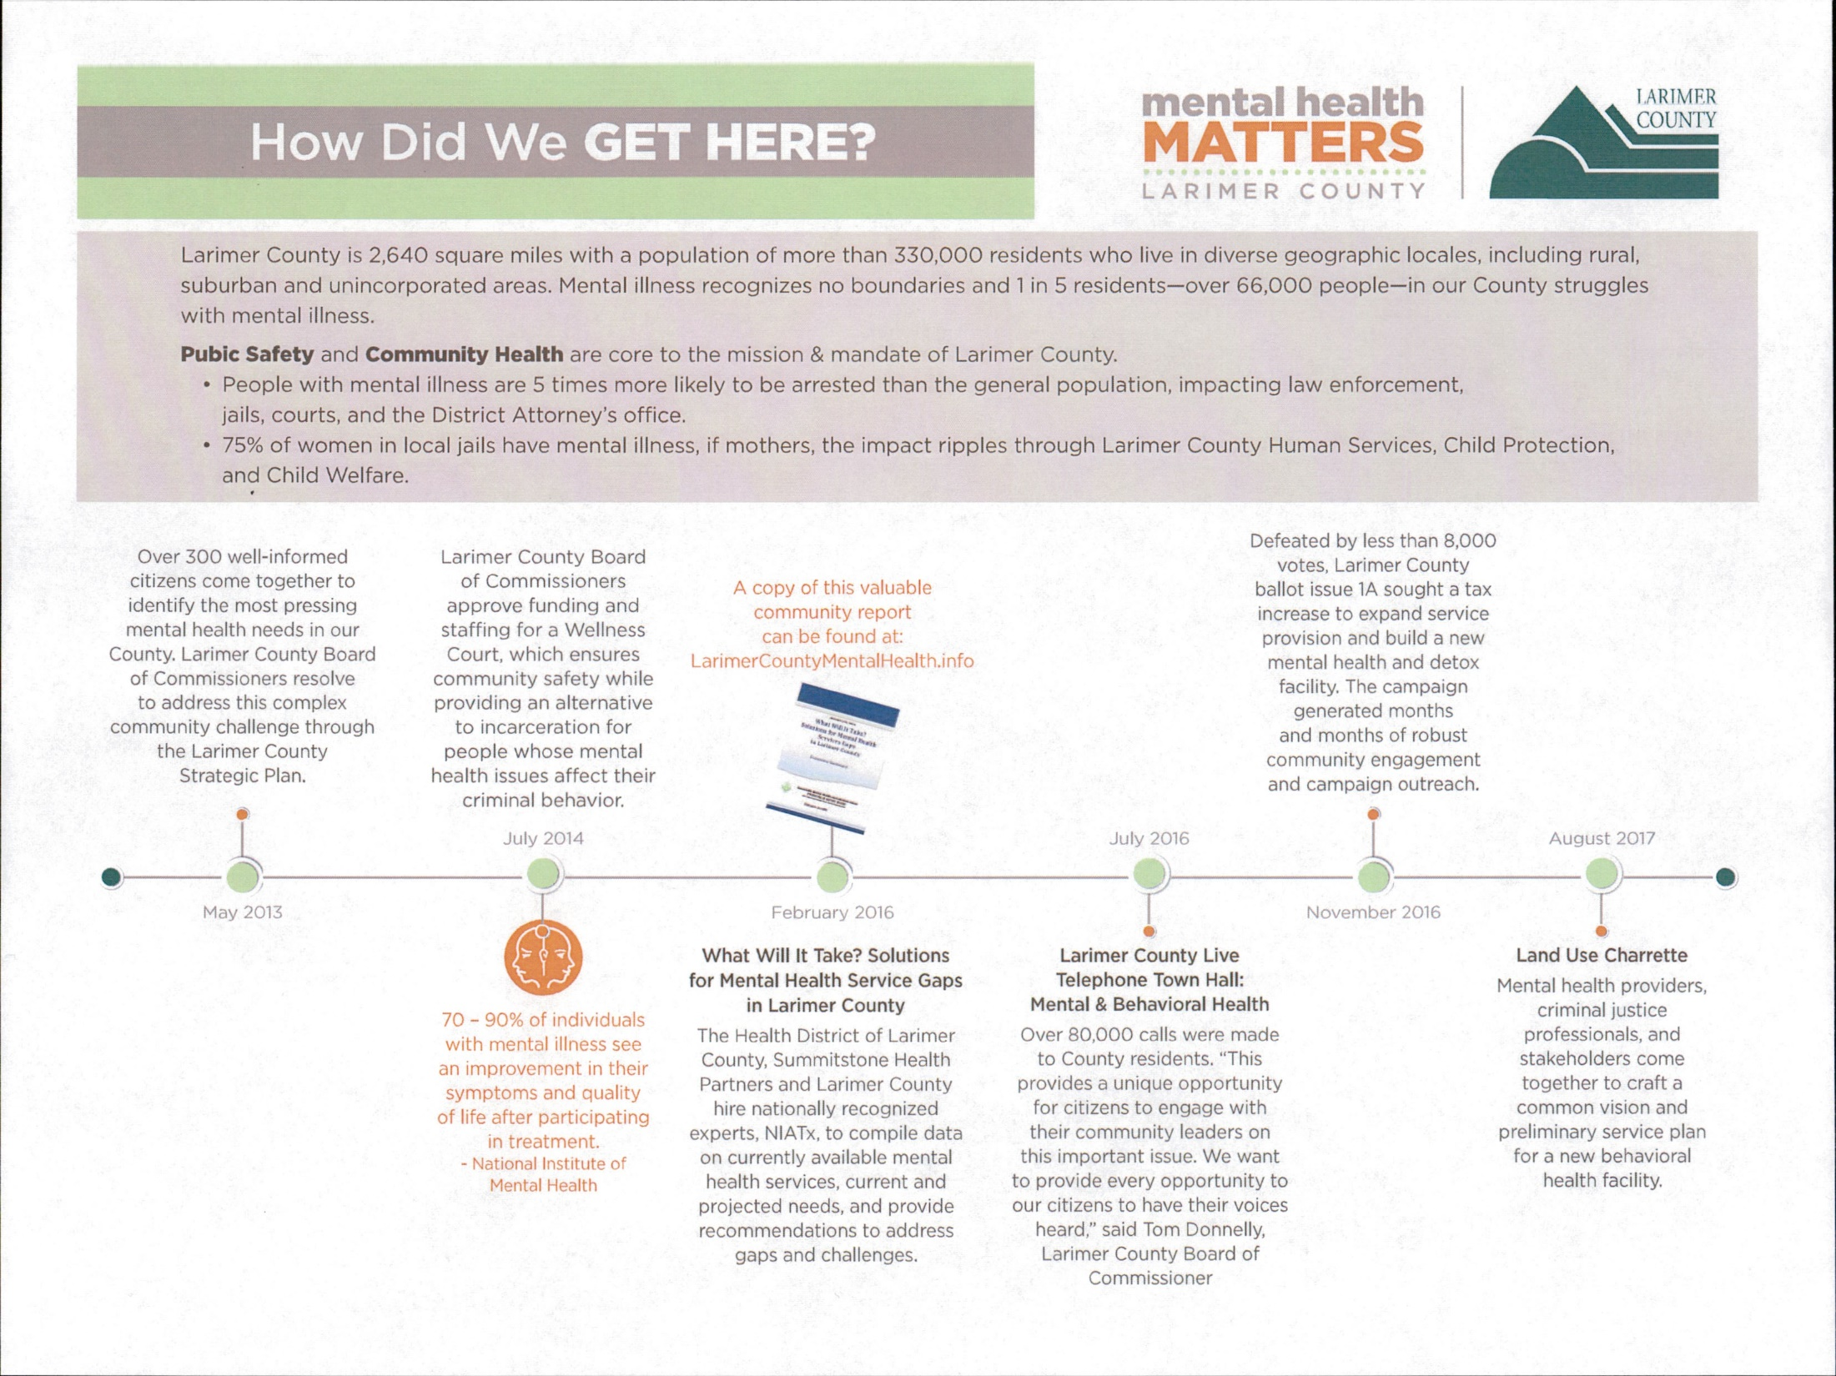

Slide 4
Timeline 2016-Failed ballot initiative 2017-community engagement/listening/awareness building 2018-Successful ballot initiative 2019-Here we go!

Slide 5
The Solution is Community Wide
Our work is informed by national experts and local professionals:
The solution has a dedicated funding stream, and is 3-pronged:
Expand & enrich local behavioral health services throughout the County through distributive services and oversight.
2. A community behavioral health facility to provide crises care, detox and residential treatment services.
Coordinated care from crisis care to community care for
long-term success.

Slide 6
Behavioral Health Services Funding Pathways
BOCC
Board of County Commissioners
Behavioral Health Services
Increase access to appropriate, affordable care
Distributed Services
Grant funds to expand existing community services
Client Assistance Fund
Special fund to decrease barriers & coordinate care
Facility
Funds for design, construction, & contracted services for facility AND monies for designated community services

Slide 7
A Community Master Behavioral Health Plan
Includes:
MHSU Alliance Road Map Report
Site Design and Land Planning Report
Community Health Improvement Plan
Municipal Partnerships
School District (PSD/TSD/EPSD) Partnerships
Community priorities

Slide 8
What this Initiative ISN’T
It’s not a hospital-all care proposed is below hospital level of care or community based services.
It’s not competitive or duplicative of any services already provided in our community, it is intended to bridge the gaps between what we currently have and what we don’t.
It’s not going to be a County service. The services will be provided by providers in our community.

Slide 9
Questions?

Slide 10
Laurie Stolen
Larimer County Behavioral Health Director
2601 Midpoint Dr.
Fort Collins, CO 80525
stolenle@larimer.org
970-498-7126

