Slide 1

Collaborating Against Human Trafficking
Elaine Fisher, M.Ed., LPC, NCC
Community Reach Center
Manager, Training and Supervision
Mary Landerholm, MSW
National Human Trafficking Technical Assistance Center
Training and Engagement Specialist
Notes:
Elaine to add her title

Slide 2

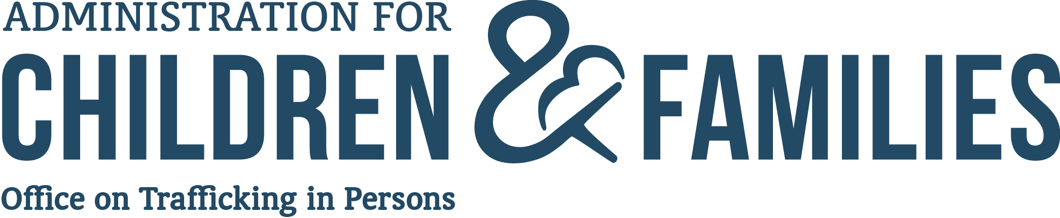
Mission
To combat human trafficking by supporting and leading systems that prevent trafficking through public awareness and protect victims through identification and assistance

Slide 3

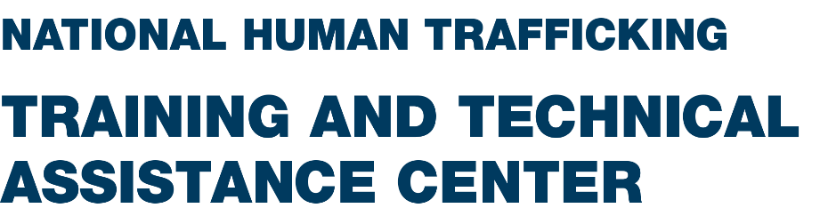
Commitments
Reduce the vulnerabilities of those most at risk of human trafficking.
Increase victim identification and access to trauma-informed services for all survivors.
Strengthen short-, medium-, and long-term health and well-being of survivors of human trafficking.
The National Human Trafficking Training and Technical Assistance Center (NHTTAC) delivers training and technical assistance to inform and enhance the public health response to human trafficking.

Slide 4


Community Reach Center
Notes:
Elaine had CRC’s mission, vision, value

Slide 5
Overview
In the Spring of 2017 via partnerships with Community Reach Center (CRC), the Department of Health and Human Services, and the National Human Trafficking Training and Technical Assistance Center (NHTTAC) an initiative was launched to deliver intensive Training/Technical Assistance to medical and behavioral health institutions, nonprofits, community- and faith-based organizations, social service agencies, and public health agencies while collaborating with a survivor leader to better inform organization through a public health perspective.
Notes:
Describe the nature of the relationship and how this project began
In the Spring of 2017 via partnerships with Community Reach Center (CRC), the Department of Health and Human Services, and the National Human Trafficking Training and Technical Assistance Center (NHTTAC) an initiative was launched to deliver intensive Training/Technical Assistance to medical and behavioral health institutions, nonprofits, community- and faith-based organizations, social service agencies, and public health agencies while collaborating with a survivor leader to better inform organization through a public health perspective.

Slide 6

Objectives
Through this initiative, a partnership was formed between Community Reach Center (Elaine Fisher, M.Ed., LPC, NCC project lead and Dr. Abigail Tucker, PsyD as leadership sponsor), the National Human Trafficking Training and Technical Assistance Center and their Survivor Fellow Mary Landerholm.
Using a public health framework, the goal was to transform the institution’s capacity to deliver comprehensive and survivor-informed services for individuals and their families vulnerable to human trafficking, those being exploited currently, and those with a history of human trafficking victimization.
Notes:
The purpose of this intention relationship was …. Using a public health framework, transform the institution’s capacity to deliver comprehensive and survivor-informed services for individuals and their families vulnerable to human trafficking, those being exploited currently, and those with a history of human trafficking victimization.

Slide 7
Why Colorado
Notes:
Why was this project a good fit for Colorado? What made this a unique opportunity to combat human trafficking. Why Colorado?

Slide 8
Colorado factors for exploitation
Agriculture/Ranching
Tourism/ski resorts
Construction
Transfer points from east to west and north to south
Denver International Airport
Commercial sex industry
Immigration influxes
Notes:
We know that Colorado has specific factor that make communities vulnerable to the experience.

Slide 9

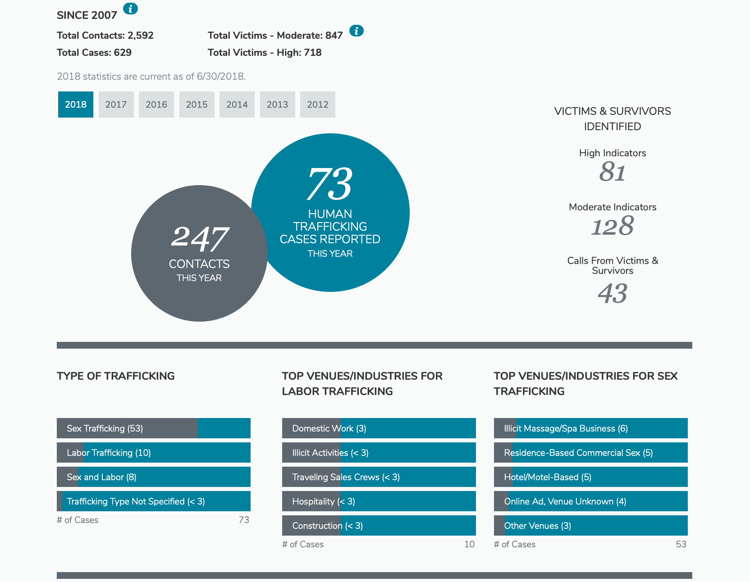
Notes:
National numbers show that there is human trafficking happening here in our state

Slide 10

The issue in Colorado
State Judicial Cases and Filings of the 2014 Human Trafficking Statutes, CY 2015-2017
 | 2015 Filings | 2016 Filings | 2017 Filings | Totals # of Filings
Involuntary Servitude § 18-3-503 | 1 | 3 | 1 | 5
Sexual Servitude-Adult § 18-3-504 | 22 | 17 | 16 | 55
Sexual Servitude-Minor § 18-3-504 | 30 | 55 | 47 | 132
Total filings (cases) | 53 (39 total cases) | 75 (50 total cases) | 64 (40 total cases) | 192 (129 cases)
Notes:
The Colorado Human Trafficking Council 2018 Report showed us cases , filing, and charges of those committing human trafficking in Colorado

Slide 11
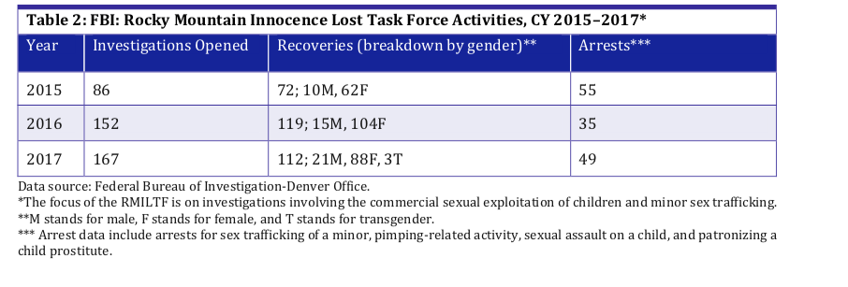
The issue in Colorado
Notes:
Colorado has the Innocence Lost Task Force that has recovered minors who are experiencing commercial sexual exploitation from 2015-2017.

Slide 12

State Hotline
2017
423 calls
120 survivors
2018 (32 of 64 counties)
608 calls
219 survivors
2019
  262 calls
  87 survivors
Notes:
The Colorado Human Trafficking hotline (CoNeht) reported increase in numbers to the hotline from 2017, and in 2018 had over half of the counties in the state utilized the hotline.

Slide 13
Framework for the Process
In order to gain insight to CRC’s current position and response to human trafficking, an organizational assessment was conducted.
From this organizational assessment, gaps and strengths were identified to support the design of an action plan to engage CRC staff and leadership in transforming the organizational practices and response to human trafficking. The assessment was completed through the following phases.
Notes:
Knowing all of these things about Colorado and how human trafficking presents, it was imperative for to utilize this opportunity for partnership with NHTTAC and CRC. The purpose of the partnership drove us to take a look at CRC and how we could improve on their current position with in the context of the issue. In orderIn order to gain insight to CRC’s current position and response to human trafficking, an organizational assessment was conducted.
From this organizational assessment, gaps and strengths were identified to support the design of an action plan to engage CRC staff and leadership in transforming the organizational practices and response to human trafficking. The assessment was completed through the following phases.

Slide 14
The Organizational Assessment Components
Phase I-Fellowship Project
Organizational Assessment
Gaps/Strengths Identified
Brainstorming Process
Draft of Action Plan from findings
Priority Program Focus Groups
Notes:
The organizational assessment was broke out into a wider process. First having an assessment of the org, connection with priority program areas, identifying gaps and strengths with in the org, leadership brainstorming sessions all which would lead into a drafting of an Action Plan for CRC to utilize moving forward.

Slide 15
Organizational Needs Assessment Questionnaire
A Grantee Needs Assessment Questionnaire (GNAQ), designed by NHTTAC (Appendix I), gave the Fellow baseline information about the organization’s current partnerships and position to respond to human trafficking, its ability to provide victim services and prevention efforts, ethical practices to serve survivors, case management, and other internal systems to support delivery of the services.
Notes:
First step was questionnaire designed by NHTTAC to capture base line information on partnership, leadership, capacity , and understanding of the issue.

Slide 16
Organizational Needs Assessment Training
(a) trauma-informed practice, (b) victimization, and (c) human trafficking.
Additional information was gleaned (a) what trainings were required for each program area, (b) what staff and leadership received what training, (c) how often training was received, and (d) whether training was mandated or elected.
Additionally, there was a consideration of community subject matter experts connecting with the organization to have conversations on exploitation; mandates for reporting domestic minor sex trafficking; and the local anti-trafficking movement at large.
To determine what training on human trafficking and other forms of victimization would be most effective for staff and leadership analyzes was required on the the current training requirements for the organization
Notes:
To determine what training on human trafficking and other forms of victimization would be most effective for staff and leadership analyzes was required on the the current training requirements for the organization utilizing the following framework…
(a) trauma-informed practice, (b) victimization, and (c) human trafficking.
Additional information was gleaned (a) what trainings were required for each program area, (b) what staff and leadership received what training, (c) how often training was received, and (d) whether training was mandated or elected.
Additionally, there was a consideration of community subject matter experts connecting with the organization to have conversations on exploitation; mandates for reporting domestic minor sex trafficking; and the local anti-trafficking movement at large.

Slide 17
Organizational Needs Assessment: Organization’s Internal Strategic Plan
Organizational Strategic Plan, including its vision and mission and values
CRC’s strategic plan included key frameworks to support this project while assuring structural stability to implement a comprehensive response moving forward, after the project timeframe. Some key items listed directly from the strategic plan include:
  Retention of our greatest resource—our staff—and continuing to position CRC as an Ultimate Employment Destination.
  Engagement and retention of our greatest asset—those we serve—by continuing to strive to be an Ultimate Wellness Destination.
  Utilization of data analytics to inform decision making in all major initiatives and in current and future operations and business decisions at the Center.
  Ensure a culture of safety is our highest priority for both our staff and for those we serve.
Notes:
Followed by the questionnaire and training analysis matching of CRC’s strategic plan for the organization 2 yrs. out was done to assure a good pairing with the over all mission, vision, value, and future work of the organizations to connect the upcoming project and partnership. The process found great paring with the orgs upcoming work and intentionality in the work in the areas of…
Retention of our greatest resource—our staff—and continuing to position CRC as an Ultimate Employment Destination.
Engagement and retention of our greatest asset—those we serve—by continuing to strive to be an Ultimate Wellness Destination.
Utilization of data analytics to inform decision making in all major initiatives and in current and future operations and business decisions at the Center.
Ensure a culture of safety is our highest priority for both our staff and for those we serve.
All which would support longevity and sustainability of project efforts moving forward.

Slide 18
Organizational Needs Assessment: Programs and Services
The Fellow analyzed the 29 current programs and services CRC offers to consumers as
The 29 programs/services were categorized into key areas where it was highly likely, fairly likely, or less likely that a survivor of human trafficking would enter that program.
From this categorization, the CRC lead and Fellow looked at the highly likely program/service areas to discuss the nature of the programs, service delivery, staffing, and connection to the broader organization. They assessed which program areas were in need of short term, medium and long term training and technical assistance. They identified three priority areas, with eight specific programs, to pilot for participation in the project moving forward. This inclusion would support buy-in from staff and leadership while providing an in depth look at programs directly connected to vulnerable populations or experiences through staff experiences. The priority program areas and specific programs were grouped as follows.
Notes:
The Fellow analyzed the 29 current programs and services CRC offers to consumers as part of its delivery stream (Appendix II). The 29 programs/services were categorized into key areas where it was highly likely, fairly likely, or less likely that a survivor of human trafficking would enter that program.
In addition to connection to those they service, the intentiality to engage these areas would support buy-in from staff and leadership while providing an in depth look at programs directly connected to vulnerable populations or experiences through staff experiences.

Slide 19

Organizational Needs Assessment: Programs and Services
The Fellow analyzed the 29 current programs and services CRC offers to consumers as
Ranking of Program Area Training Needs
Short Term | Medium Term | Long Term
Medical Services | Peer Specialist | Vocational Services
Case Management | Assertive Community Treatment Team | HUD Housing
Mobile Crisis Program | Autism Spectrum Program | Respite Residential Services
Psychological Services | In-Home Resiliency and Support Services
Outpatient Services
School-Based Services
School-Based Services Health Specialist
Early Childhood Services
Integrated Care
Group Services & Intensive Outpatient Program
Prevention and Early Intervention
Day Treatment
Justice Accountability Recovery Services
Crestone
Mesa House
Stage Integrated Treatment Center
Jail Services
Crisis Stabilization Unit & Walk-In
Mobile Crisis Team
Crisis Access & Transition Team
Psychosocial Rehabilitation
Non-Hospital Detox Center
Prevention & Recovery Early Psychosis
Notes:
29 program/services where analyzed and arranged into short. Medium, long-term priority areas of interest to embedded TA into. The highlighted areas were the program/services that were “highly likely” to have contact with someone who as at risk, confirmed, or had in the past experienced exploitation.

Slide 20
Organizational Needs Assessment: Programs and Services
Jail Services/Justice Accountability and Recovery
Jail Services: The mission of the Jail Services program is to assist inmates in the stabilization of mental health symptoms and ensure they have a smooth transition into community-based mental health services upon release.
Justice Accountability and Recovery: To provide services to our consumers with compassion, accountability, and respect, with the goal to assist them in achieving personal growth and understanding about behavioral health disorders.
Outpatient/Case Management/Front Desk
Outpatient: To enhance the social/emotional/mental well-being of children, adolescents, adults, and families. To provide a wide range of services for those age 7 and older in therapeutic and community settings to support the health and success of children and families.
Case Management: To serve individuals in a collaborative process with internal and external providers, addressing consumer’s specific needs in order to promote positive outcomes around establishing basic benefit acquisition and resource needs. Case management focuses on supporting consumers in achieving life balance and wellness by assisting them with gaining access to needed medical, social, educational, financial, and other services.
Front Desk Staff: All staff whose role is to greet or be the frontline face of services to consumers.
Notes:
The following services where identified as being of utmost importunate in connecting with for this project from the program/services analysis.

Slide 21
Organizational Needs Assessment: Programs and Services
Peer Support/Assertive Community Treatment/School-Based Teams
Peer Support: The Peer Specialists program is composed of individuals using their lived experience with mental illness, substance use, addiction, or a combination of all three to work alongside peers/consumers enrolled in services at CRC. The goal of peer support is to provide person-centered and strength-based approaches to build trusting relationships with consumers in order to assist them on their path of recovery and wellness. Peer support services are guided by key concepts of recovery and building resiliency skills.
Assertive Community Treatment: The goal of the Assertive Community Treatment team (ACT) is to provide integrated services to individuals with serious and persistent mental illnesses. These services are provided at the right time, in the right place, and at the right frequency by a multidisciplinary team.
School-Based Teams: The School-Based Services team offers services to students ages 4 to 21 who are attending preschool through grade 12 in identified schools in Adams County School Districts 1, 12, 14, 27J, and 50, Charter Schools, and Front Range Community College (Westminster location). District 14 also includes school-based health care clinics and one pediatric primary care office. All services are evidenced-based/informed and tailored to fit populations with behavioral health needs. It is the goal of the program to enhance the quality of life, promote resiliency, and support recovery, health, and the overall well-being of the person and offer family services. Frequencies of services at CRC are dependent on medical necessity. Medical necessity is determined at intake and then reevaluated every 6 months.
Notes:
The following services where identified as being of utmost importunate in connecting with for this project from the program/services analysis.

Slide 22
Organizational Needs Assessment: Capacity and Community Coalition Building
Because CRC has limited connections with the local, state, or national organizations working on human trafficking, its capacity of support is minimal. Staff and leadership are not having internal discussions on the experience of exploitation to support their consumers’ experiences.
It was important for CRC to consider capacity as a priority area. New knowledge and connections with others would leverage any work moving forward. Connecting with local agencies, task forces, multidisciplinary teams, public and private community leadership, and legislators, and engaging in conversations would support CRC in being at the table in the local context. In addition, it would assure that CRC continues its growth in supporting survivors of exploitation in relation to all anti-trafficking efforts.
Through a survivor-informed lens, this lack of connection to the well-established anti-trafficking network in Colorado was problematic. The Fellow has worked in this field locally since 2012, and was happy to connect CRC to the statewide network. Through the 4P framework established in the state, CRC was able to identify key areas of interest in its own response to the issue.
Notes:
The following services where identified as being of utmost importunate in connecting with for this project from the program/services analysis.

Slide 23
Priority Program
Focus Groups
Jail Services/Justice Accountability and Recovery
Jail Services
Justice Accountability and Recovery
Outpatient/Case Management/Front Desk
Outpatient: Case Management
Front Desk Staff (All staff whose role is to greet or be the frontline face of services to consumers.)
Peer Support/Assertive Community Treatment/School-Based Teams
Peer Support
Assertive Community Treatment
School-Based Teams
Notes:
With those priority program/service areas, 3 rounds of focus groups were conducted to get a better understand of gaps and strengths in combating exploitation

Slide 24
Priority Program
Focus Groups
How would you describe the crime of Human Trafficking?
Do you feel confident in your ability to identify someone with a trafficking experience?
If you did begin to identify a victim of HT, what would your protocol be?
What are some things you see your department needing to get the ball rolling to understand or respond to this crime?
Notes:
With those priority program/service areas, 3 rounds of focus groups were conducted to get a better understand of gaps and strengths in combating exploitation. The following questions where ask in order to get a baseline knowledge of the program/services areas ability to comprehensively respond to human trafficking.
How would you describe the crime of Human Trafficking
Do you feel confident in your ability to identify someone with a trafficking experience?
If you did begin to identify a victim of HT, what would your protocol be?
What are some things you see your department needing to get the ball rolling to understand or respond to this crime?

Slide 25
Action Plan
After completing the organizational analysis and evaluating Best Practice Protocols for developing a response to human trafficking in healthcare settings, recommendations in the following were identified to included in an Action Plan:
    Training
    Priority Programs
    Victim Identification
    Capacity & Coalition Building
    Monitoring and Evaluation
Notes:
From all of the above analysis (org assessment, strategic plan overview, training regiment, program/services, focus groups) an Action Plan was created highlighting the following needs.
Training
Priority Programs
Victim Identification
Capacity & Coalition Building
Monitoring and Evaluation

Slide 26
Training
Clinical
Areas prioritized for training consisted of non-clinical, such as front desk and reception staff; clinical staff of therapists or clinical social workers; individuals connected to the 4P framework of prevention, protection, prosecution, or partnership, such as jail services and mobile crisis staff, followed by connections to the SOAR to Wellness training through NHTTAC
Non-Clinical
Training/ HT and Specialized
4P Collaboration
SOAR- Learning Management System
Notes:
The first step was training. We cant move forward with out shared understanding of the issue. Areas prioritized for training consisted of non-clinical, such as front desk and reception staff; clinical staff of therapists or clinical social workers; individuals connected to the 4P framework of prevention, protection, prosecution, or partnership, such as jail services and mobile crisis staff, followed by connections to the SOAR to Wellness training through NHTTAC

Slide 27
Action Plan Recommendations for Training
Training Recommendation | Cost to the Center | Additional Information
Comprehensive HT Training | Staff time and administration Comprehensive Training | Clinical and Non-Clinical Staff
SOAR training (via live classroom trainings and Relias) | Staff time and administration In person and through LMS | Work with NHTTAC
Know Your Rights | Staff time and administration, Community Training | Community connections
4 P Framework | Administration Intentional connection to community | SOAR – prevention, protection, and partnership.
Monitoring and Evaluation | Current training framework | Relias (org software) for compliance data
Notes:
In order to assure implementation of training moving forward the team matched the recommendation with cost and additional information or needs to execute the recommendation.

Slide 28
Action Plan Recommendations for Training
Program Priorities
Jail Services/ JAR
Peer Specialists, Assertive Community Treatment, School Based Teams
Outpatient/ Case Management/Front Desk
Notes:
In that training process, it was imperative that the program/service areas who would be directly connected to the project be the intentional audience for upcoming trainings

Slide 29
Action Plan Recommendations for Victim Identification
Through the screening and intake analysis, key areas for improvement were identified to support the assessment in relation to the consumer’s experience with exploitation:
The screening tool currently in use.
The intake process as a whole.
The protocols for response to victimization.
The ways this process connected to CRC’s electronic health record system (TIER).
Notes:
Then we looked at screening/ victim identification The following areas of interest where highlighted in the training analysis
The screening tool currently in use.
The intake process as a whole.
The protocols for response to victimization.
The ways this process connected to CRC’s TIER system.

Slide 30
Action Plan Recommendations for Victim Identification
Victimization Screening
Intake Process
Victim Identification
Protocol when victimization has been identified
TIER platform
Notes:
The team reviewed the consumer intake process for each of the three priority program areas.
The intake process takes 90 minutes and done in a few steps.
The first step is with an agency wide intake coordinator at the point of entry into the organization, and then depending on which program areas they will use, additional questions are added to their intake.
Once the original intake is entered into CRC’s Totally Integrated Electronic Records (TIER) system, staff and providers use the assessment to determine needs and provide services.

Slide 31
Victim Identification
Screening ?’s
Through the TIER EHR system, the initial intake is facilitated with program-specific utilization to engage consumers in screening for service needs.
Key points were analyzed in the intake process, including length of intake, where trauma and victimization screening question were in the intake process, language used in questioning, who utilized the tool when, and at what point in the process was the tool utilized

Slide 32
Action Plan Recommendations for Victim Identification
Recommendation | Cost to the Center | Additional Information
Assess current protocol if and when victim is identified (program specific) | Staff time | The HT Focus Groups helped us gain clarity on the current usage of the Trauma Assessment
Identify victimization tool for potential use or replication | Training and Supervision Team Time in conjunction with Dr. Abigail Tucker | Consider other tools, literature review
Implementation of tool into TIER platform | IS and TIER Implementation staff time/scope of project time plus training time | TIER Implementation Process will be followed
Public Awareness/outreach materials for consumers | Training and Supervision team time in conjunction with Marketing and Development; Cost of printing materials | Would work with Marketing
Monitoring and Evaluation | Training and Supervision team time in conjunction with Data Analytics Team to look at running reports on the screening tool | Would brainstorm with DA team to see what is possible
Notes:
In order to assure implementation of screen protocol could and would be embedded forward the team matched the recommendation with cost and additional information or needs to execute the recommendation.

Slide 33
Action Plan Recommendations for Capacity / Coalition Building
It is the practice of CRC to have a sponsor at the leadership level for new initiatives and projects.
The identified sponsor for this project was Dr. Abigail Tucker, Director of Intensive Services. She is now the Center’s Chief Clinical Officer.
Dr. Tucker’s role is to act as a consultant and liaison to the board and to CRC's senior leaders and managers.
In addition, she represents the project at CRC's highest levels." Dr. Tucker presented a project update to the Center’s board members in July 2018.
Notes:
Capacity building and coalition engagement is very important in working with in anti-trafficking efforts as well as any victim services arena.
CRC began with internal leadership and connection from the organization (internal capacity/coalition). CRC has such building block in place with it’s key leadership of Elaine Cooper and Dr. Tucker to assure the movement of overall capacity/coalition building around anti-trafficking efforts and response would be secure.

Slide 34
Action Plan Recommendations for Capacity /Coalition Building
CRC Capacity Needs
Staff of Program Priorities
Internal Leadership
Community Partnership
Action Plan, trainings, screening. protocol for response, M & E
Resources coordination guidance
Partnership in response/services/ task forces
CRC Champions
Internal protocols for Train-the-trainer
Notes:
In addition to internal capacity/coalition building the following areas were also identified to support the recommendation.
CRC internal champions of key leadership
Priority program areas leadership
Priority program areas staff
Community partnerships

Slide 35
Action Plan Recommendations for Capacity /Coalition Building
Recommendation | Cost to the Center | Additional Information
CRC HT Champs | Staff Time | Internal protocols for response/Train-the-trainer/ Replication to other CRC programs of NHTTAC project. Consider making this a standing committee from the TIC Steering Committee led by Elaine.
Staff of Program Priorities | Staff Time | Execution of recommendations including trainings, protocol for response, monitoring and evaluation
Internal Leadership | Leadership Time | Resources/coordination/guidance
Community Partnership | Identified Staff Time | Partnership in response/services/ task forces
Notes:
In order to assure implementation of intentional capacity building protocol, recommendation were matched with cost and additional information or needs to execute the recommendation.

Slide 36
Action Plan Recommendations for Monitoring and Evaluation
Monitoring and Evaluation
Training-Clinical/ Non-clinical
Victimization Tool
Internal Protocol to response
Partnership
Logic models were drafted under each section to support the monitoring and evaluation efforts of the organization. The logic models support each priority program area in obtaining a first-round draft of outcomes for the highlighted areas of training, screening, and capacity building, while providing a platform or working document from which to transform internal processes. These logic models are a tool only, and will be revised with organizational leadership to meet priority program areas.
Notes:
As we all know, no program is complete with out monitoring and evaluation practices embedded in from the beginning.
Logic models were drafted under each section to support the monitoring and evaluation efforts of the organization. The logic models support each priority program area in obtaining a first-round draft of outcomes for the highlighted areas of training, screening, and capacity building, while providing a platform or working document from which to transform internal processes. These logic models are a tool only, and will be revised with organizational leadership to meet priority program areas.

Slide 37
Recap: Action Plan
Training
Screening
Capacity/Coalition
Monitoring & Evaluation
Notes:
Lets recap….
From the organizational assessment, the areas identified to be included in the action plan were…
Training
Screening
Capacity/coalition building
Monitoring and evaluation…
And we moved forward in implementing these recommendation areas into CRC’s organizational response to human trafficking.

Slide 38

Outcomes: Training
Eighty-one CRC staff received SOAR to Health and Wellness training within the three priority program areas. As a result, participants gained basic knowledge on human trafficking. In turn, CRC gained buy-in from staff who now feel invested in improving the agency’s response to human trafficking.
Notes:
Outcomes of training.
At the end of the project…. Eighty-one CRC staff received SOAR to Health and Wellness training within the three priority program areas. As a result, participants gained basic knowledge on human trafficking. In turn, CRC gained buy-in from staff who now feel invested in improving the agency’s response to human trafficking.

Slide 39

Action Plan Recommendations for Training
Notes:
SOAR was delivered in 2 face to face sessions
Embedded in LMS

Slide 40
Outcomes: Community Partnerships
Innocence Lost Taskforce (FBI)
Colorado Department of Human Services (CDHS)- mandatory reporting laws, new law on commercial exploitation of a child.
Laboratory to Combat Human Trafficking- hotline, community context of the issue.
Denver Anti Trafficking Alliance (DA’s Office)
United for a New Economy
Adams County HT Taskforce
Notes:
Community partnership in training also brought in key stakeholders from Colorado’s anti-trafficking movements…
Anne Darr, Victim Advocate with Innocence Lost Trask Force (FBI), discussing the state’s efforts in commercial sexual exploitation of children
Sara Nadelman, Human Trafficking Specialist with Colorado Department of Human Services and their efforts in mandatory reporting and processes with Colorado’s new law on in commercial sexual exploitation of children and how it effects service providers.
Laboratory to Combat Human Trafficking- hotline, community context of the issue, and research

Slide 41
Training-Current State
SOAR modules in Relias allow for ongoing training support 24/7
  SOAR to Health and Wellness
  SOAR: Trauma Informed Care
  SOAR: Culturally and Linguistically Appropriate Services
In addition to the classroom trainings provided throughout the Fellowship, we have trained upwards of 50 plus additional staff in SOAR to Health and Wellness and almost 40 staff in the other two modules.
CRC continues to host trainings with community partners as part of ongoing annual training plan for all staff (required for some teams, elective for others)
  Colorado Department of Human Services
  United for a New Economy
  Innocence Lost (FBI)
  Colorado Human Trafficking Council
Notes:
Since the project has ended….

Slide 42
Outcomes: Victim Screening
Proposal to add new trauma-informed screening prompts within the existing Trauma Screen was accepted in September 2018
Pilot teams implemented new screening questions
Notes:
All priority programs received updating screening questions in the internal management system. All programs were invited to provide feedback on the changes while giving sight to trauma-informed questioning. Each group felt confident in its ability to screen for victimization and that staff could implement this process in their procedures.

Slide 43
Trauma Addendum; Victim Screening Update at CRC
Physical Abuse
Some people have experienced hitting, kicking, or harm that results in bruises or cuts that was carried out by someone responsible for the care of another. Has something like this ever happened to you?
Domestic Violence/Abuse
Some people have experienced or witnessed hitting, choking, pushing, use or threat of use of weapon, control of finances, isolation. This experience may be/have been between members of same household or in context of romantic relationship. Has something like this ever happened to you?
Sexual Abuse/Molestation
Some people have experienced unwelcome sexual touch, photographing, or videotaping sexual acts. Has something like this ever happened to you?
Notes:
With collaborative effort from key leadership at CRC the following screening questions were added to their infrastructure as well as in priority program areas.
Physical Abuse
Some people have experienced hitting, kicking, or harm that results in bruises or cuts that was carried out by someone responsible for the care of another. Has something like this ever happened to you?
Domestic Violence/Abuse
Some people have experienced or witnessed hitting, choking, pushing, use or threat of use of weapon, control of finances, isolation. This experience may be/have been between members of same household or in context of romantic relationship. Has something like this ever happened to you?
Sexual Abuse/Molestation
Some people have experienced unwelcome sexual touch, photographing, or videotaping sexual acts. Has something like this ever happened to you?

Slide 44
Trauma Addendum; Victim Screening Update at CRC
Verbal/Emotional Abuse
Some people have experienced or witnessed name calling, threats, yelling, excessive demands, or isolation. Has something like this ever happened to you?
Physical Neglect
Some people have been kept from appropriate shelter, food, clothing, hygiene, and/or medical care. Has something like this ever happened to you?
Emotional Neglect
Some people have experienced lack of affection and/or supportive relationships where emotional needs are not being met. Has something like this ever happened to you?
Military Related Trauma
Some people have experienced events (directly or indirectly) like extended deployment, real or simulated exposure to acts of combat, or challenges receiving community support/access to resources when serving/supporting military efforts. Has something like this ever happened to you?
Notes:
With collaborative effort from key leadership at CRC the following screening questions were added to their infrastructure as well as in priority program areas.
Verbal/Emotional Abuse
Some people have experienced or witnessed name calling, threats, yelling, excessive demands, or isolation. Has something like this ever happened to you?
Physical Neglect
Some people have been kept from appropriate shelter, food, clothing, hygiene, and/or medical care. Has something like this ever happened to you?
Emotional Neglect
Some people have experienced lack of affection and/or supportive relationships where emotional needs are not being met. Has something like this ever happened to you?
Military Related Trauma
Some people have experienced events (directly or indirectly) like extended deployment, real or simulated exposure to acts of combat, or challenges receiving community support/access to resources when serving/supporting military efforts. Has something like this ever happened to you?

Slide 45
Trauma Addendum; Victim Screening Update at CRC
Witness to Violence
Some people have witnessed violent acts in their homes, schools, workplaces, or communities. Has something like this ever happened to you?
Exploitation
Some people work and don’t get paid, or they find the work to be different than what was initially agreed upon. Has something like this ever happened to you?
Some people work for others who are threatening or controlling to the point they are unable to leave or talk with people they want. Has something like this ever happened to you?
Some people are pressured or forced to engage in sexual acts they do not feel comfortable doing or in exchange for money or other items such as food, clothing, or shelter. Has something like this ever happened to you?
Notes:
With collaborative effort from key leadership at CRC the following screening questions were added to their infrastructure as well as in priority program areas.
Witness to Violence
Some people have witnessed violent acts in their homes, schools, workplaces, or communities. Has something like this ever happened to you?
Exploitation
Some people work and don’t get paid, or they find the work to be different than what was initially agreed upon. Has something like this ever happened to you?
Some people work for others who are threatening or controlling to the point they are unable to leave or talk with people they want. Has something like this ever happened to you?
Some people are pressured or forced to engage in sexual acts they do not feel comfortable doing or in exchange for money or other items such as food, clothing, or shelter. Has something like this ever happened to you?

Slide 46
Trauma Addendum; Victim Screening Update at CRC
Community Violence
Some people have experienced, witnessed, or been affected by a violent act in public, such as a shooting, robbery, or gang violence. Has anything like this ever happened to you?
Elder Abuse
Some people have experienced or witnessed the mistreatment of an older adult by those responsible for their care, and it is often financial in nature. Has something like this ever happened to you?
Financial Abuse
Some people have experienced mishandling of their finances by someone responsible for their care. Has something like this ever happened to you?
Notes:
With collaborative effort from key leadership at CRC the following screening questions were added to their infrastructure as well as in priority program areas.
ommunity Violence
Some people have experienced, witnessed, or been affected by a violent act in public, such as a shooting, robbery, or gang violence. Has anything like this ever happened to you?
Elder Abuse
Some people have experienced or witnessed the mistreatment of an older adult by those responsible for their care, and it is often financial in nature. Has something like this ever happened to you?
Financial Abuse
Some people have experienced mishandling of their finances by someone responsible for their care. Has something like this ever happened to you?

Slide 47
Outcomes: Capacity/Coalition Building
https://combathumantrafficking.org
Notes:
Areas prioritized for capacity/coalition building connected to the 4P framework of prevention, protection, prosecution, or partnership.
CRC identified it’s current touch points with in the framework as well as identified areas to connect with moving forward to assure that a comprehensive response was laid out from the start.

Slide 48
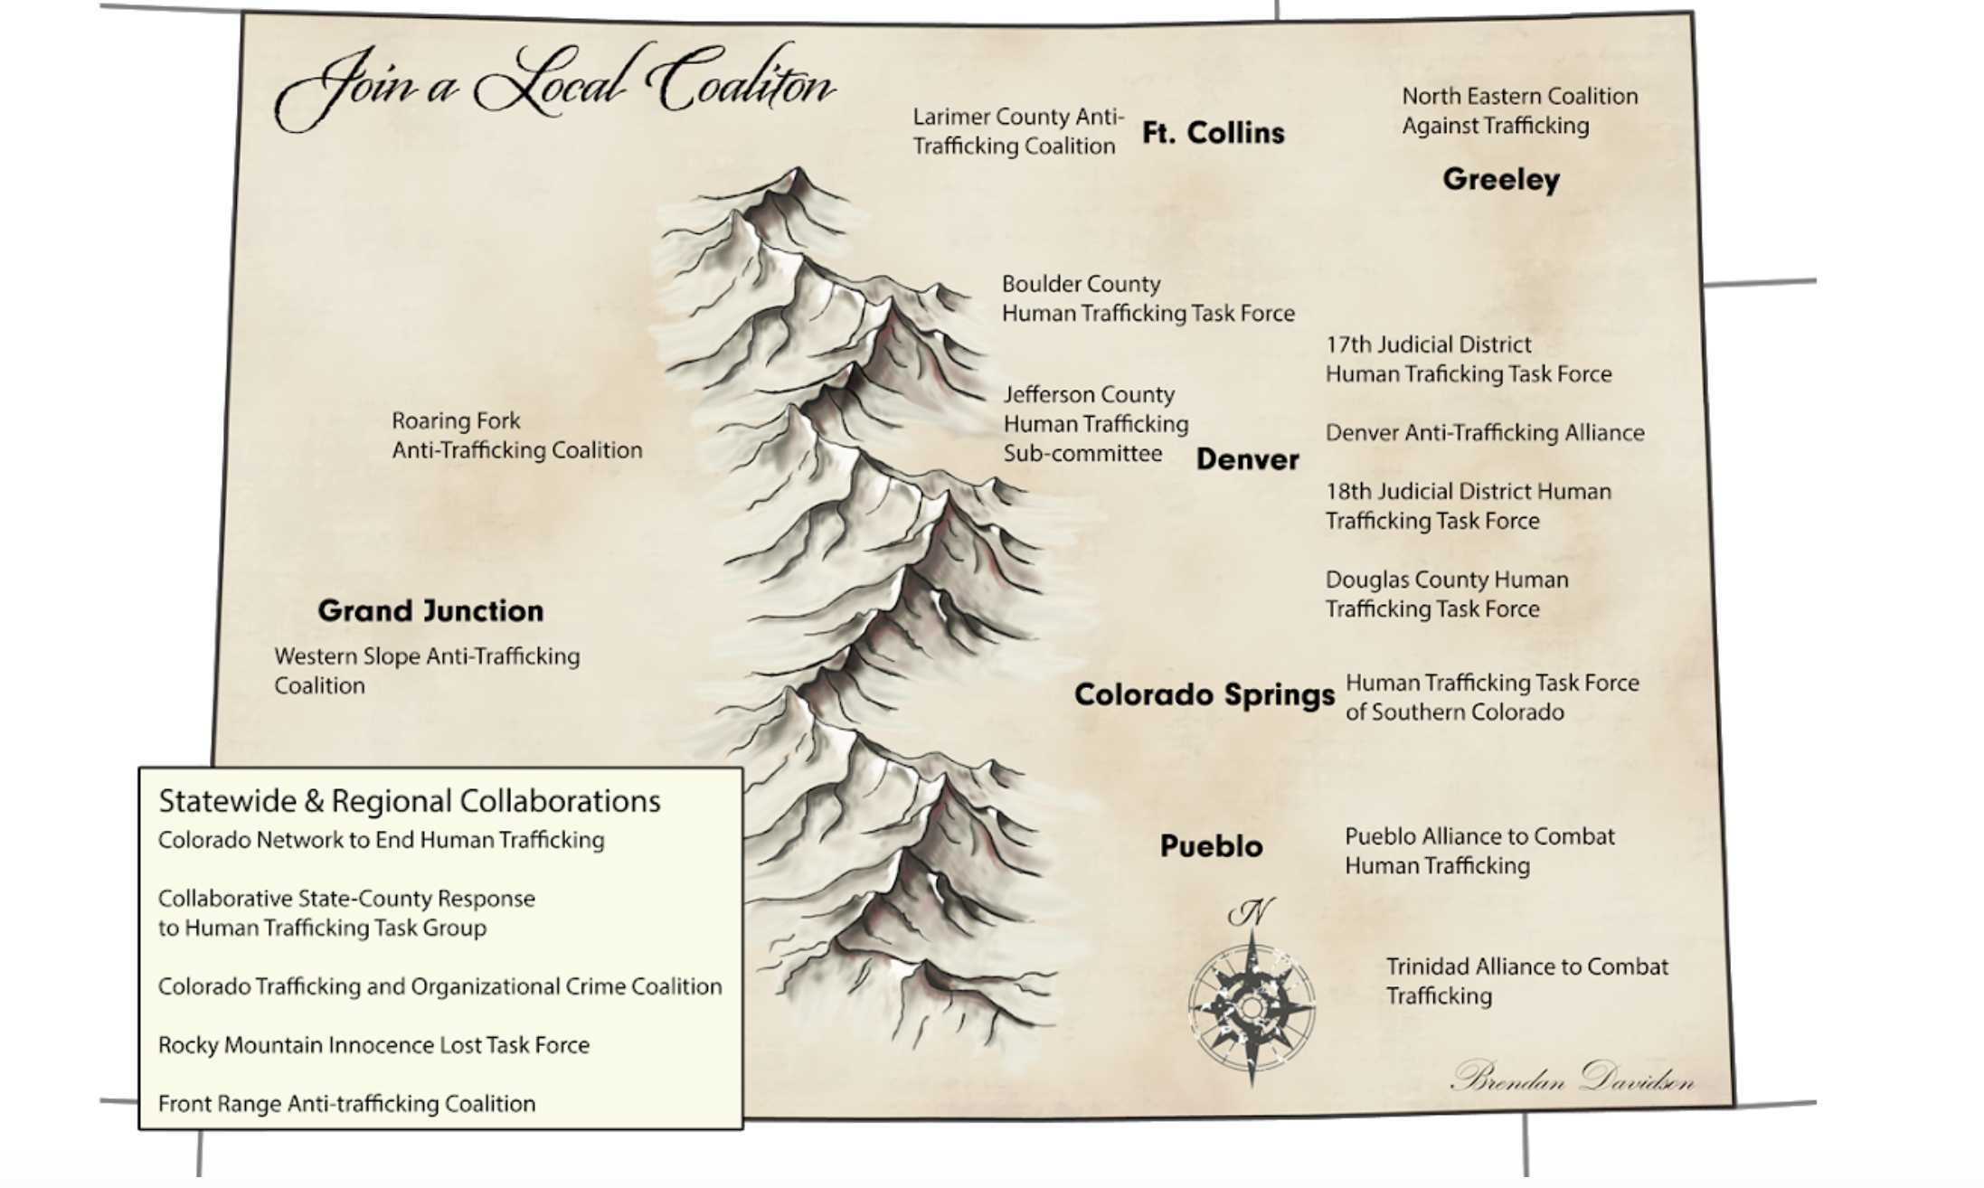
Capacity/ Coalition Building Colorado Human Trafficking Movement
Notes:
The recommendations for capacity building were identified as engagement with local task forces in the areas of the organization’s locations. CRC is a statewide organization, and there are 17 ( now 21) identified working task forces in the state, many in areas close to CRC facilities.
Along with identification of task forces in local areas, recommendations for specific calls to action or sector-specific responses were highlighted as key networks for connections. One specific connection was with the Colorado Human Trafficking Task Group through the Colorado Department of Human Services, along with Colorado Legal Services, Rocky Mountain Immigrant Advocacy Network, and the Colorado Human Trafficking Council formed by legislation in 2015.

Slide 49
Capacity/coalition current state
The focus groups that became the Human Trafficking Champions is now a full fledged committee, renamed Combating Human Trafficking Committee.
This committee has members representing some of the pilot program members, passionate staff who wanted to join after receiving HT training, and members of our crisis continuum.
  Elaine Fisher, Manager of Training and Supervision is the co-chair for the newly formed Denver Anti Trafficking Alliance Mental Health Subcommittee
  Jenna Bogan, Manager for Behavioral Health Urgent Care Clinic, sits on the Adams County HT Taskforce
Mission Statement:
To integrate and enhance knowledge + competency in human trafficking as it relates to mental health.
Notes:
Since the project has ended….

Slide 50
CRC-Where are we now?
Continue to work with community partners and their particular subject matter expertise
The Combating Human Trafficking Champions Committee meets regularly to continue to see the action plan recommendations implemented in our system
International Human Trafficking and Social Justice Conference, Sept 2019
Colorado Behavioral Healthcare Council Conference, Sept 2019
Published
  Mental Health Weekly (2018, December). Denver center becomes first to include human trafficking curriculum.
  Taylor, Scott; Westminster Window (2019, June). Looking for cues to help trafficking victims.

Slide 51
A Part of Something Bigger…..
“I gained such a wealth of knowledge and experience working with NHTTAC, and with Mary personally and professionally. Once you understand the nuances of this crime and recognize that it is happening in your backyard, it is hard to remain unchanged by that experience. It has been a professional highlight and honor to be part of this project. CRC gained not only support and expertise at the state and national level, we also gained the connection with Mary, with LCHT, that allows us to continue to coordinate and collaborate with our own local expert, who now also has an intimate knowledge of us as a Center.” —Elaine Fisher

Slide 52
A Part of Something Bigger…..
“It was such an honor to be a part of this project. I’ve been able to connect with this organization and create a solid authentic relationship, while supporting growth and change in my local anti-trafficking movement. I am forever changed by this opportunity and will take not only the relationships I have gained, but the knowledge around organization work and its connection to service delivery for survivors of exploitation out into my community to continue to support all those who are involved in the elimination of exploitation in the State of Colorado and our country as a whole.”- Mary Landerholm

Slide 53
Customized Training and Technical Assistance
Survivor Involvement
SOAR
Technical Assistance
Offers professional development opportunities for survivors through fellowships and scholarships.
Collaborates with a diverse group of survivor leaders to develop and implement materials, training, and technical assistance that build agency capacity to address trafficking using trauma-informed principles and survivor-informed practices.
Accredited SOAR trainings are available for anyone interested in learning how to recognize and respond to human trafficking in health care or social service trainings.
Target audiences for trainings are health care providers, social workers, public health professionals, and behavioral health care professionals.
NHTTAC can provide skilled trainers and specific subject matter expertise for your training event or speakers for your conferences.
NHTTAC services are free and delivered based on need.
Notes:
NHTTAC TTA service available for audience members

Slide 54
Contact Us
Visit: www.acf.hhs.gov/otip/training/nhttac
Email: marylanderholm@nhttac.org
Phone: 844–648–8822
Call Center Hours: 8:30 a.m.–5 p.m. (eastern) Monday–Friday

Slide 55
Contact Us
Visit: www.communityreachcenter.org
Email: el.fisher@communityreachcenter.org
Phone: 303-853-3557

