Slide 1
Phase-Based Care
An Innovative Approach to Mental Health Care
Jules Rosen; MD
Michelle Hoy; LPC, CACIII
David Hayden; LPC, CACIII, MBA
Sharon Raggio; LPC LMFT MBA

Slide 2
Community Mental Health Center Challenges
Increasing demands for care
  ACA resulted in 40% higher Medicaid recipients in CO
Care delivered in “silos”
  Typically poor coordination between meds and therapy
Long wait time to access psychiatry
  Annecdotal: 7 to 12 weeks, longer for Medicaid and Rural
Therapists with large caseloads see returning patients routinely

Slide 3
Implication of Inadequate Access and Engagement
Patient suffering
Family distress
Financial loss
Over-use of hospital emergency departments
Increased morbidity
Suicides

Slide 4
Core Values
Access
Engagement
Person-centered
Cost-effective
Promote good patient outcomes
Promote staff satisfaction

Slide 5
Principle of Phase-based care
Mental illness has phases (for most people)
During “acute” phase: resources need to be evidence-based, intensity appropriate, and timely
    Monthly “therapy” visits are not evidence-based
USE VALID RATING INSTRUMENTS AS GUIDE TREATMENT INTESITY OVER TIME
Coordinate treatment efforts of ALL team members
When symptoms improve, treatment plan changes to meet the reduced intensity.

Slide 6
Points of Agreement
Treatment works for different people at different times
Treatment per pt preference and needs AND our capacity
The right TX at the right time = best clinical and financial outcomes
Evidence-based and Person-centered drive process
  Medication Mindfulness Groups
  Psychotherapy Pet Therapy “Happy Hour”
  Peer Support Equine Therapy OTHER

Slide 7
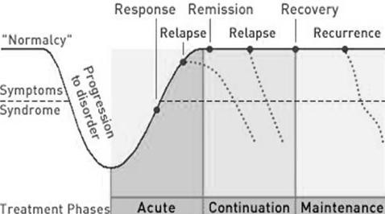
Phases of Depression
6-12 weeks 6-9 Months 1 year
(Kupfer et al, 1991, J Clin Psychiatry)

Slide 8
Every Touch Has MEANING
Improved reduction in depressive symptoms Additional
Visit (6 weeks) Antidepressant Placebo
1 56% 51%
2 70% 79%
The credentials of the “toucher” does not matter!!!
6 Week RCTs; 15 with 6 visits; 19 without 5 visits, 7 with 4 visits
Therapeutic Effect is Cumulative. No Effect on Completion Rates (59 – 63%) . Posternak and Zimmerman (2007) Br. J. of Psychiatry
Notes:
40% of the placebo response is explained by each extra visit. 15 studies had weekly f/u; 19 studies had weekly without week 5; 7 studies skipped weeks 3 and 5

Slide 9
Notes:
62 medication trials and 115 therapy trials.

Slide 10
Measuring Care Matters

Slide 11
Challenges
Long wait-times to engage in treatment
Once engaged, treatment intensity not matched to symptom severity
Staff resources are not managed to prioritize care to the most highly symptomatic patients
Appointments scheduled according to provider schedules rather than patient need
  symptom severity should guide treatment intensity over time

Slide 12
Solutions: Phase-based Care
Illness severity presents with “phases” for most patients
Medication and non-medication approaches can be equally effective when coordinated through an integrated team approach
Quantitative assessment of symptom severity longitudinally with rating instruments improves outcomes

Slide 13
The Culture Change
Therapists and medical providers have “routines” for managing stable patients
  “My patients have the right to see me once per month”
  Sometimes fueled by State regulation requiring routine visits or discharge
Fully integrated care of medical and non-medical teams not the norm
  Some exceptions like ACT team
Use of valid rating instruments not universally accepted across medical and especially non-medical team members
Universal response to Phase-based Care: “You will have to double our staff”

Slide 14
Developing Phase-based Clinics
Use of mathematical algorithms and scalable database to manage patient flow and staff allocations
  Algorithms used to incremental shift clinic from “routine” to Phase based
Single, multi-disciplinary care plan modified as symptoms change
Treatment team of physicians, APNs, therapists, case managers and peers
  meet weekly to review PHQ 9 scores, resource utilization
Patients can chose evidence-based treatment modalities
  psychotherapy, medications, groups, peer support case management
Scheduled appointments as well as weekly walk-in options
The PHQ 9 depression rating scale is completed at each visit to assess progress or lack of progress.

Slide 15
Rapid Recovery Clinic for Depression
Initially met 4 hours per week plus one hour team meeting
  Now 8 hours per week and 2 providers and 4 therapists
Patient can have scheduled appointment or walk-in
Appointment frequency and duration based on patient need
Valid rating instrument: PHQ-9
Patients review their measurements with team
Assumptions of staffing model created by team members
  how many therapy / med management sessions will you need to treat this depression?
Weekly team meetings review all new and acute patients

Slide 16
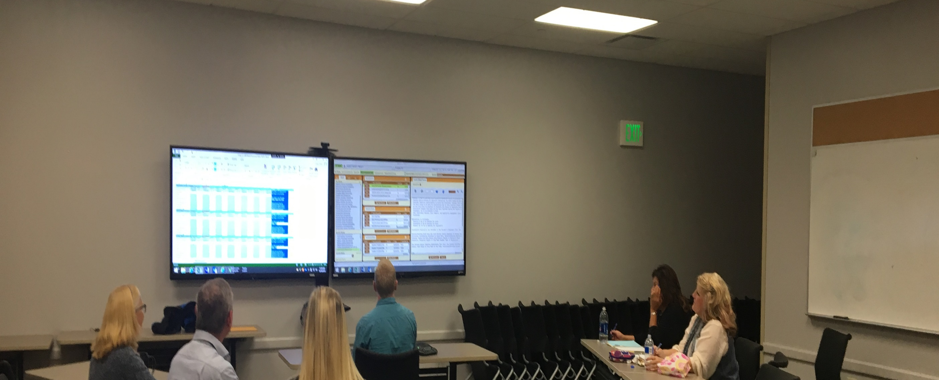
Weekly Team Meeting

Slide 17
Rapid Recovery Dashboard
12/30/2018
Active Pts. | 142 | Days to appt. | 4.5 | Ave. therapy hrs. / client (acute) | 2
Acute Phase | 78 | Days to provider | 3.9 | Average # Provider Hours per client, (acute) | 1.5
% drop out (wk 6) | 13 | Ave PHQ init | 20.3 | Average # Peer hours per client, (acute) | 0.51
Total pts. (15 mths) | 182 | Ave. PHQ wk 12 | 12.0 | Ave. CM hrs / pt. (acute) | 0.95

Slide 18
Summary of Clinical Outcomes
Acute Phase for Depression : PHQ 9 of >10
  “Recovery” means out of acute phase; different from remission
Week 6 and 12: 63% and 78% no longer in acute phase
  STAR D data of routine care time to remission: 16% and 33% at weeks 6 and 12
Time to engagement with full treatment team: 4 days
  Anecdotal time nationwide > 7 weeks

Slide 19
Resource Utilization
4 hours per week of clinic time (recently expanded)
8 hours of provider time (2 providers)
12 hours of therapy (3 therapists)
4 hrs. of CM, MCM, and Peer
Admit 6-8 new patients per week plus 8 – 12 scheduled f/u
Typically 15 – 20 walk-ins

Slide 20
Developing Phase-based Clinic
Identify your population
  Diagnosis specific vs. general population
Examine data
Empower front line staff to create clinic and liberate from old assumptions
  Therapy does not have to be 50 minutes
Efficient use of team reduces repetition and redundancy
Create leadership team that BELIEVES this can work
  Initial reaction is “how many more staff are you going to hire?”
Build a model and create tools to monitor

Slide 21
Creating model: Group Exercise
How many new patients/year?
How long for initial evaluation?
% going on to therapy (acute)?
% needing medication (acute)?
Average provider time (acute)?
Average therapist time (acute)?
Average CM (acute)?
Average Group utilization (acute)?
DO SAME FOR CONTINUATION PHASE

Slide 22
Outpatient Steamboat Clinic
# of New Patients per year | 364 |  |  | 60 % going to Psych |  |  |  |  |  | 100 % |  |  |  |  | 75% go to therapy
 |  | # patients |  | Provider |  |  |  |  | Initial Intake |  |  |  |  | Therapist
Acute Phase |  |  |  | hr/pt | Hrs./yr |  | hrs/wk |  | hr/pt | Hrs/year |  | hrs/week |  | hr/pt |  |  | hrs./year
# of New Patients per year |  | 273
# of Weeks per acute episode | 8 |  |  | 2.00 | 328 |  | 6.30 |  | 2.00 | 728 |  | 14 |  | 3.00 |  |  | 819
Continuation Phase
# of new patients per year |  | 191
# OF PATIENTS FROM ACUTE PHASE OR MAINTENANCE |  | 0
Total patients |  | 191
# of Weeks per episode | 8 |  |  | 0.50 | 96 |  | 1.84 |  | N/A | N/A |  | N/A |  | 2.00 |  |  | 382
Maintenance Phase | 52
# OF NEW PATIENTS/ WEEK IN MAINTENANCE |  | 0
# of patients FROM Continuation |  | 96 |  | 0.25 | 14 |  | 0.28 |  | N/A | N/A |  | N/A |  | 1.00 |  |  | 96
Total Hours |  |  |  |  | 437 |  | 8.41 |  |  | 728 |  | 14.0 |  |  |  |  | 1,297
CFTE Hours Per Year | 1200 | CFTE Need |  |  |  |  | 0.4 |  |  |  |  | 0.6 |  |  |  |  | 1.1
CFTE Hours Per Week | 23

Slide 23
Insert Video.

Slide 24
Staff Satisfaction
I have had the opportunity to be in the RIE for the Rapid Recovery Clinic and continue with its progression afterwards. What I have seen to be the most valuable for both the staff and clients is our ability to adapt and change. This clinic looks nothing like it did the first 6 months and that has come from leadership allowing the people on the frontlines to make the decisions on what they need, to help the clients succeed.

Slide 25
Core Values
Access
Engagement
Person-centered
Cost-effective
Promote good patient outcomes
Promote staff satisfaction

Slide 26


Slide 27
Staff Comments
This clinic looks nothing like it did the first 6 months … leadership allows… the frontlines to make the decisions …to help clients succeed.
We now have the ability to get someone in for all services within a week of their intake and the results speak for themselves.
One client still comes in almost weekly. She sees clients in groups who are as she was; crying, anxious, and depressed. She recognizes their cognitive distortions and comes up with solutions.
A client with psychotic depression returned to stable functioning within about two weeks. Having him wait another month or two to get in would have likely led him to inpatient hospitalization.

