Slide 1
Implementing Acudetox
in the Community Behavioral
Health Setting
Nataeah Barron LMFT, LAC
Scott Clawson CAC III
North Range Behavioral Health

Slide 2
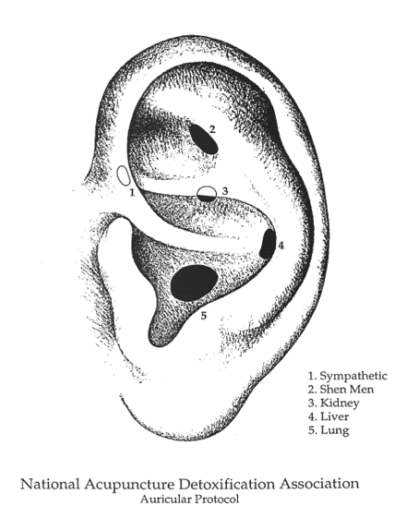
A non-verbal approach to healing that involves placing up to five small, sterilized, disposable needles into five specific sites on each ear.
These needles usually remain in place for 30-45 minutes for full benefits.
Sympathetic
Shen Men
Kidney
Liver
Lung

Slide 3
Beads and Seeds
Silver
Promotes calmness
Gold
Increases energy
Seeds
Whatever the
body needs

Slide 4
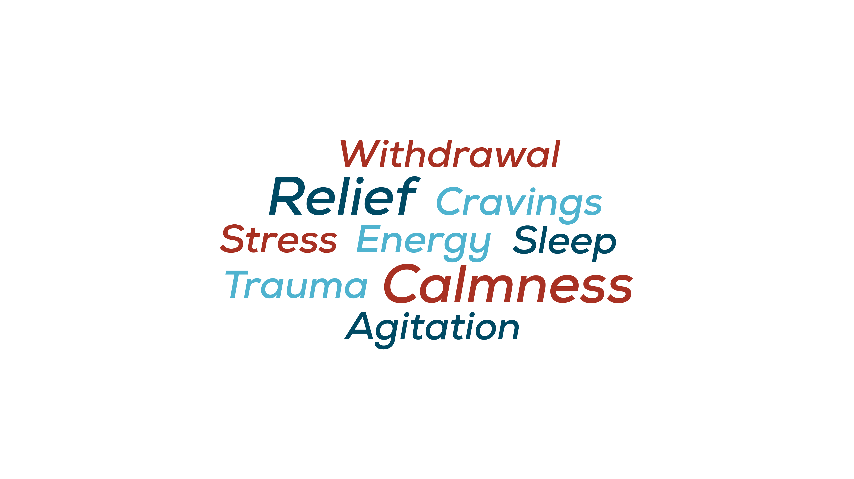

Slide 5
Certification Process for ADS
(Acupuncture Detox Specialist)
Licensed/CAC
Complete 3 day training
40 supervised treatments
Letter of intention
Attend AA/NA meeting

Slide 6
How the Youth teams use it
Individual clients
Group therapy
Staff wellness

Slide 7
How the Adult team uses it
Individual clients
Co-worker individual clients
Couple’s counseling
Group therapy-limitations

Slide 8
Shifting Perceptions and Changing Lives
Approved by high-risk teens
Requested by parents of court-ordered youth
Requested by Magistrate and GALs
Valued by community as an effective secondary trauma and anxiety management tool

Slide 9
Acudetox-Responses
Real client quotes about it:
“I was able to sleep through the night.”
“I feel an overall calmness throughout my body.”
“My back muscles loosened up.”

Slide 10
Demonstration time
If you’d like a treatment…
Snack
Waiver
Treatment

Slide 11
Questions?
Stay for the moderated Q&A.
Nataeah Barron LMFT, LAC
Nataeah.Barron@NorthRange.org
Scott Clawson CAC III
Scott.Clawson@NorthRange.org

