Slide 1
A Story of Implementing a
Family-Centered Co-Occurring
Residential Program
Kathryn Warner, MA, CACIII | Janis Pottorff, LCSW, IMH-E® III | Tiffany Gunnells, PhD, LPC, CACIII

Slide 2

Disclosure
Wings was made possible with funding provided by
Signal Behavioral Health Network

Slide 3


Research
Responsive Relationships
Repair
Recovery
Reflections

Slide 4




Research
Family-Oriented Treatment
70%
3%
21%
6%

Slide 5
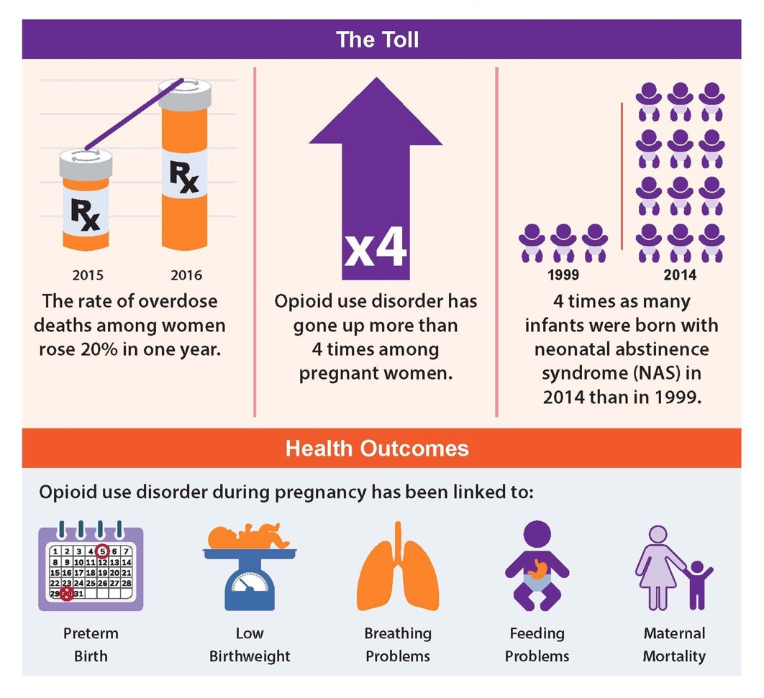
www.cdc.gov/reproductivehealth/opioid-use-disorder-pregnancy/index.html

Slide 6

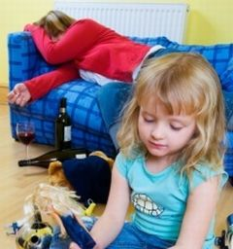
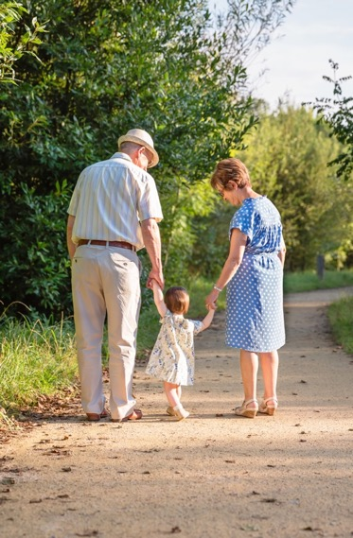

Additional Research

Slide 7

Smith Family Story

Slide 8

ACEs
Adverse Childhood Experiences
Ten factors
The higher the number, the more risk that healthy development
will be derailed

Slide 9

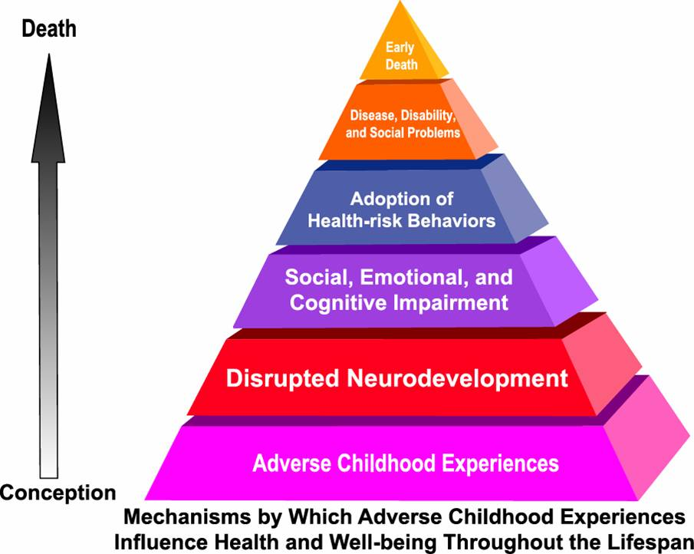

Slide 10


Slide 13

Substance Use Disorders have long been deemed a family disease and often generational.

Slide 14
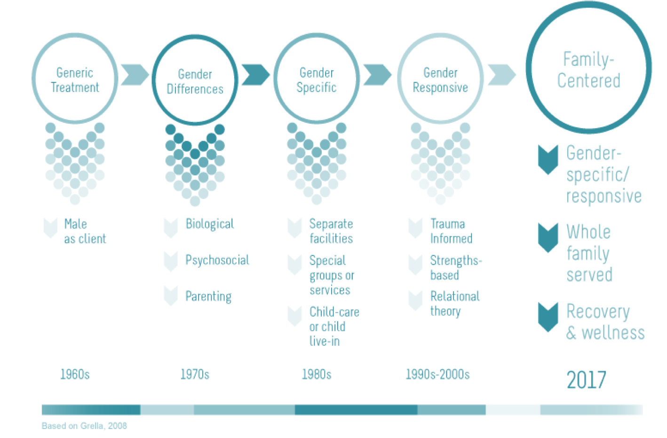

Slide 15
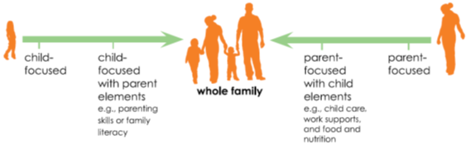
The Two-Generation Continuum
Two-generation (2Gen) approaches address the needs of children and their parents together to harness the family’s full potential and put the entire family on a path to permanent economic security. These approaches break down barriers so that families’ hard work to pull themselves out of poverty pays off. They strengthen education, economic supports, social capital, and health and well-being so that families can create a legacy of economic security that passes from one generation to the next.

Slide 16
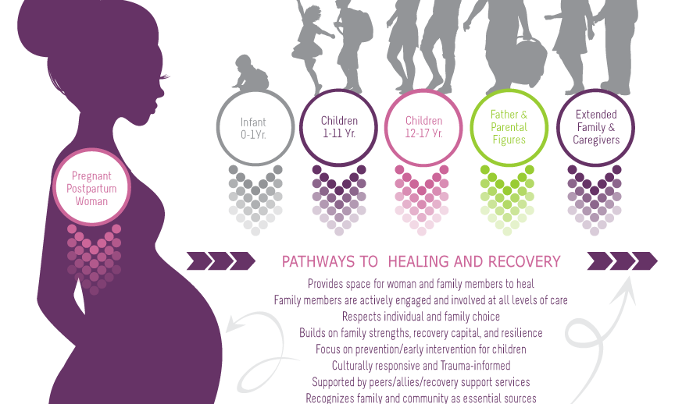
From the ATTC for prenatal and postpartum women

Slide 17

Responsive Relationships
Evidence-based
Mindfulness
Culturally Competent
Seeking Safety
Family Groups
Incredible Years
Wrap Around Services
SafeCare
PCIT
CPP
DBT
Social Model
Trauma-informed
Compassion
Collaboration
Whole Family Focused
Gender-responsive
Developmental

Slide 18


Slide 19

Regulation
Restores parent/child relationships
Key to supporting mindfulness and supporting parent/child interactions
Children are mirror learners
Can only learn new skills and problem solving when in a calm state

Slide 20

Words Have Power. People First.
“I love you!”
“How was your day?”
Reading a book together
Hugs, high-fives, kisses
Using affirmative language and actions to inspire hope and advance multigenerational family recovery.

Slide 21


Slide 22
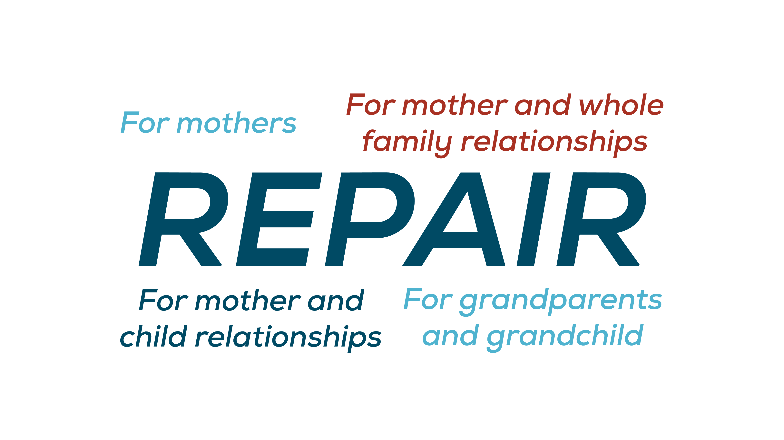

Slide 23

Health outcomes from Positive Experiences
Being in nurturing supportive relationships
Living, playing, and learning in safe, stable, protective and equitable environments
Engaging in constructive social / civic activities that develop a sense of connectedness
Developing social and emotional competencies

Slide 24
Aftercare
Building community and support
Resiliency
Continuum of Care
Maintenance

Slide 25
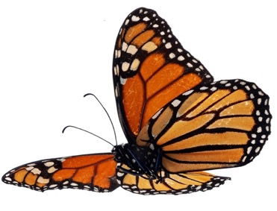



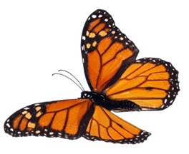

Smith Family Recovery

Slide 26
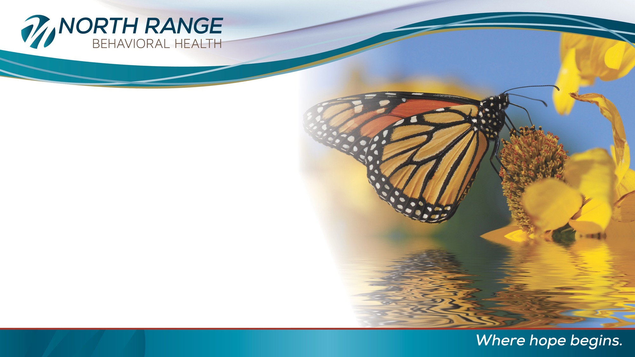
Reflections
Workforce development
Systemic structures and collaboration
Strategic planning
Outcome measures
Sustainability
Engagement/treatment for family members/other caregivers
Legal and ethical considerations
Time

Slide 27

Questions?

Slide 28
Thank You
Kathryn Warner
Kathryn.Warner@NorthRange.org
Janis Pottorff
Janis.Pottorff@NorthRange.org
Tiffany Gunnells
Tiffany.Gunnells@NorthRange.org

