Slide 1
INCREASING ACCESS TO
BEHAVIORAL HEALTH CARE
IN COLORADO THROUGH TELEPSYCHIATRY

Slide 2
WITH YOU TODAY
Calvin Parshad
Clinic Partnerships Manager
Genoa Healthcare Telepsychiatry
Samir Malik
EVP / General Manager
Genoa Healthcare Telepsychiatry

Slide 3
TODAY’S ROADMAP
The Colorado Mental Health Landscape & SPMI Patient Population
How Telepsychiatry is Closing the Gap
About Genoa Telepsychiatry
State Telepsychiatry Policy and Reimbursement
Building Successful & Sustainable Programs
Q&A

Slide 5
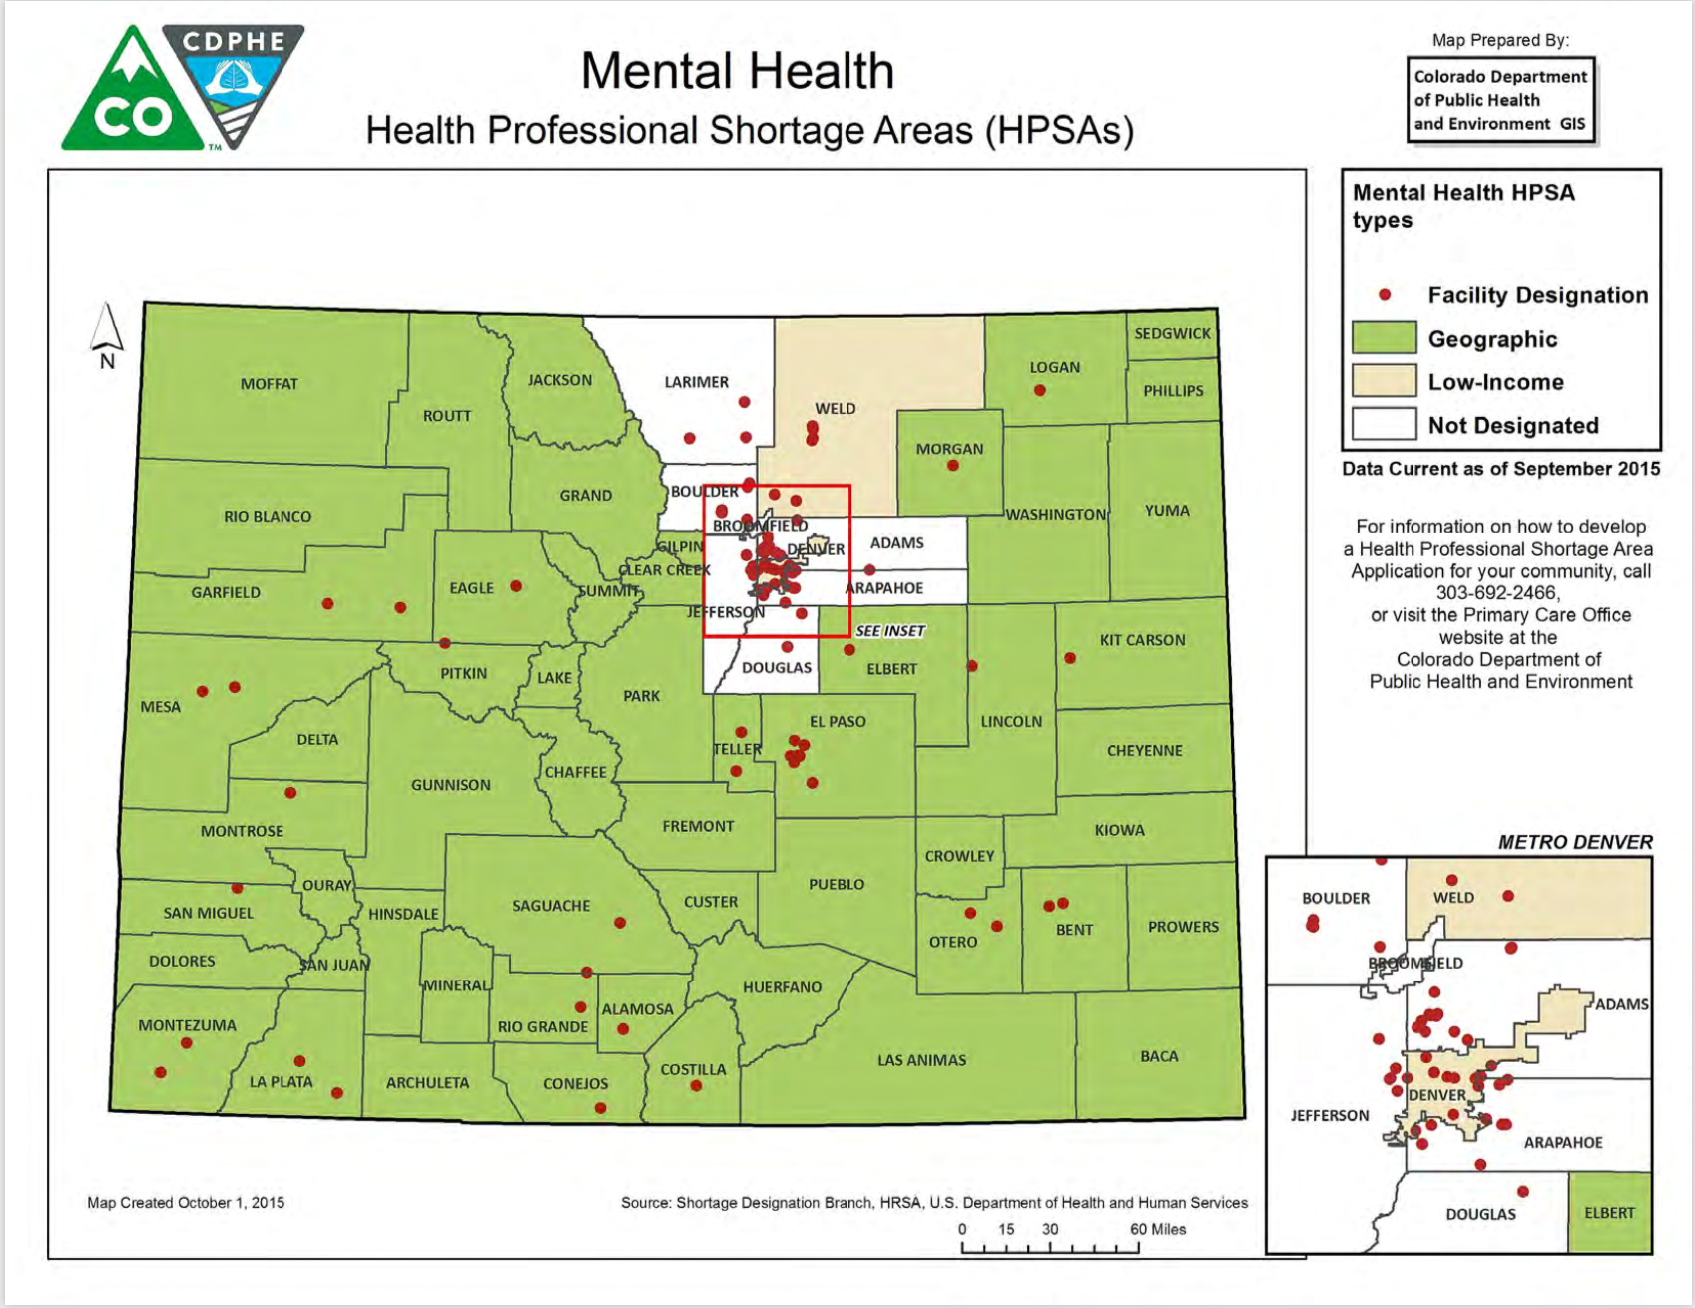
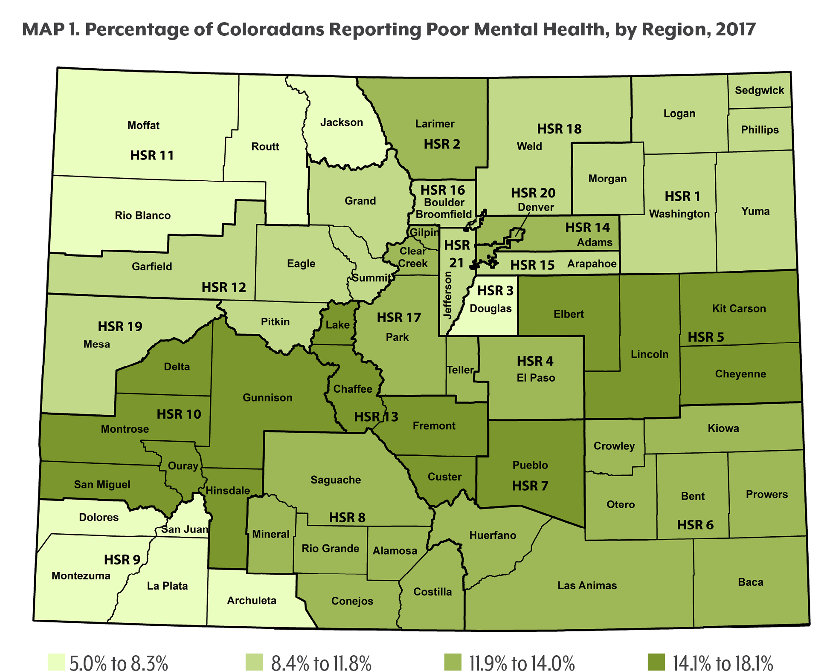
Behavioral Healthcare Access in Colorado
Telepsychiatry offers a sustainable solution to the provider shortage in areas with the poorest mental health care

Slide 6
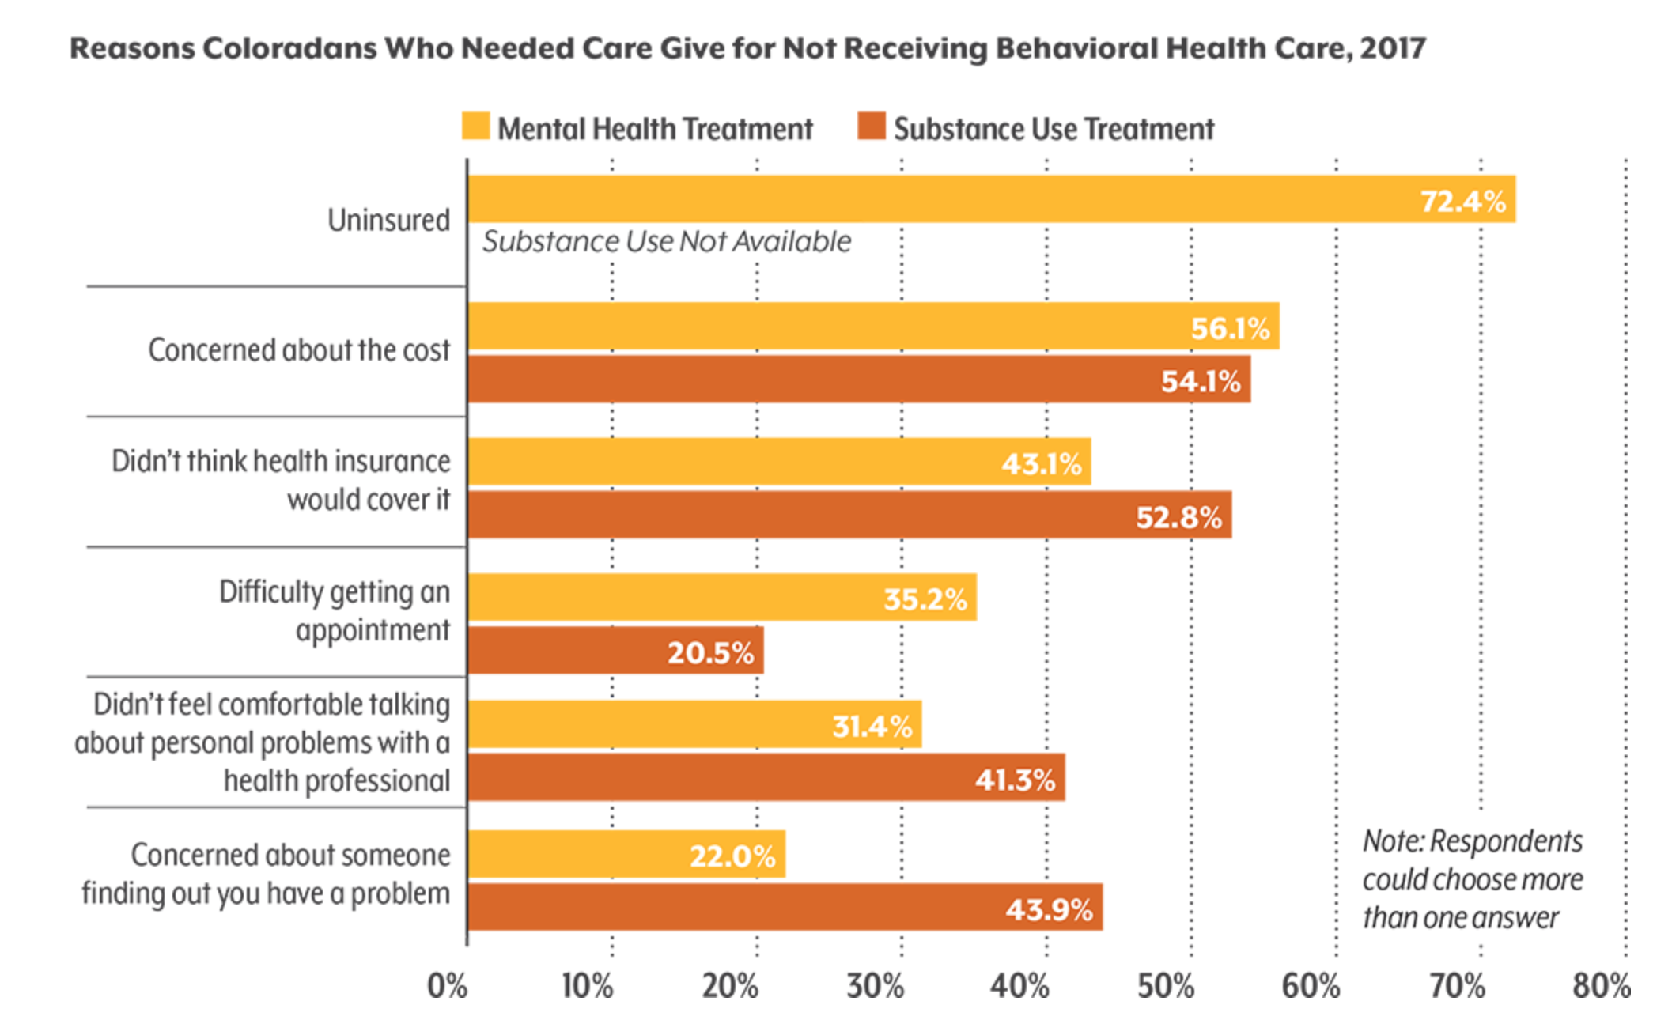
Colorado Mental Health Statistics
35.2 % who couldn’t access needed mental health services said it was because they had a hard time getting an appointment.
20.5 % of those who couldn’t access needed services for drug or alcohol use said it was because they had a hard time getting an appointment.
Of those who couldn’t access needed behavioral health services, 70.2 % did see their primary care doctor within the past year.
Coloradans in southwestern Colorado and Upper Arkansas Valley reported the highest rates of not getting necessary mental health services

Slide 7
Telepsychiatry That Builds Your Team
We help clinic partners...
Hire psychiatrists & APRNs selectively
Reduce client wait times to days, not months
Operate telepsychiatry sustainably
Coordinated care between provider, pharmacy & clinic staff

Slide 8
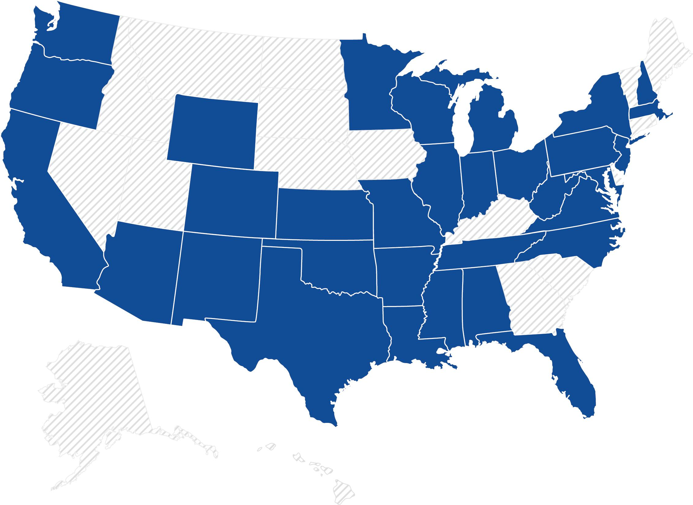
Our Footprint
The nation’s largest outpatient telepsychiatry community
^{4,000+}
¹²⁰⁺
Psychiatrists and APRNs in our community
Sites currently being served
^{215,000+}
Programs in
Client encounters annually
^{35+ states}
Notes:
Speaker notes:
Genoa Healthcare Telepsychiatry co-authored a peer-reviewed study, published in the APA's Journal of Rural Mental Health, that demonstrates the impact telepsychiatry can have on increasing access to mental healthcare.
In the study, data was analyzed from 242 Medicaid patients being treated in community mental health centers in Missouri. Results showed that patients with hybrid telepsychiatry plus in- person visits had improved timeliness of care and increased number of total outpatient encounters compared to the group with in-person visits only, indicating hybrid care may be more effective than in-person visits alone.

Slide 9
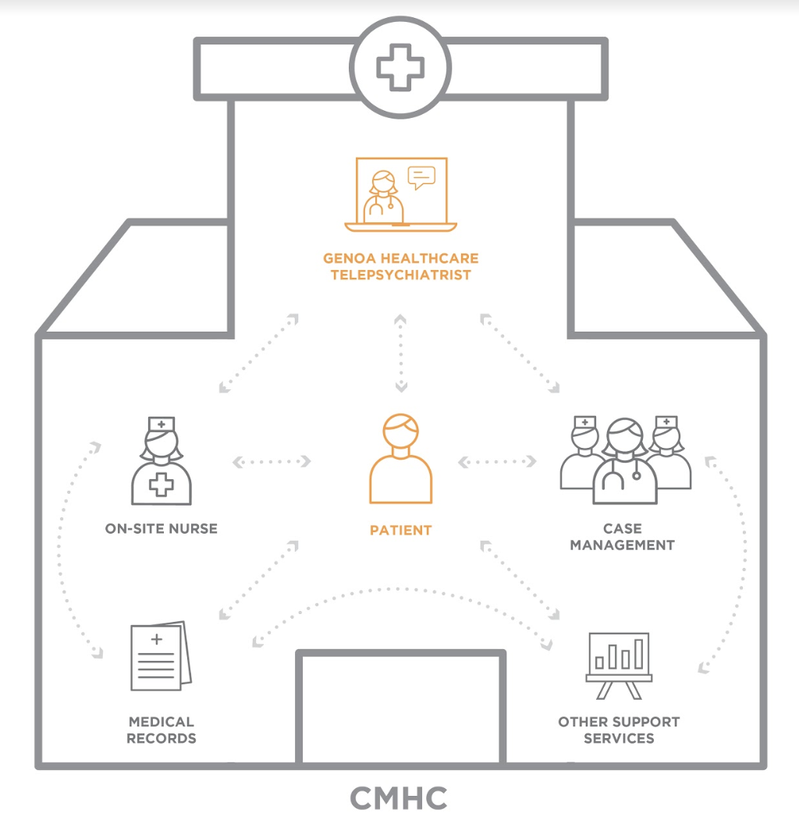
Coordinated Care
TELEPSYCHIATRY PROGRAM ENSURES COORDINATED, QUALITY CARE
Notes:
Speaker notes:
No matter what the vertical, the goal is coordinated care.

Slide 10
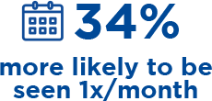
Study Showed Telepsychiatry Improved Patient Outcomes
Patients in rural communities who had access to telepsychiatry were seen:
*APA Journal of Rural Mental Health, Vol 43(1), Jan 2019, 30-37
Notes:
Speaker notes:
Genoa Healthcare Telepsychiatry co-authored a peer-reviewed study, published in the APA's Journal of Rural Mental Health, that demonstrates the impact telepsychiatry can have on increasing access to mental healthcare.
In the study, data was analyzed from 242 Medicaid patients being treated in community mental health centers in Missouri. Results showed that patients with hybrid telepsychiatry plus in- person visits had improved timeliness of care and increased number of total outpatient encounters compared to the group with in-person visits only, indicating hybrid care may be more effective than in-person visits alone.

Slide 11
Denver Integrated BH Care Initiative
One coordinated system, delivering outcomes oriented, value-based care for the Denver community. Partners so far:

Slide 12
Opportunities for Care
Reaching Behavioral Health Clients Across Care Systems
Community Mental Health Centers
Medication Assisted Treatment Programs
Assertive Community Treatment Programs
Psychiatric Hospitals
Federally Qualified Health Centers
Medicaid Client Homes
Managed Care Organizations
Notes:
Speaker notes:
While much of Genoa Healthcare’s work is done with community mental health centers and federally qualified health centers, there’s vast potential to explore other verticals.

Slide 13
QUESTIONS?

Slide 14
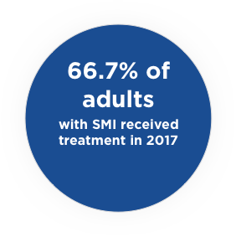
Unique Challenges Faced By People Living With SPMI
In addition to lack of access to care, low treatment rates are driven by barriers & challenges specific to this population
Homelessness
People with untreated SPMI make up 1/3rd of total U.S. homeless population
Hospitalization & readmission
SPMI patients have 1.4x higher odds of a 30-day readmission
Poverty
25%+ of adults with SPMI live below the poverty line
*Medical-surgical readmissions in patients with co-occurring serious mental illness; General Hospital Psychiatry.
*Serious Mental Illness and Homelessness; Treatment Advocacy Center.
*Serious Mental Illness Among Adults Below the Poverty Line; Substance Abuse and Mental Health Services Administration. November 15, 2016
*Serious Mental Illness (SMI) Prevalence in Jails and Prisons; A Background Paper from the Office of Research & Public Affairs. September 2016.

Slide 15
Why SPMI patient outcomes suffer
No-show and medicated adherence rates pose outcomes challenges – rendering follow-up visits even more critical
No-Show Rates/Utilization | Medication Adherence
29-42% fail to begin treatment and 15-50% don’t return for a second appointment | Adherence to antipsychotic medications has an average rate of 50%
Follow-up care for people with mental illness is linked to fewer repeat ED visits, improved physical and mental function, and increased compliance with follow up instructions
*Reducing Appointment No-Shows: Going From Theory to Practice. PMC 2014 March 21, 48(9): 743-749
*Predicting Community Tenure in Patients with Recurrent Utilization of a Psychiatric Emergency Service. General Hospital Psychiatry.
Notes:
Research suggests that follow-up care for people with mental illness is linked to fewer repeat ED visits, improved physical and mental function and increased compliance with follow-up instructions.⁹ New models of care, such as integrated outpatient telepsychiatry, are critical in ensuring this patient population receives effective continuity of care.
ACT teams

Slide 16
Getting Started with Telepsychiatry
Telepsychiatry can fill the gap when there is a challenge hiring prescribers
CO Medicaid grants autonomy to PMHNPs and prescribing psychologists
144 CO-licensed MD/DOs and APRNs in Genoa Telepsychiatry community
Provider screens, In-house interviews, and a white glove approach for a long-term match clinic partners

Slide 17
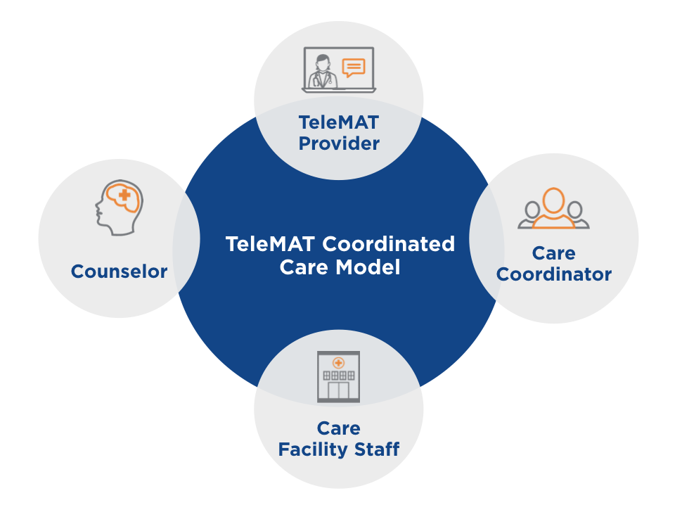
TeleMAT: Medication-Assisted Treatment using Telemedicine
With TeleMAT, patients receive timely, quality care directly within their local health care center.
Benefits of TeleMAT:
TeleMAT enables psychiatric providers to treat patients remotely through a secure, HIPAA-compliant video platform
TeleMAT providers seamlessly integrate into each clinic’s coordinated care model

Slide 18
RYAN HAIGHT ACT
A physician-patient relationship must be established in order for the telepsychiatrist to e-Prescribe any medication. The Federation of State Medical Boards states:
“Where an existing physician-patient relationship is not present, a physician must take appropriate steps to establish a physician-patient relationship consistent with the guidelines identified in Section Two, and, while each circumstance is unique, such physician-patient relationships may be established using telemedicine technologies provided the standard of care is met.”
DEA’s Use of Telemedicine states while providing MAT practitioners are exempt from in-person medical evaluation requirement as a prerequisite to prescribing or otherwise dispensing controlled substances via the Internet if the practitioner is engaged in the “practice of telemedicine” as defined under 21 U.S.C. § 802(54)
Notes:
The Ryan Haight Act is still very relevant today and you must ensure you’re taking the appropriate steps in your telepsychiatry program to comply.
Why is it important?
The Ryan Haight Act proscribes delivery, distribution, and dispensing of all controlled scripts that do not originate through 1) an in-person medical exam, 2) a covering practitioner, or 3) 1 of 7 practice of telemedicine exceptions.
Telemedicine sessions conducted by a provider observing the appropriate standard of care qualifies for establishing the doctor-patient relationship necessary to prescribe controlled medications.
The Federation of State Medical Boards which has stated that a telemedicine encounter on its own is sufficient to establish an appropriate physician-patient relationship (Source: http://www.fsmb.org/globalassets/advocacy/policies/fsmb_telemedicine_policy.pdf).
Source: http://www.fsmb.org/Media/Default/PDF/FSMB/Advocacy/FSMB_Telemedicine_Policy.pdf
According to the DEA’s Use of Telemedicine While Providing Medication Assisted Treatment (MAT) statement, pursuant to the provisions of the Ryan Haight Act of 2008, DEA-registered practitioners acting within the United States, which include DATA 2000-waivered practitioners, are exempt from the in-person medical evaluation requirement as a prerequisite to prescribing or otherwise dispensing controlled substances via the Internet if the practitioner is engaged in the “practice of telemedicine” as defined under 21 U.S.C. § 802(54)

Slide 19
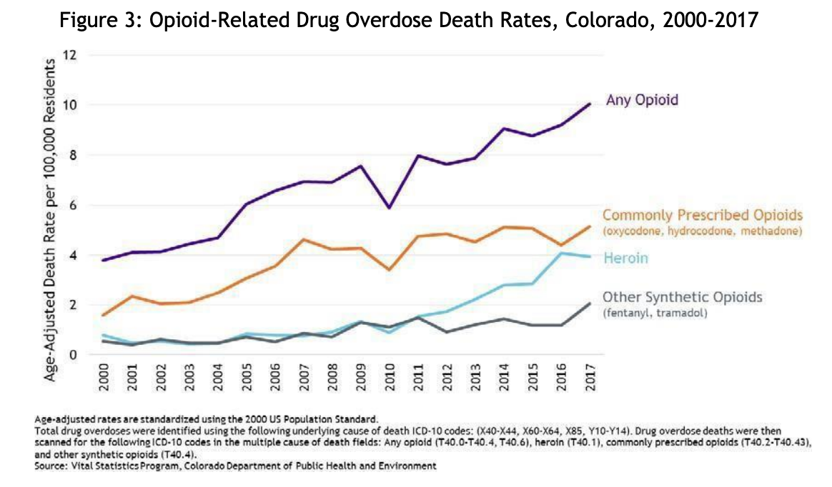
TeleMAT is a powerful tool for battling the Opioid Epidemic by bringing substance abuse experts into rural communities

Slide 20
TeleMAT enables clients to engage more frequently in virtual visits with their providers
Notes:
CBT approach

Slide 21
Impact of Non-Adherence
“Drugs don’t work on patients who don’t take them.”
C. Everrett Koop, MD, former US Surgeon General
3x
10%
$185b+
the number of office visits
Higher hospital admissions
Annual cost to payors

Slide 22
Integrated pharmacy & telepsychiatry
Genoa Healthcare’s unique model supports patients with complex health & social needs
 | BETTER HEALTH OUTCOMES Genoa’s high-touch model of telepsychiatry combined with on-site pharmacy staff improves patient engagement and health outcomes
 | MEDICATION MANAGEMENT & CUSTOMIZATION Refill Management Medication Synchronization Medication Therapy Management Custom blister packaging & pre-filled pill organizers Delivery by courier or by CMC available
 | CARE COORDINATION Genoa pharmacists call patients for adherence reminders & check-ins, get to know patients and find solutions to patient-specific adherence barriers

Slide 23
QUESTIONS?

Slide 24
RULES & REGULATIONS
In-person contact between a health care provider and a recipient is not required under the state’s medical assistance program for the diagnosis and development of a treatment plan
CO Medicaid will cover telemedicine direct member services which can involve up to two collaborating providers and the member
The originating site is eligible for a facility fee. Providers eligible for the originating site facility fee
The Medicaid requirement for face-to-face contact between provider and member may be waived prior to treating the member through telemedicine for the first time
Interstate Medical Licensure Compact (IMLC)
Private Parity Laws

Slide 25
E-PRESCRIBING
CO-specific info on most commonly prescribed drugs in mental and behavioral space. Set the scene!
Notes:
Most commonly prescribed drugs in Colorado:
https://www.cchpca.org/telehealth-policy/current-state-laws-and-reimbursement-policies/colorado-professional-regulationhealth-safety-online-prescribing

Slide 26
HOW WILL THIS HELP CLINICS & CLIENTS?
Legislation is designed to close gaps in the state’s current telehealth insurance coverage law, provide coverage clarity to patients, and ensure payment parity to in-network health care providers.
A health plan may not impose an originating-site restriction with respect to telemedicine services or distinguish between telemedicine services provided to patients in rural locations and those provided to patients in urban locations; provided that the law shall not be construed to require coverage of an otherwise non-covered benefit.

Slide 27
REIMBURSEMENT
EACH SESSION PERFORMED GENERATES
TWO BILLABLE CODES:
PHYSICIAN SERVICES
TELEMEDICINE BONUS
^{OUTPATIENT CPT CODES}
^{NPI: Physician}
^{ORIGINATING SITE FEE}
^{NPI: Facility}
Initial Evaluation Codes:
90792, 99204
Follow-up Codes:
99211, 99212, 99213, 99214, 99215
Q3014
$21.88 per client encounter for Medicaid and $26.15 for Medicare in rural HPSAs

Slide 28
OUR COMMITMENT

Slide 29
IS TELEPSYCHIATRY FOR YOU?
You need a provider who is capable of creating better outcomes and patient satisfaction
You need to integrate behavioral health and primary care to engage patients and provide coordinated care to the underserved
Notes:
A focus on long-term programming success, supporting clinic workflows, financial sustainability, and excellent care standards.
A laser focus on the Medicaid and CMHC space has demonstrated meaningful efficacy in improving access and engagement for the underserved.

Slide 30
REACH OUT
Where you have gaps in coverage so we can match you with providers who have experience with OUD, rural vs. urban populations, marijuana dependency
Any questions about telehealth coverage, legislation, advocacy, and/or reimbursement
FCC’s Connected Care $5 million grant

Slide 31
RESOURCES
Colorado Health Access Survey, Colorado Health Institute
Colorado Department of Public Health and Environment
Colorado Prescription Drug Monitoring Program
Center for Connected Care Policy
Health Resources and Services Administration
CMS.gov

Slide 32
THANK YOU TO OUR HOST

Slide 33
CONTACT:
cparshad@genoahealthcare.com
Notes:
How telepsychiatry can increase access to care in underserved areas in CO
How to overcome barriers to care in CO
How to leverage a successful telepsychiatry program in CO
Telepsychiatry is the future of care delivery in CO
How telepsychiatry complements your existing practice
Telepsychiatry is different -- here’s how it helps -
Challenge of prescribing through telepsych - through EHR
Why did you decide to explore telepsych?
Barriers?
Impact?

