Slide 1
2021 Day at the Capitol
Policy Academy

Slide 2
CBHC Day at the Capitol 2021 Policy Academy - Agenda
Remarks from Governor Jared Polis
Remarks from Representatives Mary Young & Rod Pelton
2021 Session Update: Budget and Legislative
CBHC 2021 Legislative & Policy Priorities

Slide 3
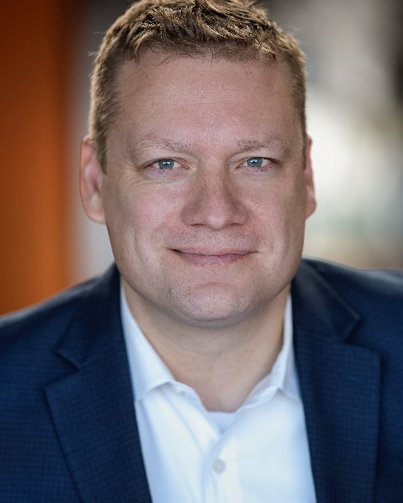
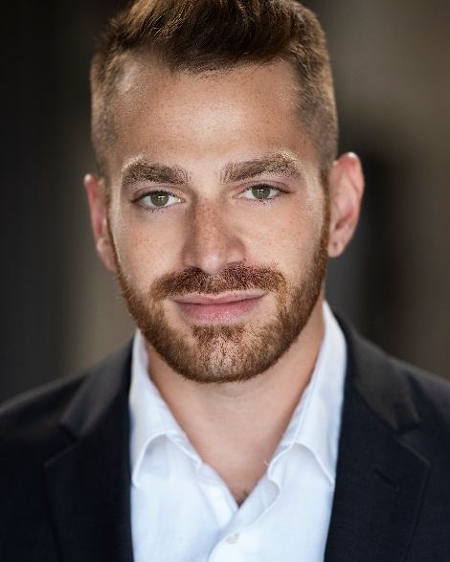
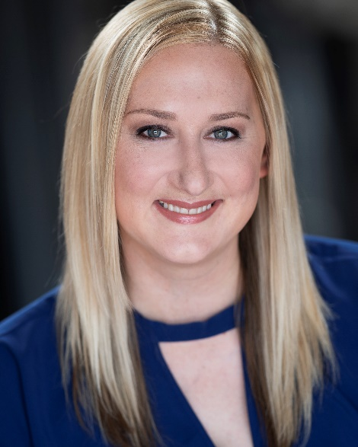
CBHC Team
Doyle Forrestal
Frank Cornelia
Moses Gur
Natalie Strom
CBHC Chief Executive Officer
CBHC Deputy Director & Chief Strategy Officer
CBHC Director of Policy & Member Engagement
CBHC Membership
Services & Communications Coordinator

Slide 4
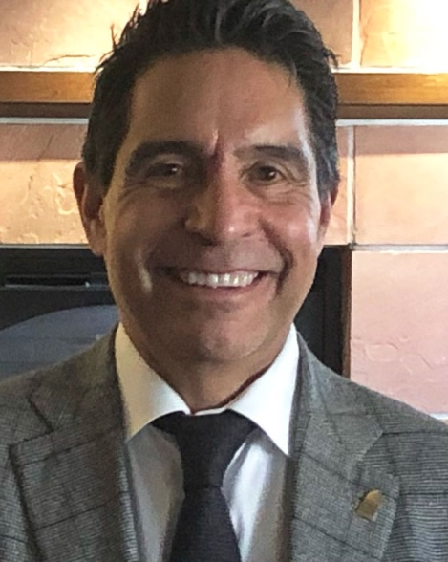
CBHC Lobbyists
Gil Romero
Karen Wick
Principal/Attorney
Capitol Success Group
Principal Strategist
Swift Strategies

Slide 5
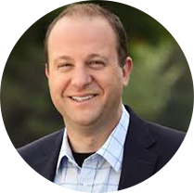
Colorado Governor jared polis

Slide 6
State Representative Mary young

Slide 7
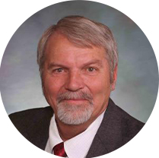
State representative rod pelton

Slide 8
2021 Budget & Legislative Update
Gil Romero & Karen Wick

Slide 9
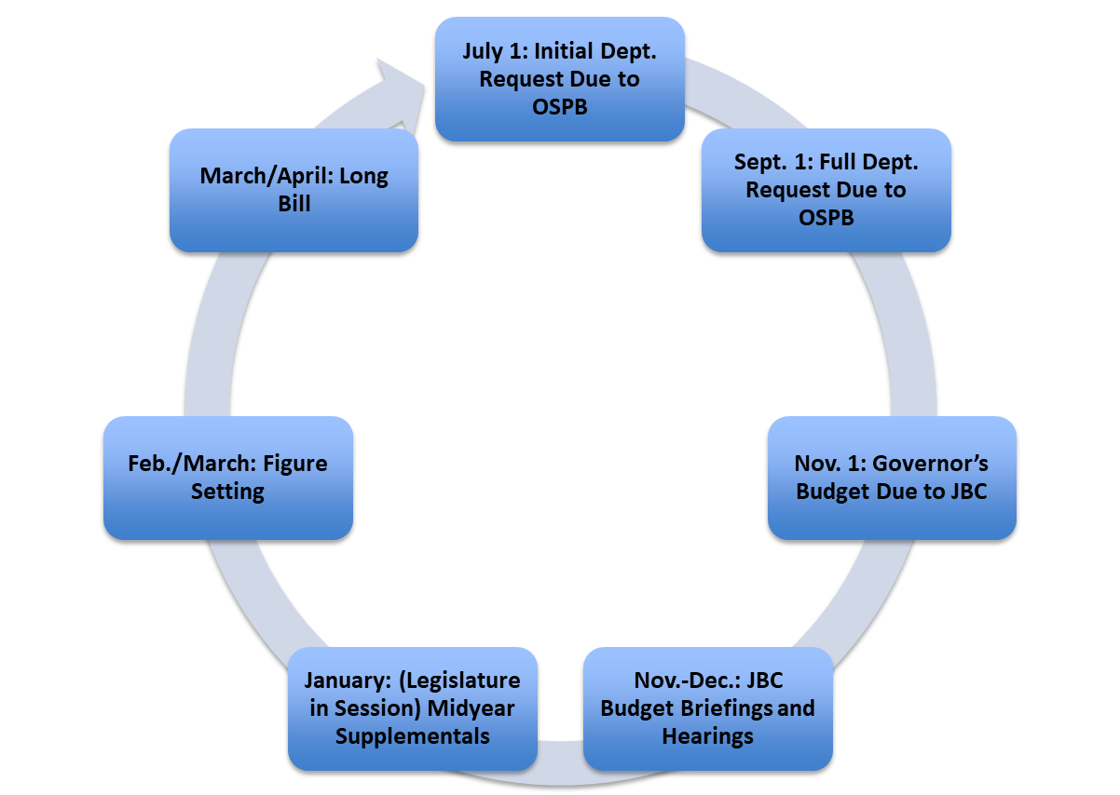
Colorado’s Budget Cycle

Slide 10
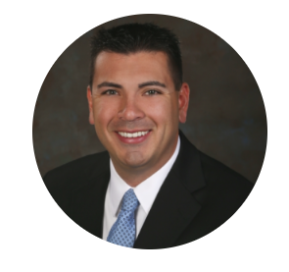
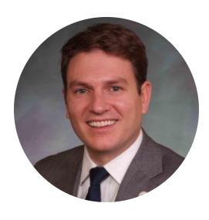
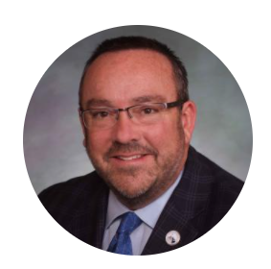
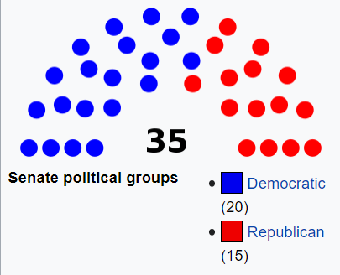
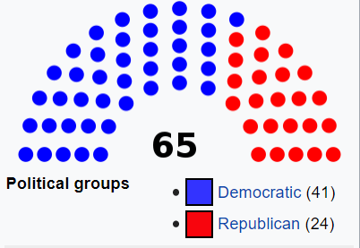
Senate
House
Senate President Leroy Garcia
Minority Leader Chris Holbert
Speaker
Alec Garnett
Minority Leader
Hugh McKean

Slide 11
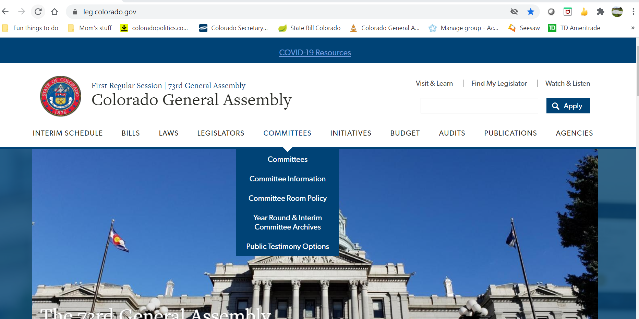
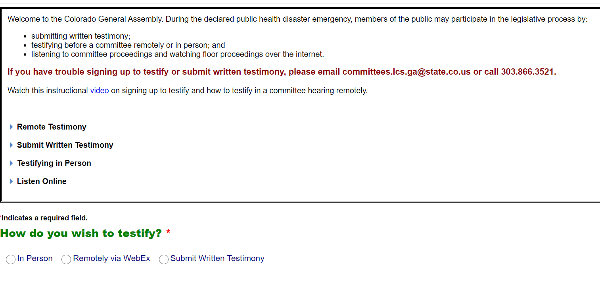
Sign up to testify

Slide 12
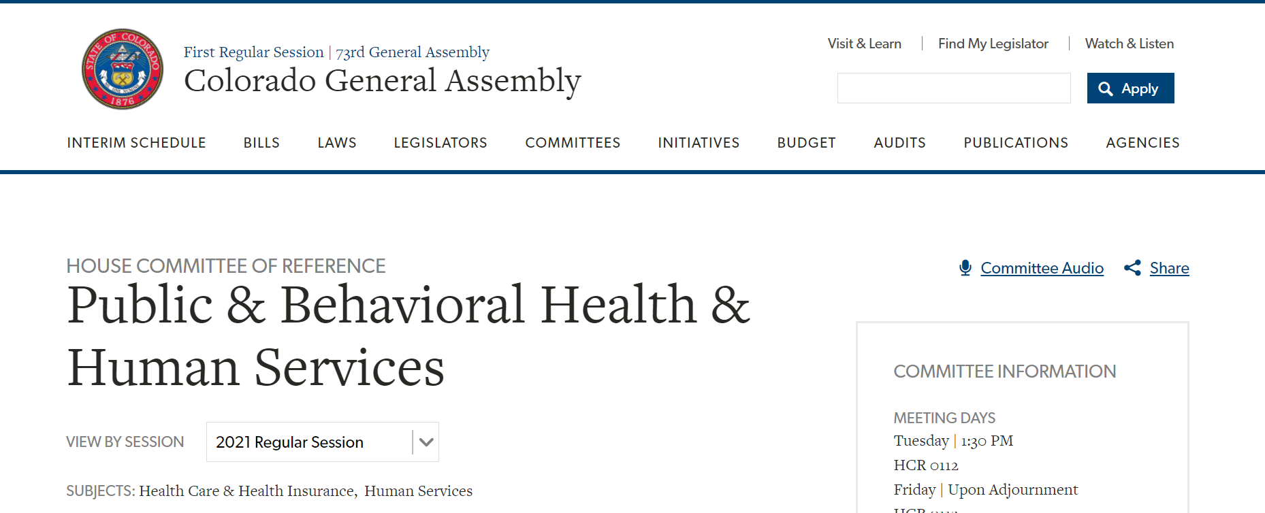
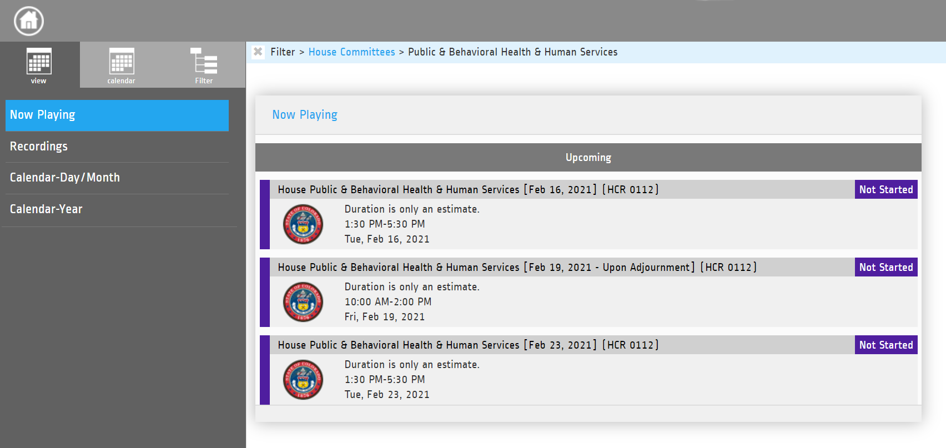

Slide 13
Questions?

Slide 14
CBHC 2021 Legislative & Policy Priorities
Frank Cornelia & Moses Gur

Slide 15
Area of Focus: 2021-2022 State Budget
CBHC Advocacy Priorities
Ask the JBC to REJECT the proposed cuts for SUD funding in the CDHS budget.
Please PROTECT the 2.5% provider rate increase approved by JBC members.
Notes:
Support the safety net behavioral health workforce
Advocate against programmatic cuts in behavioral health line items
Ensure sustainability for widely needed programs across the state, such as withdrawal management facilities, residential facilities, and prevention and recovery programming

Slide 16
Area of Focus: Teen Mental Health First Aid
Senator Chris Kolker & Representative Dafna Michaelson Jenet
Please support the Senate bill, Expanding Behavioral Health Training for Educators in Secondary Schools, so that Colorado teens can be better equipped to support their peers and identify and utilize supports in their communities.
Notes:
The intent of this CBHC-led initiative is to increase the availability of Teen Mental Health First Aid and other trainings across Colorado
Similar in structure to SB20-001, this bill will authorize the Colorado Department of Education (CDE) to contract with a vendor to develop a train-the-trainer program to increase the number of specialty trainers across the state
The bill currently appropriates $250K to CDE for this purpose

Slide 17
Area of Focus: Behavioral Health Recovery Act
Senator Brittany Pettersen & Representative Dafna Michaelson Jenet
Please support the Behavioral Health Recovery Act when it is introduced.
This bill will restore critical funding for needed SUD treatment programs and will direct additional resources to behavioral health providers that are struggling because of unexpected expenses or decreased revenue because of the COVID-19 pandemic.
Notes:
Will attempt to restore funding to various legislative programs, including some MSO specific line items, CMHC projects, and other community-based resources
Will carry-over language from HB20-1411 to support providers through the pandemic
This bill includes a broad coalition led by CBHC, COPA, the Consortium for Prescription Drug Abuse Prevention, & others

Slide 18
Area of Focus: CMHCs & SUD Treatment Programs as Other Outlet Pharmacies
Senators Joann Ginal & Faith Winter
Please support the Ginal/Winter bill to continue the Pharmacy Board regulations, including the language that has been added to allow licensed community mental health clinics and facilities that have substance use disorder treatment programs to be included in the definition of “other outlets”.
Notes:
CBHC-led initiative to include CMHCs and facilities that have licensed SUD treatment programs as an “other outlet” in C.R.S 12-280-103 (32) (a), allowing the disbursement of controlled substances in a timely and supervised fashion in a regulated facility
CBHC ran a bill in 2014 (HB-1083) that achieved this goal for Acute Treatment Units (ATUs)
No anticipated appropriation and would allow increased access to MAT

Slide 19
Area of Focus: Behavioral Health Emergency and Disaster Preparedness & Response
CBHC-led Initiative, not yet sponsored
CBHC is working with the Governor’s Office and CDPHE to finalize the details of this potential legislation. We will keep you informed of the progress and reach out when a bill has been introduced.
Notes:
Formalize the role of community-based safety net behavioral health providers in preparing for, responding to, and recovering from disasters.
Direct CDPHE to manage a fund and promulgate rules to support behavioral health provider emergency and disaster related initiatives.
Create the structure for future appropriations, or non-legislative dollars, to be contributed into the fund for these purposes.

Slide 20
Be Prepared to Respond
Behavioral Health Authority
Peers & Recovery
Bill led by CDHS, sponsored by Representative Mary Young & Rod Pelton and Senator Rhonda Fields.
Sets implementation standards, timelines, and expectations for BHTF recommendations regarding BHA.
CBHC is optimistic about the opportunity to streamline administrative complexity.
Bill led by Mental Health Colorado to increase Peer professional autonomy by creating peer-organizations that can bill Medicaid directly.
Further directs OBH to specify recovery as a component of MSO’s contracts.
CBHC supports peers as a critical component of the BH workforce alongside licensed professionals.

Slide 21
Be Prepared to Respond
Secure Transportation for Behavioral Health
988 Crisis Line State Implementation
Bill led by my Mental Health Colorado to create a licensing structure for non-ambulatory, BH-specific transportation services.
Directs HCPF to identify a pathway to pay for this service for Medicaid populations.
CBHC supports increasing the availability of BH-responsive transportation services.
Bill led by Mental Health Colorado to implement the federally allowed telecom charge towards crisis services.
Connects Colorado’s crisis hotline to the 988 system being set up nationally.
CBHC does not have a position on this bill at this time; we are encouraged by the opportunity to further explore how Colorado can increase investments in crisis infrastructure.

Slide 22
Be Prepared to Respond
Annual Mental Health Wellness Exam Coverage by Insurance
Police & Community Partnerships
Bill led by FOP to increase a line item that supports various police BH programs.
Directs an investment into programs that support the mental health of officers; create opportunities for programs that pair police and mental health response jointly.
CBHC supports further bolstering Colorado's social response innovation.
Sponsored by Dafna Michaelson-Jenet, this bill revives a concept from 2020 to require every commercial insurance payor to cover at least one annual 60-minute behavioral health wellness exam.
CBHC supports increasing access to behavioral health wellness exams and further ensuring parity in private insurance markets.

Slide 23
Questions?

Slide 24
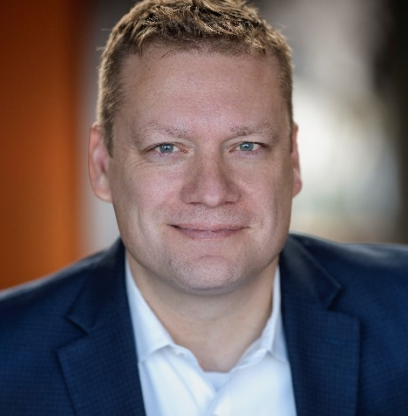
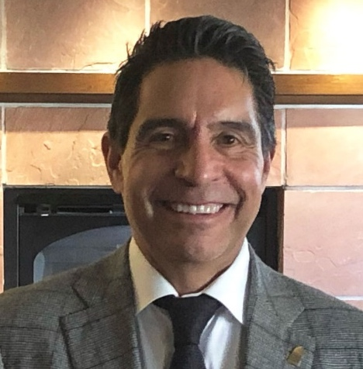
How to get in touch
Doyle Forrestal
Frank Cornelia
Gil Romero
Karen Wick
CBHC CEO
CBHC Deputy Director & Chief Strategy Officer
Capitol Success Group
Swift Strategies
dforrestal@cbhc.org 303-885-4097
Gil@capitolsuccessgroup.com 303-921-8630
Karen@swift-strategies.com 720-435-3885
fcornelia@cbhc.org 720-454-5740

Slide 25
Thank You!

