Slide 1
The "Next Normal" Strategic & Sustainability Challenges To Community-Based Behavioral Health Organizations
Monica E. Oss
Chief Executive Officer OPEN MINDS
October 2, 2021
Notes:
Saturday, October 2
3-hour session, open only to CEOs and board chairs of CBHC-member organizations
Time: 8:00 - 11:00 AM MT (with a mid-morning break)
Title: The "Next Normal" Strategic & Sustainability Challenges To Community-based Behavioral Health Organizations
Description: This by-invitation-only session will focus on two key governance issues. First, what are the
pandemic-driven market forces that are changing the sustainable business models of community-based
behavioral health organizations? Then, what is the framework for strategy development and maintaining
competitive advantage in the 'next normal". The session will be a combination of executive briefing and
interactive strategy discussion.

Slide 2
Discussion Agenda
Market forces changing the business models of community-based behavioral health organizations
Key drivers of health and human service landscape
Implications for traditional community mental health centers
Emerging opportunities
Framework for strategy development for maintaining post-pandemic competitive advantage
Key strategy questions
Strategy development best practices
Strategy leadership roadmap
2

Slide 3
“Change is the only constant in life...”
Heraclitus, Greek philosopher
3
Notes:
The mantra of every executive these days
There are days I wake up and think ‘just keep it coming’
The big unknowns – pandemic 2.0, federal/state budgets, political changes, regulatory shifts, new competition, new technology
The requirement? Framework for resilient operations and orderly process for making changes – big and small – with shifts in the landscape to maintain competitive advantage and sustainability -

Slide 4
1. Market Forces Changing The Business Models Of Community-Based Behavioral Health Organizations Key drivers of health and human service landscape Implications for traditional community mental health centers Emerging opportunities

Slide 5
What Is Driving The ‘Lasting Impact’ Of The Pandemic On The Health & Human Service Landscape?
Entrance of out-of-industry mega-companies in the health and human service space
Increasing dominance of health plans in health care delivery system
“Backward integration” of health plans, increasing their owned service delivery capacity
Outsized investment in new companies serving the “complex consumer” market
Customer preference for integrated care – medical, behavioral, social
Digital health adoption in Medicaid and Medicare populations
Acceptance of and preference for virtual primary care
The creation of new digital behavioral health companies

Slide 6
Driver #1: Preference For Integrated Care –Medical, Behavioral, Social – Driving Value-Based Reimbursement
Integrated models have demonstrated better consumer outcomes and lower total costs
FFS reimbursement does not permit maximum benefits of integrated care
Integrated care coordination
Interoperability at consumer record level
VBR/APM to facilitate flexibility for personalization
VBR/APM to align financial incentives
VBR arrangements without downside financial risk have been found to not deliver “macro” cost savings

Slide 7
Driver #1: Preference For Integrated Care –Medical, Behavioral, Social – Driving Value-Based Reimbursement
Integrated models have demonstrated better consumer outcomes and lower total costs
The Implications?
Less spending specific to “behavioral health”
Traditional “behavioral health therapy” visits replaced by short-term behavioral interventions
Less targeted case management – replaced by new models of coordinated care programs
Behavioral health organization market positioning is limited
FFS reimbursement does not permit maximum benefits of integrated care
Integrated care coordination
Interoperability at consumer record level
VBR/APM to facilitate flexibility for personalization
VBR/APM to align financial incentives
VBR arrangements without downside financial risk have been found to not deliver “macro” cost savings

Slide 8
Medicare expanding virtual health options
Many state Medicaid plans keeping virtual care options allowed during pandemic
Driver #2: Digital Health Adoption Is Not Just Commercial – In Medicaid & Medicare Populations
Medicaid and Medicare health plans are expanding their use of consumer treatment tools and digital first behavioral health provider organizations
1 in 4 Medicare patients used telehealth during peak of pandemic, with majority using only telephones
85% of Medicaid beneficiaries have a smartphone
“90% of Medicaid consumers can get all of their mental health and addiction treatment services on-line”

Slide 9
Medicare expanding virtual health options
Many state Medicaid plans keeping virtual care options allowed during pandemic
The Implications?
Proportion of service delivered in-clinic face-to-face decreasing in favor of virtual services
Competition for Medicaid and Medicare market share extends beyond traditional “service areas”
Medicaid and Medicare market share more susceptible to new digital first investor-owned companies
Advantage goes to the provider organizations with a seamless suite of tech-enabled services – virtual, text, remote monitoring, etc.
Driver #2: Digital Health Adoption Is Not Just Commercial – In Medicaid & Medicare Populations
Medicaid and Medicare health plans are expanding their use of consumer treatment tools and digital first behavioral health provider organizations
1 in 4 Medicare patients used telehealth during peak of pandemic, with majority using only telephones
85% of Medicaid beneficiaries have a smartphone
“90% of Medicaid consumers can get all of their mental health and addiction treatment services on-line”

Slide 10
Market Share Of Largest Health Insurance Companies
Driver #3: Increasing Dominance Of Health Plans In Health Care Delivery System
Medicaid: 72% enrolled in health plans
Medicare: 38% enrolled in heatlh plans
Commercial: 99% enrolled in heatlh plans

Slide 11
Market Share Of Largest Health Insurance Companies
Driver #3: Increasing Dominance Of Health Plans In Health Care Delivery System
The Implications?
Health plans increasingly control budget decisions – criteria for network membership, “preferred status,” clinical criteria
Narrow networks increasingly acceptable
End of “any willing provider”
Medicaid: 72% enrolled in health plans
Medicare: 38% enrolled in heatlh plans
Commercial: 99% enrolled in heatlh plans

Slide 12
The Accelerated Move Away From Fee-For-Service
The Medicare transformation
Medicaid VBR requirements
Employers embrace high-performance networks
The “hybrid” advantage in risk contracts
The shifting definitions of “value”

Slide 13
The Implications?
Specialty provider organizations risk displacement in ‘preferred’ network agreements by primary care organizations
The ability to address social support needs (and/or provide social supports) is a differentiating factor for some behavioral health organizations
Provider organization competition for market share will be around ability to accept financial risk
More risk-based contracts will shrink the provider network and increase the importance of financial strength
The Accelerated Move Away From Fee-For-Service
The Medicare transformation
Medicaid VBR requirements
Employers embrace high-performance networks
The “hybrid” advantage in risk contracts
The shifting definitions of ‘value’

Slide 14
Driver #4: ‘Backward Integration’ Of Health Plans, Increasing Their Owned Service Delivery Capacity
Health Plans
Payvider Positioning
Backward integration with health plans owning service delivery system – and hiring clinical professionals to provide direct services

Slide 15
Driver #4: ‘Backward Integration’ Of Health Plans, Increasing Their Owned Service Delivery Capacity
The Implications?
Many behavioral health services likely to be provided by health plan-owned subsidiaries (AbleTo owned by Optum, MDLive and Breakthrough Mental Health owned by Cigna, etc.)
Health plan increasingly “own” primary care capacity
Care coordination models will change role of “targeted case management”
Health Plans
Payvider Positioning
Backward integration with health plans owning service delivery system – and hiring clinical professionals to provide direct services

Slide 16
Driver #5: Acceptance Of & Growing Preference For Virtual Primary Care

Slide 17
The Implications?
Eliminates “place” as a criteria for service
Moves service delivery to tech-enabled consumer assessment tools
Referrals to behavioral health will be dependent on relationships and/or marketing to virtual primary care organizations
Driver #5: Acceptance Of & Growing Preference For Virtual Primary Care

Slide 18
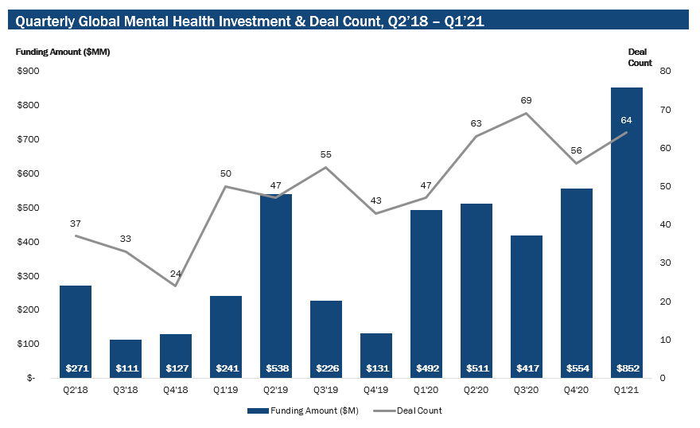
Driver #6: Outsized Investment In New Companies Serving The ‘Complex Consumer’ Market
Quarterly Global Mental Health Investment & Deal Count, Q218 – Q121
Majority of behavioral health funding went to three types of solutions:
Digital treatment
Digital therapeutics
Non-clinical behavioral health “adjacent” apps
$852 billion invested in behavioral health programs in 1Q

Slide 19
Driver #6: Outsized Investment In New Companies Serving The ‘Complex Consumer’ Market
Quarterly Global Mental Health Investment & Deal Count, Q218 – Q121
The Implications?
The rise of competitive organizations with fewer constraints on investments for growth
Focus on revenue and market share – not margins
Market positioning of emerging organizations focused on performance metrics and cost
Payer and health plan confusion about capabilities
Majority of behavioral health funding went to three types of solutions—
Digital treatment
Digital therapeutics
Non-clinical behavioral health “adjacent” apps
$852 billion invested in behavioral health programs in 1Q

Slide 20
Driver #7: The Creation Of New ‘Digital First’ Behavioral Health Companies

Slide 21
The Implications?
Appeal to both health plans and consumers is “on demand” services
Erosion of non-SMI market share likely among provider organizations with on-site services
Competition for workforce – and distortion of the clinical professional labor market – among these organizations
Extension of digital models into SMI and complex consumer market happening
Driver #7: The Creation Of New ‘Digital First’ Behavioral Health Companies

Slide 22
Driver #8: Entrance Of Out-Of-Industry Mega-Companies In The Health & Human Service Space
Walmart Health executives announced that by the end of 2021, the company planned to have at least 22 in-person clinics across Arkansas, Florida, Georgia, and Illinois

Slide 23
Driver #8: Entrance Of Out-Of-Industry Mega-Companies In The Health & Human Service Space
The Implications?
CVS – Bought Minute Clinics and converting them to HealthHubs – some locations adding behavioral health, chronic disease management, and infusion/dialysis services
Walmart – Adding health care suite to their retail centers – virtual care, pharmacy, eyeglasses, health clinics, behavioral health services
Amazon – purchased care coordination, mail order pharmacy, and virtual care companies; Alexa HIPAA compliant, opening first on-site health clinics; adding home care services
Walmart Health executives announced that by the end of 2021, the company planned to have at least 22 in-person clinics across Arkansas, Florida, Georgia, and Illinois

Slide 24
Driver #8: Entrance Of Out-Of-Industry Mega-Companies In The Health & Human Service Space
The Footprint?
15,320 new health service locations
CVS – 9,967 locations
Walmart – 4,743 locations
Amazon – 610 locations (110 warehouse locations and 500 Whole Foods locations)
Walmart Health executives announced that by the end of 2021, the company planned to have at least 22 in-person clinics across Arkansas, Florida, Georgia, and Illinois

Slide 25
Most specialty provider organizations are not able to deliver sustainable “hybrid” services
Emerging Developments With Market Impact
The coming financial cliff – pandemic-related rules and support funding will dwindle by 2022

Slide 26
1. Market Forces Changing The Business Models Of Community-Based Behavioral Health Organizations Key drivers of health and human service landscape Implications for traditional community mental health centers Emerging opportunities

Slide 27
“Integrated” care coordination models preferred
Virtual therapies become the norm and ‘hybrid’ models become dominant
What can be done by telehealth or by new technologies? What needs to be done “face to face”? In clinic? In home?
The rise of hybrid service bundles
Home-based/virtual primary care model
Facility-based services transition to ‘hybrid’ and bundled
Home-based/virtual addiction treatment
Home-based/virtual long-term care
Hospital at home and SNF at home
New competition from existing (and new) health and human service organizations – both traditional and virtual
New competition with health plans as “payviders”
Price sensitivity + risk-based reimbursement
What We Know About The ‘Next Normal’ Landscape

Slide 28
The Result Of These Market Changes?
1
Many traditional services have declining demand
Many traditional services have declining price points
New consumer and health plan service expectations
Changing reimbursement with declining price points and service bundling
New technology investments may be required to remain competitive
2
3
4
5

Slide 29
Implications For Role Of Traditional CMHCs In The Landscape
Less revenue in ‘earmarked’ dollars - the allocation process changing
Relationships shifted from government to health plans
Original concept of ‘community mental health’ changed in market place
“Value proposition” definition has changed
Moving from role as extension of government to competitive service organization

Slide 30
1. Market Forces Changing The Business Models Of Community-Based Behavioral Health Organizations Key drivers of health and human service landscape Implications for traditional community mental health centers Emerging opportunities

Slide 31
The Competition For Consumers
Services for less complex consumers being captured by new service delivery systems
Health plans are ‘backward integrating’ and capturing care coordination/case management dollars for complex consumer populations
New science and technology changing the ‘value proposition’ – both price and performance/quality of services for complex consumers

Slide 32
Programs to manage the care of consumers with complex needs – integrated “whole person” care coordination (medical, behavioral, social), risk-based, leverage new technologies
Primary care services for consumers with complex needs
Home-based services
Targeted social supports programs
“In lieu of” services offering alternatives to traditional residential and inpatient care
For Provider Organizations, The Opportunities Are Many…
But Require New Business Models
Advantage goes to any organization with “better” performance and cost data….

Slide 33
2. Framework For Strategy Development For Maintaining Post-pandemic Competitive Advantage Key strategy questions Strategy development best practices Strategy leadership roadmap

Slide 34
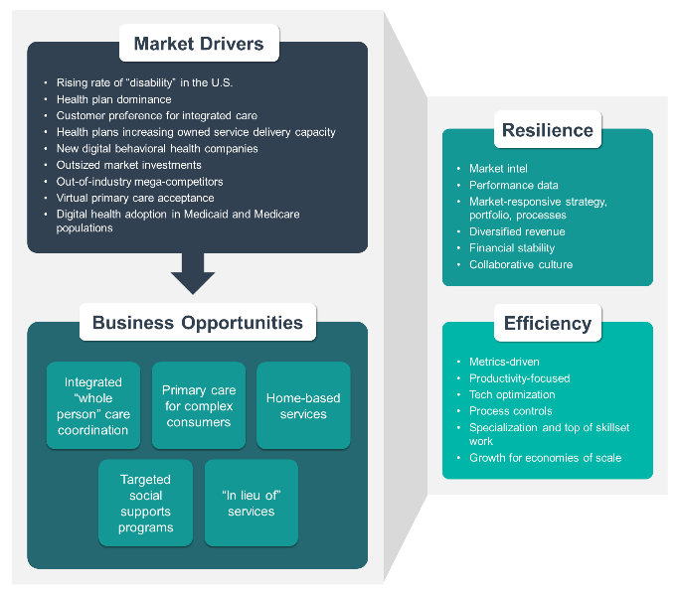
Framework For Post-Pandemic Sustainability

Slide 35
The Big Questions…
What is your “vision” for the market position of your organization’s service lines in the post-crisis period?
What services will be the anchor of margins and sustainability in the new market landscape?
What services do you need to add?
What services do you need to terminate?
What is required to assure competitive positioning – merger, technology, contracts, new service model, etc.?
Can your organization maintain financial stability in the ‘next normal’ at its current scale?
Does your organization’s mission need to change?
Keys To Executive Strategy Leadership
Vision and mission as the foundation
Sustainable business model as the focus
Understanding of impact of future scenarios

Slide 36
Strategic Market Positioning Options
Cash-paying market niche – great specialty in right geography
Low-cost provider of specific services
Center of excellence – state-of-the-art service with demonstrated outcomes for hard-to-treat conditions
“Preferred” health plan (and other payer) contracting
Direct-to-consumer
Direct-to-consumer
Payer- health plan
Direct-to-consumer
Payer- health plan
Payer- health plan

Slide 37
Thinking About The ‘Next Big Thing’…
Community-based
Those four market positioning options provide a framework to identify a profitability replacement for traditional services The “Next Big Thing” for the service line portfolio
Tech-enabled
Customer-centric
High Value
Data-driven
Risk-based

Slide 38
The Big Strategy Questions
The diversification question
The scale question

Slide 39
2. Framework For Strategy Development For Maintaining Post-pandemic Competitive Advantage Key strategy questions Strategy development best practices Strategy leadership roadmap

Slide 40
The OPEN MINDS Strategic Planning Process
Phase I: Situation Analysis – Where We Are & Where We Want To Be
Phase II: Strategy Development With Tactics, High-Level Implementation Plan, & Timeline
Phase III: Detailed Implementation Planning, Budgeting & Feasibility Analysis
Phase IV: Strategy Implementation

Slide 41
The Performance Measurement-Strategy Link
Strategy
Organizational Performance Measurement
Organizational Performance Management
Payer/Health Plan Contract Performance
Culture Change
Access Measures — Price, Time to Appointment, Convenience, Etc.
Consumer Experience
Clinical & Service Performance
Revenue, Margins, & Financial Sustainability
Strategic Initiatives
Development of integrated care approaches and programs
Improved managed care functionality with optimized revenue cycle management
Improved consumer access and engagement
Service line development, diversification, and new revenue streams
New technology investments
Contracts and systems for value-based reimbursement
Margin improvement with operational process reengineering and unit cost management

Slide 42
The OPEN MINDS Key Performance Domains
For Health & Human Service Provider Organizations
“High Performing” On Payer Contracts
The Speed & Cost Factors
The Consumer Experience
Search engine ranking and optimization scores
Inquiries
Inquiry response time
Inquiry conversion rates
Time to appointment
Service rates
Net promoter score
Customer satisfaction
Customer experience monitoring (“mystery shopper”) results
Clinically Cutting Edge
Consistency in “treatment model” – lack of unexplained variability
Current in clinical and service practices
Financial Sustainability
Revenue – by service line
Liquidity – current ratio, days cash outstanding, cash flow from operations, days of accounts receivable
Profitability – revenue growth and net operating profit margin, by service line
Leverage – debt to equity ratio
National health home measures
NCQA HEDIS measures
CMS STARS measures
Most common health plan contract measures
Specific health plan contract measures
Specific funder performance measures
Online reputation
Rate-value linkage
Short time to evaluation and adoption of new treatment technology

Slide 43
Data-Driven Decisionmaking – Experience Is Not Enough Right Now
The OPEN MINDS Framework For Building A Data-Driven Organization
Advantage goes to the organization with the right data – fast….
Even in a crisis, it’s important to focus on building a data-driven team
Data reinforces objectives – and promotes order over control
Data supports communication as creates a common vocabulary and understanding
1. Market-Driven Strategy & The Metrics Of Success
3. The “Wish List” Of Metrics – Prioritized With Feasibility Assessment
4. Select The C-Suite Base Metrics Set
5. Operationalize The C-Suite Base Metrics Set In An Automated Ongoing Reporting Format
6. Practice Data-Driven Decision Making @ The C-Suite Level
7. Add High-Value Metrics That Require Investment (The ROI Question)
8. Extend Data-Driven Decision Making Within The Organization- With Transparency
11. Share Selected Performance Data With External Stakeholders
10. Add Performance-Based Elements To Team Compensation
12. Share Real-Time Performance Data With Partners
2. C-Suite Technical Assistance – Linking Strategy To Metrics
9. Organization-wide Education On Using Metrics In Service Delivery

Slide 44
The OPEN MINDS Framework For Building A Data-Driven Organization
1. Market-Driven Strategy & The Metrics Of Success
3. The “Wish List” Of Metrics – Prioritized With Feasibility Assessment
4. Select The C-Suite Base Metrics Set
5. Operationalize The C-Suite Base Metrics Set In An Automated Ongoing Reporting Format
6. Practice Data-Driven Decision Making @ The C-Suite Level
7. Add High-Value Metrics That Require Investment (The ROI Question)
8. Extend Data-Driven Decision Making Within The Organization- With Transparency
11. Share Selected Performance Data With External Stakeholders
10. Add Performance-Based Elements To Team Compensation
12. Share Real-Time Performance Data With Partners
2. C-Suite Technical Assistance – Linking Strategy To Metrics
9. Organization-wide Education On Using Metrics In Service Delivery
Advantage goes to the organization with the right data – fast….
Even in a crisis, it’s important to focus on building a data-driven team
Data reinforces objectives – and promotes order over control
Data supports communication as creates a common vocabulary and understanding
Metrics are the key to prioritizing investments in improving customer value.
Adopt a ‘strategic quality’ approach - focused on improving service attributes that are most important to customers.
There is nothing so useless as doing efficiently that which should not be done at all.
Peter Drucker
Make metrics a key element in compensation and promotions
Use performance data for marketing advantage
Build partnerships with data transparency

Slide 45
2. Framework For Strategy Development For Maintaining Post-pandemic Competitive Advantage Key strategy questions Strategy development best practices Strategy leadership roadmap

Slide 46
What Do Leaders Need To Do To ‘Transform’ Their Organizations?
1. Constantly monitor the market that matters – and go beyond your comfort zone for strategic insight
(Be in it…)
3. Create a sustainability-focused strategy
(Think vision, mission, and bottom line…)
4. Be laser-focused on step-by-step plan for implementing that strategy
(Get out your pointy boots…)
2. Build organizational resilience and efficiency as the foundation for success
(Success demands lots of Qi…)
5. Monitor (and communicate) your strategy implementation metrics – obsessively
(Know the score early…)
6. Be willing to be wrong – and make prompt course corrections to strategy
(Humility and flexibility are key…)
The leadership roadmap is simple to describe and very hard to do…

Slide 47
The OPEN MINDS Five-Step Cycle For Strategy Implementation
1. Translate objectives and strategies into tactics and measurable performance
2. Do “action detailing” - create the operational workplans with specific roles and responsibilities
3. Sync the plan and plan investments and staffing with budgets & operating plans
4. Get leadership buy-in and engage team members at all levels
5. Measure progress, course correct, and plan for the unexpected

Slide 48
“No Excuses” Is The Rule
Plans fail for two reasons – the wrong plan or poor execution
Monitor performance – if the results are not there, either change the plan or change execution of the plan and people – promptly

Slide 49
Building The Sustainable Organization For The “Next Normal”
Metrics driven
Ongoing market intelligence on customers and competitors
Productivity focused
Real-time internal performance data
Leverage and optimization of technology
Market responsive, nimble strategy/portfolio and processes
Efficiency
Resilience
Strong process controls for quality and replicability
Diversified revenue stream
Specialization and “top of skillset” work
Financial stability and cash reserves
Growth for economies of scale
Collaborative culture across management silos
49

Slide 50
Ten Best Practices For Organizational Sustainability
Data-driven decision making – Metrics-based management to facilitate prompt data-driven decision making across the organization
Sustainability-focused strategic planning with market analysis, portfolio analysis, and scenario analysis
Marketing framework – market positioning, revenue/business development, stakeholder communication, pricing
Standardized innovation and service line development process
Customer-focused service delivery design and management
Infrastructure for hybrid service delivery in integrated systems – and other new business models
Infrastructure to support working with health plans – managed care, value-based reimbursement, risk sharing
Workforce optimization strategy and practices
Standardized processes for technology strategy, prioritization, selection, implementation, and optimization
Monitoring and improvement of organizational financial strength

Slide 51
So What If It Isn’t Working?
Be willing to say so
Is it?
Adjustment
The plan
The implementation
The changing market
Solutions?
Pivot
Merger or sale

Slide 52
The leader’s primary role is to provide vision and a plan – and then seek order, not control
Don’t be too busy with the urgent to think - and take a wide view
Bad leadership decisions have a larger negative impact in this turbulent environment
Don’t get too attached to any vision or plan – you are not in control
“Your organization is but a leaf on the river of life…”
Leadership Matters More Than Ever

Slide 53
“The greatest danger in times of turbulence is not the turbulence –
it is to act with yesterday’s logic.”
Peter Drucker

