Slide 1
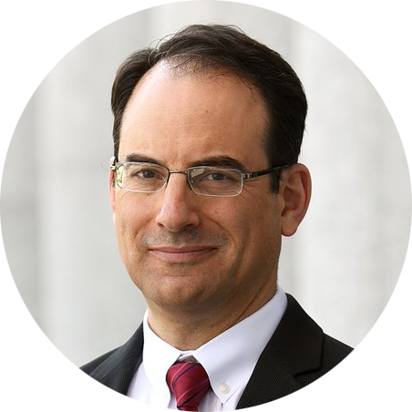
Phil Weiser
Heidi K. Williams
Colorado Attorney General
Director, Opioid Response Unit
A Colorado Model: Getting to Yes

Slide 2
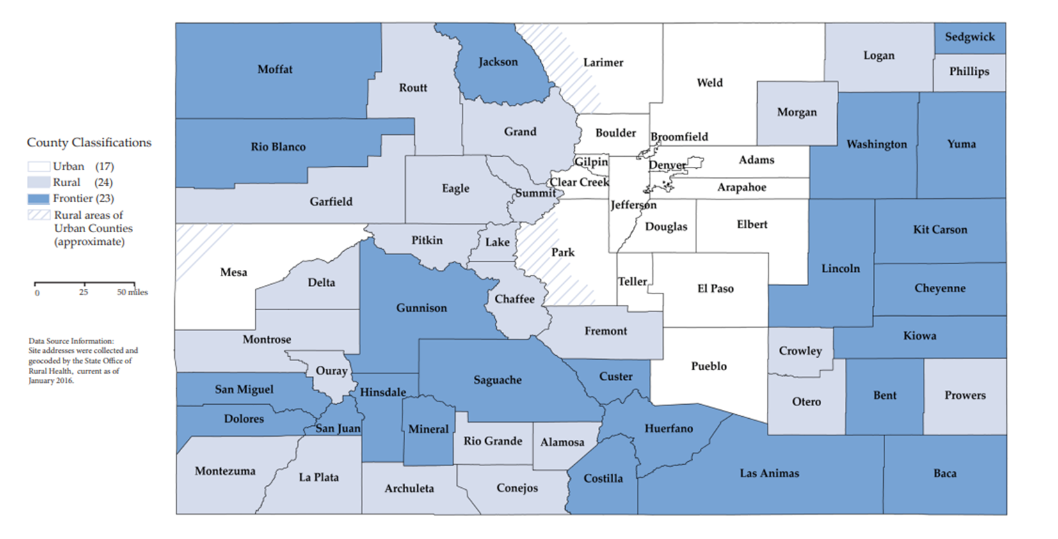
Colorado’s Diverse Population

Slide 4
Core Principles for
All Colorado Plan
Utilize
Existing
Infrastructure
To the Extent
Possible
Ensure
Equity for All
Local Governments
Maximize
Settlement Funds

Slide 5
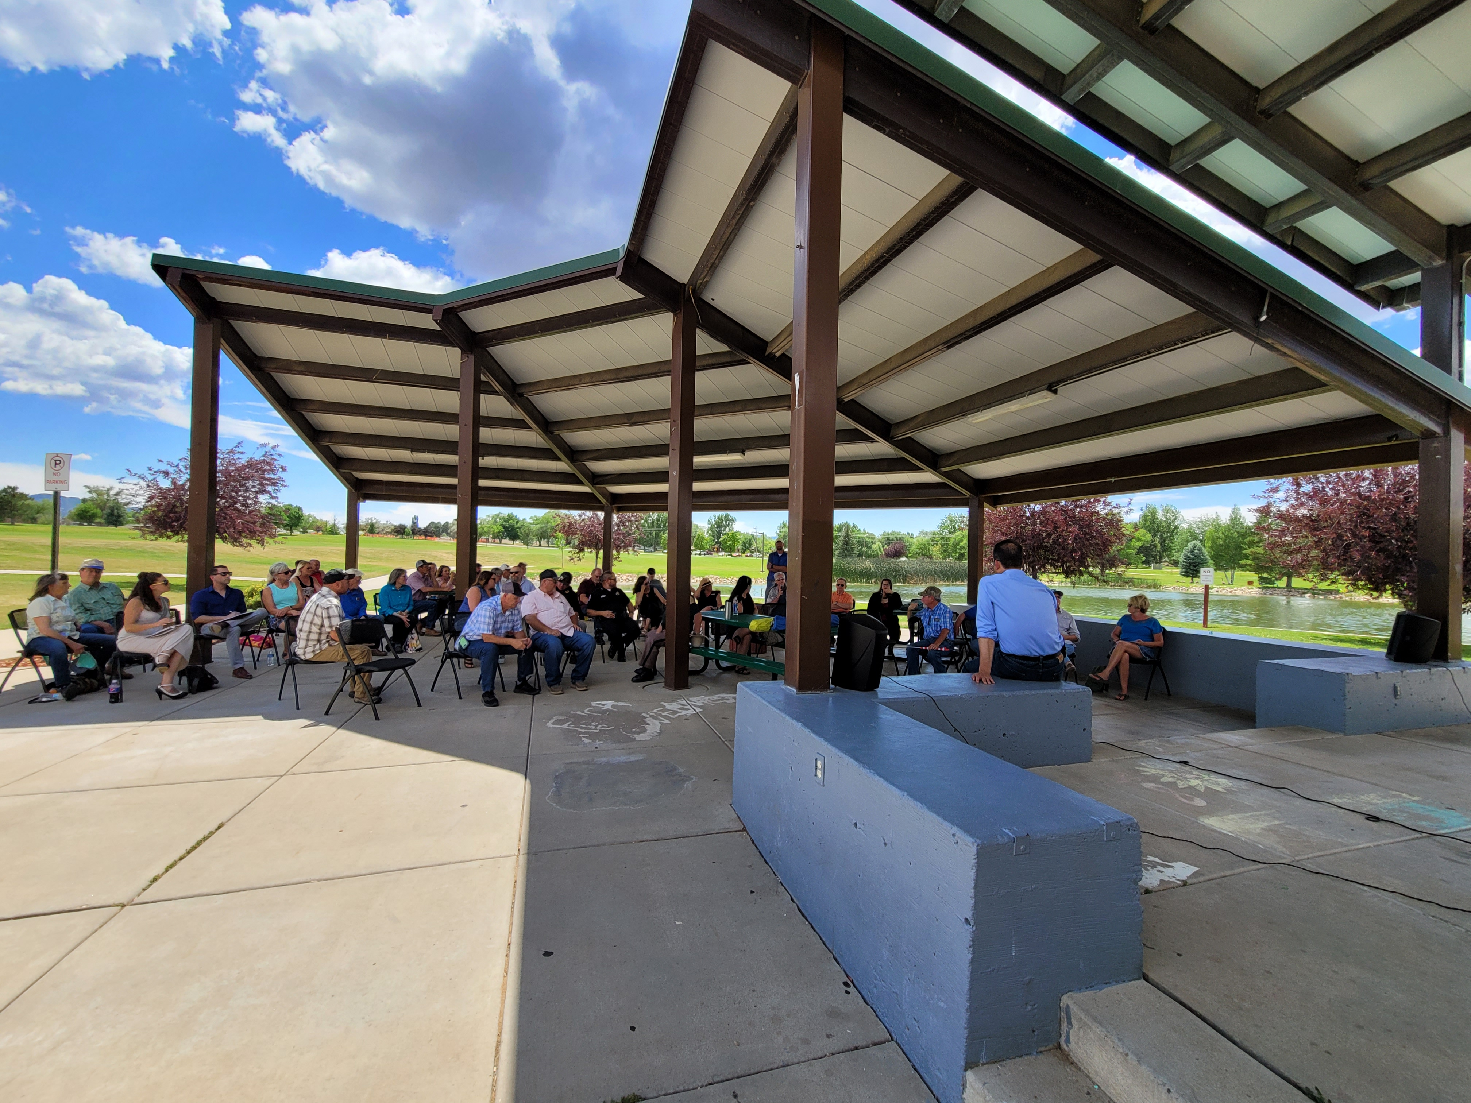
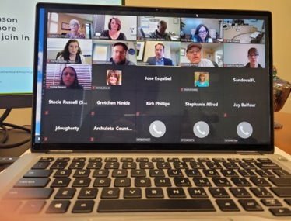
Colorado Attorney General - Outreach

Slide 6
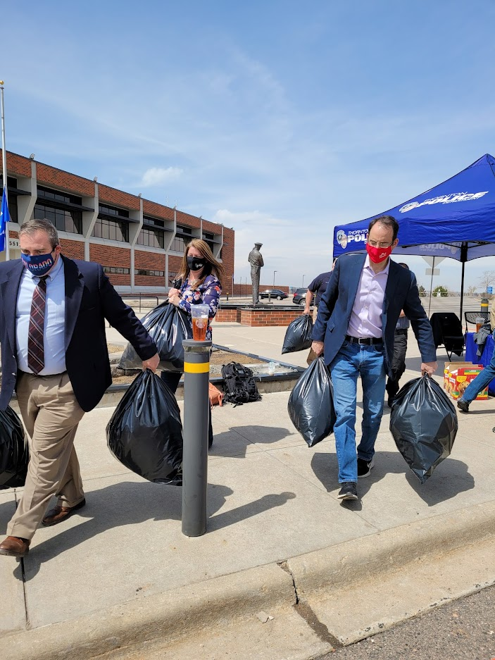
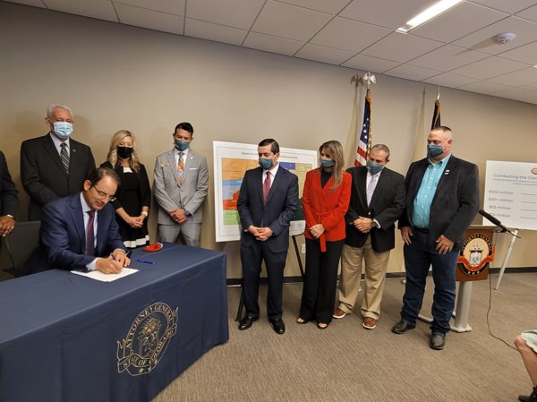
Building the Coalition
Our state framework represents what works in Colorado - local control with state support
THANK YOU!
For signing the Colorado Opioid MOU and settlement releases!

Slide 7
20%
Direct Allocation by Formula to
Participating local Governments
*Requirements – Full Transparency
Colorado
Opioid
Settlement
Funds
Distribution
60%
Regional Opioid Abatement Fund
Formula Allocations to Regions
*Requirement – Full Transparency
10%
Infrastructure Fund – State
This fund will support hard hit areas
in the state with resource needs
*Requirement – Full Transparency
10%
Direct Allocation to State Government
*Requirement – Full Transparency

Slide 8
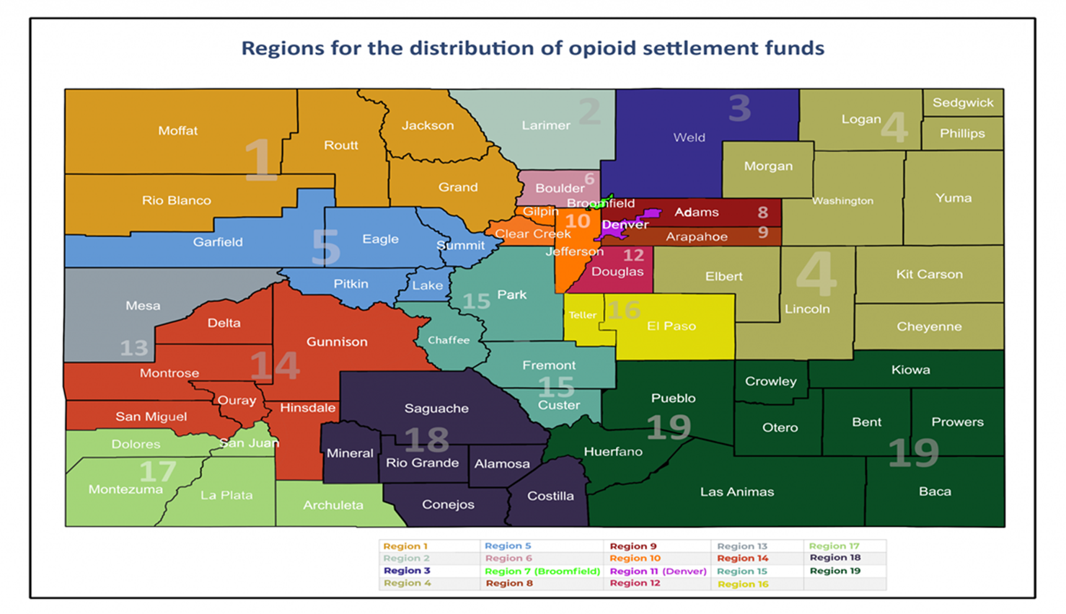
Colorado Opioid Regions

Slide 9
Resources – Best Practices:
PRINCIPLES FOR THE USE OF FUNDS FROM THE OPIOID LITIGATION – Bloomberg school of public health
Evidence Based Strategies for Abatement of Harms from the Opioid Epidemic - Harvard Medical School, Blavatnik Institute for Health Care Policy
Best Practices
Funding – look for ways to “braid” funds
State Opioid Response (SOR) grants from Office of Behavioral Health
(can be used for stimulants and opioids)
ARPA Behavioral Health Funds
Attorney General office grants
Infrastructure fund for rural areas

Slide 10
Opioid Settlement Funds – Allowable Uses
Treatment and Recovery
Evidence-based treatment models
Medication Assisted Treatment (MAT)
Supportive Housing and residential treatment – access to MAT
Mental Health Trauma issues resulting from opioid use
Expand Telehealth to increase access to treatment, MAT, counseling, psychiatric support and other forms of treatment services
Addiction Medicine Workforce Development
Scholarships for Certified Addiction Specialists
Prescription Drug Monitoring Program
Continuum of Care (Warm Hand-Offs/Hub and Spoke Models
Gender specific Care (Women, Children, families, etc.)
Opioid Crisis Response Plan (Colorado)

Slide 11
Opioid Settlement Funds – Allowable Uses
Intervention
Evidence-based treatment models
Health Care Provider screening for Opioid Use Disorder (OUD) and other risk factors
Health Care Provider know how to appropriately counsel, treat/refer patient for OUD Treatment
Screening, Brief Intervention and Referral to Treatment (SBIRT) programs
Training and long-term implementation of SBIRT in key systems (health, schools, colleges, criminal justice and probation)
Training for ER personnel – MAT induction, post-discharge planning, warm hand-offs
School based contacts for parent resources
Develop best practices on addressing OUD in the workplace
Engage non-profits and faith community as a system to support outreach for treatment
Opioid Crisis Response Plan (Colorado)

Slide 12
Opioid Settlement Funds – Allowable Uses
Criminal Justice
Innovative treatment, diversion strategies
and wrap-around services
Address the needs of persons involved in the criminal justice system who have OUD and co-occurring SUD or mental health issues
Support pre-arrest diversion and deflection strategies
Support pre-trial services
Support treatment and recovery courts – including referrals to MAT or other evidence based treatment
Including those who are incarcerated, on probation or on parole
Including those who are leaving jail or prison or have recently left jail or prison
Support Continuum of Care/Warm Hand-Offs/Hub and Spoke model
Opioid Crisis Response Plan (Colorado)

Slide 13
Opioid Settlement Funds – Allowable Uses
Prevention & Education
Widespread prevention and education efforts
Among communities
Any campaign that implements evidence-informed prevention, such as reduced social and physical access, stigma reduction – including staffing, educational campaigns, or training of coalitions in evidence-informed implementation
Prescribing Practices (Colorado Consortium for Rx Drug Abuse Prevention)
Misuse of Opioids
Safe Disposal
Fentanyl Awareness (Email Heidi for social media toolkit)
School based programs
Community Coalitions
Non-profit and faith community
Opioid Crisis Response Plan (Colorado)

Slide 14
Opioid Settlement Funds – Allowable Uses
Harm Reduction
Strategies for reducing or mitigating the Negative consequences associated with Substance use
Increase availability and distribution of naloxone
First responders
Overdose patients
Opioid users
Family and friends of opioid users
Schools
Community navigators and outreach workers
Drug offenders upon release from jail/prison
Other members of the general public
Syringe service programs
Access to testing and treatment for infectious diseases such as HIV and Hepatitis C resulting from IV opioid use.
Opioid Crisis Response Plan (Colorado)

Slide 15
Opioid Settlement Funds – Allowable Uses
Other
Regional Planning to identify goals for opioid reduction and support efforts or to identify areas and populations with the greatest needs for treatment intervention services
Government dashboard to track key opioid-related indicators and supports as identified through collaborative community processes
Staffing and training
Funding for programs and services regarding staff training and networking to improve staff capability to abate the opioid crisis.
Support infrastructure and staffing for collaborative cross-systems coordination
Administrative costs for any of the approved purposes in the MOU (Exhibit A) – not to exceed 10%
Opioid Crisis Response Plan (Colorado)

Slide 16
Colorado’s Opioid Crisis

Slide 17
Timeline:
Opt-Out: June-July 31, 2022
Second payments made to National Administrator – July 15, 2022
Colorado Opioid Abatement Council Annual Conference August 15/16
300 attendees from around the state of Colorado
50+ speakers
Two-Year Plan Due for all other regions:
September 15, 2022
November 1, 2022
December 15, 2022
Settlement funds distribution: 4th Quarter
Amended Two-Year Plan: March 15, 2022
Ongoing technical assistance for regions and local governments
Complete
Ongoing

Slide 18
Colorado’s Opioid Crisis

Slide 19
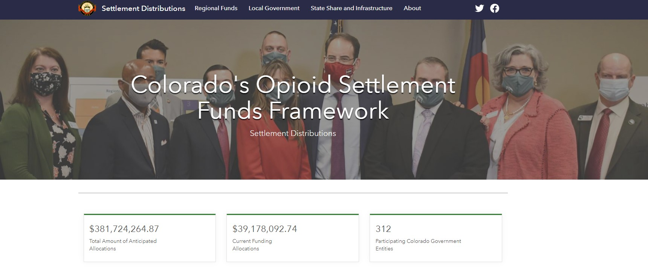

Slide 20
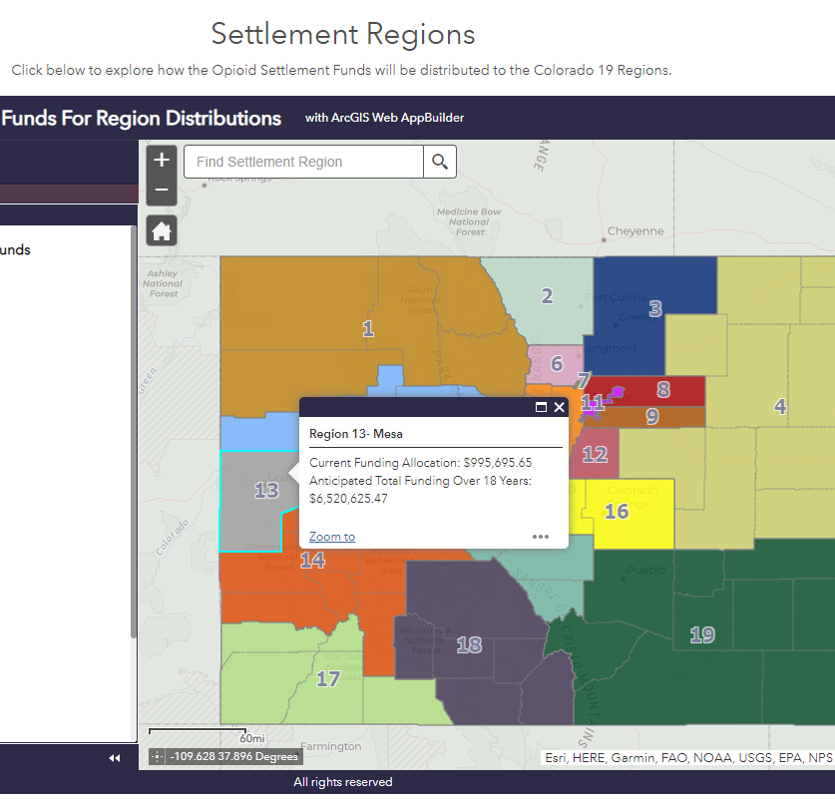
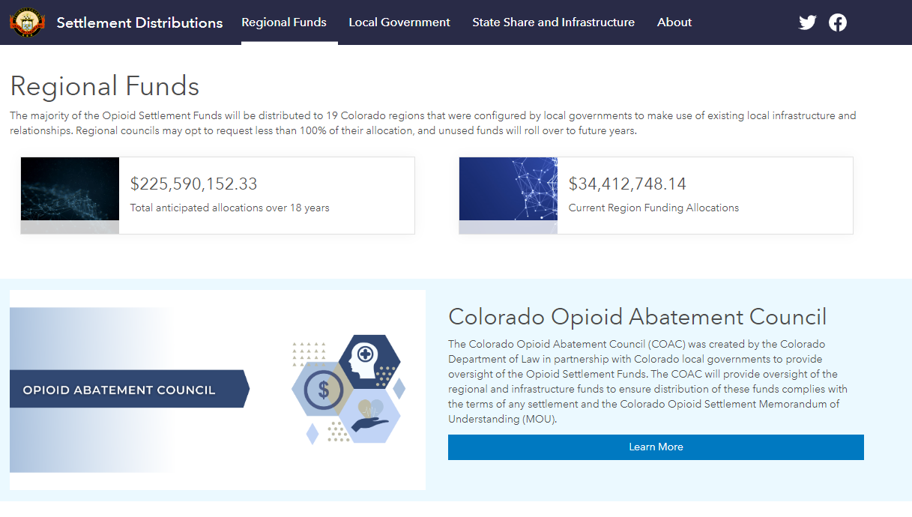
Notes:
Regional Fund page with interactive region map that shows the current and anticipated total funding for each region.
Page Includes:
Total anticipated regional allocations
Current first year allocations
Interactive map – site visitors can select the regions and will receive a pop-up with the region funding data
Outcome data will be added when data becomes available

Slide 21
Notes:
State and Infrastructure share information.
Page includes:
Total State and Infrastructure Share anticipated allocations
Current first year allocations
Additional expenditure information will be added when available

Slide 22
Notes:
Resource section highlighting the Abatement Council and the Advisory Committee.
Section Includes:
Abatement Council
Advisory Committee
Links to additional resources
Sign-up option to the DOL opioid newsletter

Slide 23
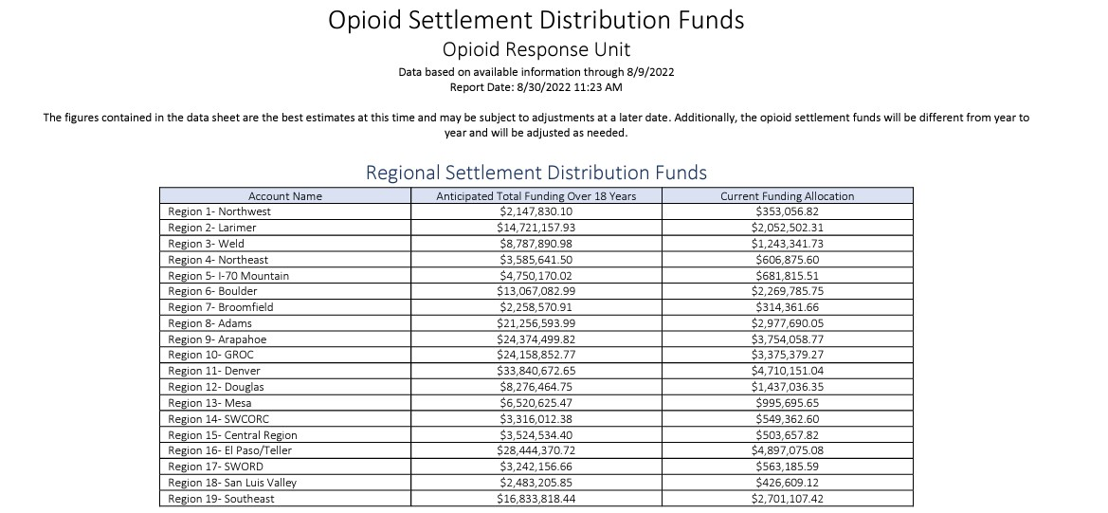
Click Here
To Pull Up Table Here

Slide 24
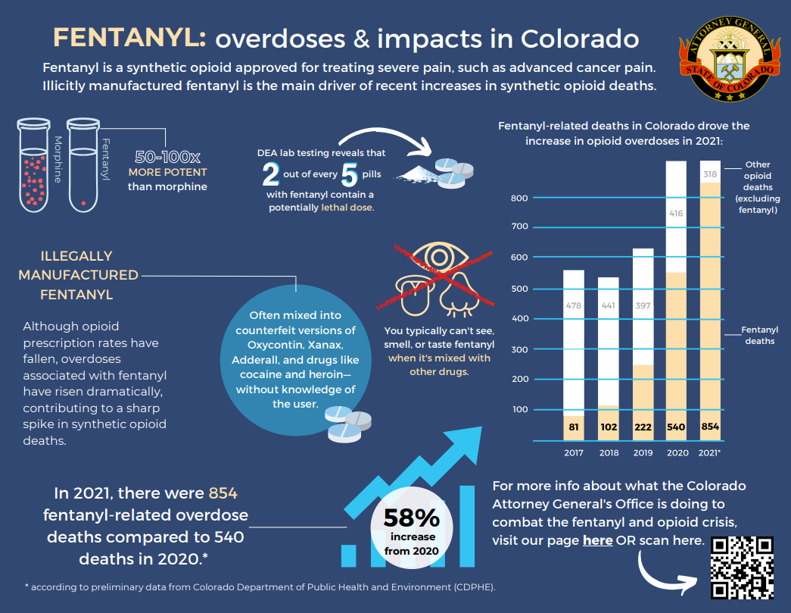
Fentanyl Awareness Social Media Kit
Infographic Link
Email us for the full toolkit:
opioids@coag.gov

Slide 25
Questions?
?
Resources
Exhibit A – Allowable Uses
Colorado’s Opioid Settlement Funds Framework
Opioid Crisis Response Plan (Colorado)
Colorado Memorandum of Understanding
COAG.GOV/OPIOIDS
Heidi Williams – Director of Opioid Response
Heidi.Williams@coag.gov
720-508-6098

