Slide 1
A Conceptual and Practical Model for Trauma Treatment
Janine M. D’Anniballe, Ph.D.
Director of Psychological Health and Performance
University of Colorado, Boulder

Slide 2
What is Psychological Trauma?
DSM-5-TR definition: actual or threatened death, serious injury, or sexual violation
  Responses include: intrusion, avoidance, changes in cognitions and/or mood, physical reactivity
  Single incident event examples
  Cultural and environmental considerations
  Genetic considerations (e.g., amygdala reactivity)
  BUT … what is missing?

Slide 3

What is Psychological Trauma
Complex Trauma (C-PTSD)
Comes from longer-term repetitive patterns of painful events
Chronic misattunement with caregiver(s)
Examples?
Themes?

Slide 4
C-PTSD: Impact and Adaptive Responses
  Difficulty with self-concept or identity
  Challenges with emotional regulation
  Interpersonal difficulties
  Shame
  Dissociation
  Vulnerabilities to addiction

Slide 5

Trauma – a painful past experience that affects us in the present.

Slide 6

Common Treatment Goal with any Trauma: Move the Nervous System from Dysregulation to Regulation

Slide 7
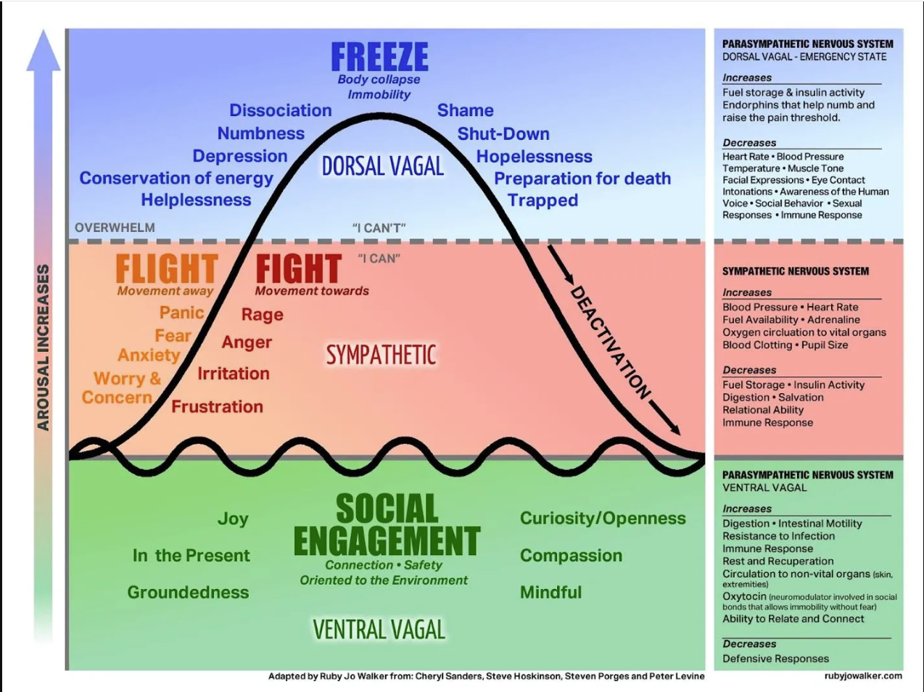

Slide 8

Four Stages of Trauma Treatment
(Judith Herman, Daniel Siegel, Christine Courtois, Bessel Van derKolk)
Therapist Getting Grounded First

Slide 9
Assumptions of this Treatment Model
Non-linear
Phase II is not the “standard”
Therapist is actively engaged in healing their own trauma

Slide 10
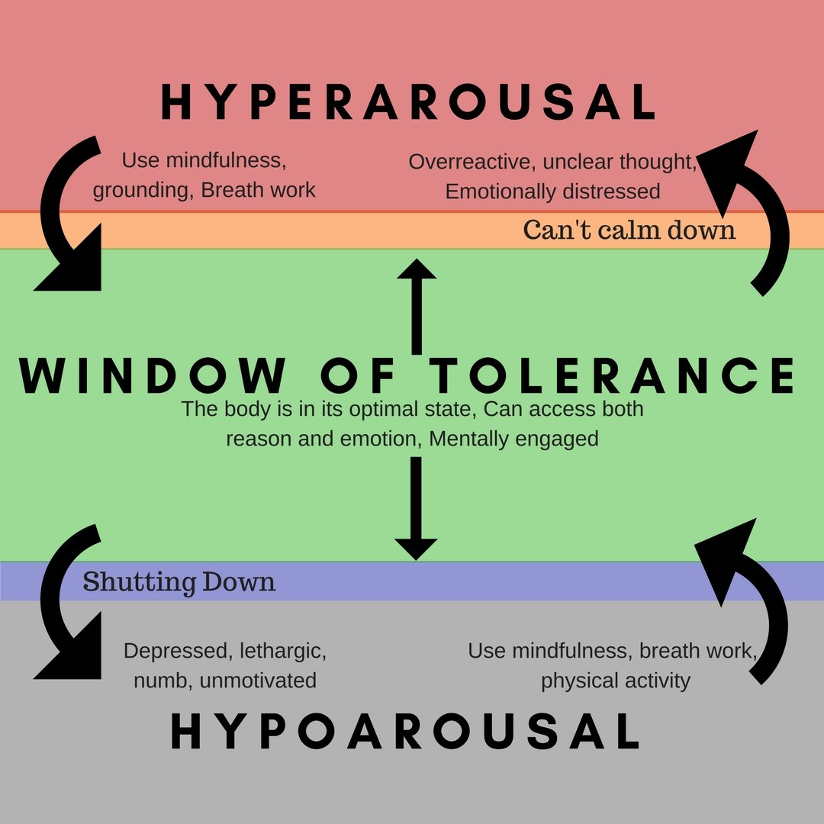

Slide 11

Phase I: Establishing Safety
Psychoeducation
Safety and safety planning
Symptom reduction
Emotion regulation
Coping skills
Support
Don’t Sleep on Phase I

Slide 12

Phase I: Establishing Safety
Measured in SKILLS not TIME
Use the window of tolerance as the North Star
Identify what takes client out of the window of tolerance

Slide 13
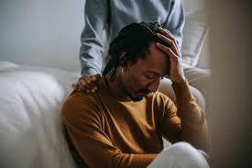
Phase II: Remembrance and Mourning
Goal: create an explicity-remembered narrative account of the harmful event(s)
By facing and resolving the intrusive memory, there can be more control

Slide 14

Readiness for Phase II
sufficient safety
favorable life circumstances
good therapeutic relationship
willing to engage with traumatic content

Slide 15

Readiness for Phase II
possess range of affect regulation skills and uses them
support
general sense of sufficient resilience

Slide 16


Slide 17

Phase II: Remembrance and Mourning
Approaches:
Pairing memory with affect
Acknowledging and processing somatic or implicit memory (not just an intellectual discussion)
Naming and grieving losses

Slide 18

How do you know if Phase II work is effective?
Denial and minimization reduce
Client stays in the window of tolerance (in and out of session)
Client remains present while remembering the past

Slide 19

How do you know if Phase II work is effective?
Client is in control of the remembering
Decreased dissociation
Awareness of the body

Slide 20

Phase III: Integration and Reconnection
Applying trauma’s impact in relation to current life challenges
Making meaning
Intimacy and sexuality
Working on physical health

Slide 21

Phase III: Integration and Reconnection
Parenting skills
Career choices
Enhancing relationship with self and others

Slide 22

Phase III: Reconnection and Integration
Taking risks to trust
Reworking identity
Values, needs, and wants
Identifying triggers
Working with limiting beliefs

Slide 23


Phase IV: Truth and Repair
Themes of justice and accountability (formal and informal)
Truth-telling to bystanders, enablers, and misresponders
Empowerment and social change
Judith Herman, MD

Slide 24
Question:
How might you work with accountability and repair of bystanders?

Slide 25

Phase IV: Trauma-Centered Social Justice (TCSJ)
Recognizes the impact of emotional abuse on people and communities while striving for social justice
Particularly in the #BlackLives Matter, #MeToo, and Climate Justice social justice movements
Noa Ben-Asher, JD
St. John’s University School of Law

Slide 26


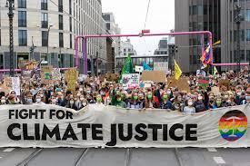
Trauma-Centered Social Justice
Intersectionality approach
Aims to address root causes of trauma by advocating for systemic changes that promote equity and justice.

Slide 27

Brainstorm for Activism Ideas
Sexual violence
Gun violence
Identity-based violence
Environmental abuse

