Slide 1
Colorado Behavioral Health Landscape: Legislation, Budget, Policy, Politics
CBHC
Notes:
EDS: kick off, explain different title and broader focus

Slide 2
What we’ll cover
CBHC Team
Policy lookback:
BH reform over last decade, 2024 legislative session
Looking ahead
Budget, 2025 session expectations, CBHC policy priorities
Q & A
Notes:
Edie

Slide 3
The CBHC Team
Kara Johnson-Hufford
Frank Cornelia
Edie Sonn
Chief Executive Officer
Deputy Executive Director
Senior Director of External Affairs
Betsy Molgano
Veronica Bell
Brittany Langevin
Program Manager & Policy Analyst
Public Policy Specialist
Administrative Director
Notes:
Edie

Slide 4
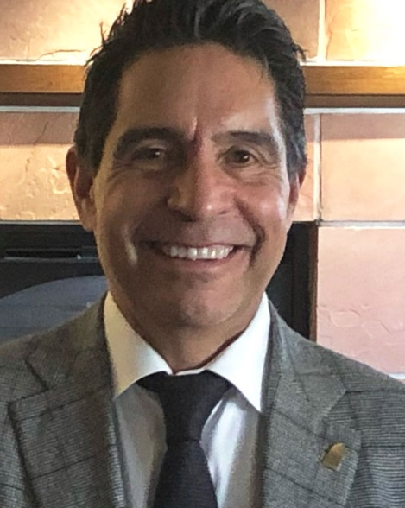
CBHC Advocacy Team
Gil Romero
Karen Wick
Principal/Attorney
Capitol Success Group
Principal Strategist
Swift Strategies
Notes:
Edie

Slide 5
We Envision Resilient Communities and Mental Wellbeing for all Coloradans
About CBHC
Who we are
What we do
We are an association of providers offering mental health and substance abuse treatment in communities across Colorado.
We respond to community needs with a spectrum of care – outpatient, crisis, residential, wraparound services - for our state’s most vulnerable individuals.
We carry out our work in partnership with policymakers and community partners to provide access to quality care throughout Colorado.
Notes:
Edie

Slide 6
Notes:
Edie

Slide 7
Notes:
Edie

Slide 8
A Rapidly Changing System
Opioid and Other Substance use Disorders Interim Study Committee
Competency and Restoration Services
ACC Re-procurement
Crisis System Re-procurement
ACA Passed
Amendment 64
SB14-215: Disposition of Marijuana Tax Revenue
SB16-202: Increasing Access Effective Substance Use Services
Pandemic and State Budget Crisis
Redefined Safety Net System under BHA Authority
2010
2012
2013
2014
2015
2016
2017
2018
2019
2020
2022
2024
SB13-200: Expand Medicaid Eligibility
SB13-266: Coordinated Behavioral Health Crisis Response
Governor Hickenlooper Plan to Strengthen Colorado’s Crisis System – Budget Actions
State Innovation Model (SIM) Demonstration
SB17-207: Strengthening Colorado’s Statewide Response to Behavioral Health Crises
HB19-1237: Behavioral Health Facility Licensure
Governor Polis Creates Behavioral Health Task Force
HB22-1278
Behavioral Health Administration, ARPA $$
Notes:
Frank
Don’t go into detail on this – note SIGNIFICANT pace of change over last 10 years
- Crisis system
- Medicaid reform
Complex new safety net structure
Don’t be fooled by the fact that we’ve highlighted only a few bills and policy developments – each of these years saw literally dozens of behavioral health-related bills
2024 session: CBHC tracked/engaged on 50+ bills affecting our members

Slide 9
Where Are We Now?
2022 behavioral health reforms taking effect
New provider types
18 comprehensive providers, XX essential providers approved
New Medicaid payment model
New regulatory requirements in effect
New Medicaid managed care (RAE) entities for 7/1/25; Behavioral Health Administrative Service Organizations (BHASO) will be announced shortly
Notes:
Frank

Slide 10
Where Are We Now?
Financing landscape affecting behavioral health
“Unwind” of COVID public health emergency = ↓ Medicaid, ↑ uninsured
Actual disenrollments in some parts of the state significantly higher than projected → significant increases in uncompensated care for some safety net providers
Most of our members’ clients are on Medicaid = majority of centers’ funding is from HCPF
Funding for services to uninsured clients comes from BHA – but there was no increase in BHA funding for this FY
End of ARPA grants
Declining Marijuana Tax Cash Fund $$ (funding for crisis services)
New payment models
Notes:
Edie take unwind – Frank take rest – Karen chime in

Slide 11
Where Are We Now?
2024 legislative and budget developments affecting CBHC’s members
SB 24-007, Mental Health First Aid
HB 24-1045, SUD treatment bill
HB 24-1217, family input form
HB 24-1384, CCBHC
Provider rates
ARPA swap
Notes:
Frank take first two
Edie take rest
Karen chime in

Slide 12
Looking Ahead
Notes:
Edie

Slide 13
Budget
Notes:
Karen

Slide 14
Budget Picture
Outlook: Gloomy
$1B statewide shortfall projected
Departments asked to budget to flat or ↓1%
Medicaid currently $154M in red
Declining Marijuana Tax Cash Fund revenues
Notes:
Karen

Slide 15
Politics, Policy
Notes:
Edie intro Karen to lead off on the “politics” discussion

Slide 16
Legislative Landscape
All House seats in play, ½ Senate
Will Ds keep super-majority in House? Will they get it in Senate?
Implications of that?
Notes:
Karen

Slide 17
Anticipated Legislation from Others
Medical necessity determinations for MH/SUD services
Bills from Interim Committee on Treatment of Persons with Behavioral Health Disorders in the Criminal and Juvenile Justice Systems
Inventory crisis response approaches, funding gaps and strategies
Increase coverage for inpatient SUD treatment
Opportunity to amend BHDCJS bill re: crisis training?
Expand hospital provider fee
Notes:
Edie: Medical necessity determinations
Frank: BHDCJS
Edie: hospital provider fee
Karen: chime in

Slide 18
CBHC Policy Priorities
2025 and beyond
Mend the safety net
Increase community supports for emergency and involuntary treatment
Thoughtfully evolve the regulatory structure to balance accountability and access
Parity
Notes:
Edie lead off
This slide and the next one explain the two foundational pillars of our policy strategy for the foreseeable future
Everything we will work on proactively will be grounded in ensuring that individuals who need access to core safety net services will have it
Frank: Increase community supports
Edie: regulatory
Frank: parity
Mend the safety net –
- (explain what we mean by/are working on re: “community supports for emergency and involuntary tx”)
- Parity – while there is a specific statutory meaning about equivalence between physical health and behavioral health coverage, that’s not the equivalence that matters to safety net providers and the people they serve. Rather, it’s equivalence between Medicaid and commercial coverage. (explain differences between covered services and providers – note this is a long-term play that begins with building a data-driven case – call on providers in the room to send info about denied claims through DOI provider complaint page)

Slide 19
CBHC Policy Priorities
Fund the safety net
Ensure that financing approaches don’t inadvertently jeopardize crucial services
Recognize that many important services we provide are not traditional “safety net” services and are not fully funded
Sustainable capacity funding to sustain continuum of comprehensive services
CCBHC essential for new BH funding – hopefully starting 2026
2025 and beyond
Notes:
Frank: intro, 1st set of bullets Edie: CCBHC
Majority of our members’ funding comes from the state – so it’s essential that we advocate for state funding that enables our members to fulfill their mission
But how do we do this in the face of the budget realities discussed earlier?

Slide 20
CBHC’s Philosophy and Pledge
Partner with HCPF, BHA, other stakeholders to thoughtfully evolve the system
No surprises
Be a constructive problem-solver
Notes:
Edie

Slide 21
Thank You!

