Slide 1
Mental Health Partners
Assembling the Puzzle:
What the CCBHC Model is and Where it Fits in Colorado’s Evolving Behavioral Healthcare Landscape
MHP and Eleos

Slide 2
The Agenda
What is CCBHC
History and national landscape
Model Components, Criteria, and Partnership
Impacts of the model
Why is CCBHC Important in Colorado
PPS Model and Federal Medicaid Match
Value Alignment
National Framework to Achieve State Goals

Slide 3
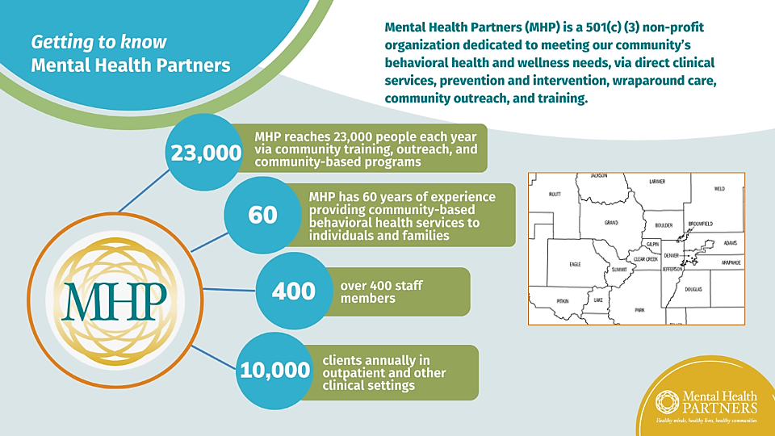

Slide 4
Two types of CCBHC implementation & payment
States implement CCBHCs in Medicaid: Demonstration, SPA, or Waiver
Payment is a bundled rate inclusive of all CCBHC services and activities (prospective payment system, or PPS)
Funding flexes according to need and volume
Payment supports the cost of non-billable activities (such as population health management and data analytics)
Clinic receives CCBHC grant from SAMHSA
Funding is capped at $4M over 4 years
SAMHSA CCBHC grants provide a springboard for program launch, with Medicaid implementation supporting scalability and sustainability.

Slide 5
Federal & State CCBHC Actions Across the Country
Established CCBHC Model through Medicaid Demonstration or Independent Medicaid Pathway
Implementing
Launching CCBHC Model through Medicaid Demonstration or Independent Medicaid Pathway
Previous Planning Grant Recipient & Eligible for Demonstration
Readiness
At least 1 Clinic-level SAMHSA CCBHC Grantee
No State Certified or CCBHC Grantees
State Legislation to Pursue the CCBHC Model

Slide 6
Timeline: Demonstration Expansion
Dec. 2024: Planning grants awarded
July 2026: 10 demo states selected
July 2028: 10 demo states selected
July 2030: 10 demo states selected
April 1, 2026: Demo applications due
July 29, 2024: Planning grant NOFO released
Sept. 12, 2024: Planning grant apps due
States may move forward with a SPA or other Medicaid option on their own timeline and shift into the demo during any expansion cycle

Slide 7
The Agenda
What is CCBHC
History and national landscape
Model Components, Criteria, and Partnership
Impacts of the model
Why is CCBHC Important in Colorado
PPS Model and Federal Medicaid Match
Value Alignment
National Framework to Achieve State Goals

Slide 8
What Is the Certified Community Behavioral Health Clinics (CCBHC) Model?
CCBHC is a national gold standard for high quality behavioral health care
Comprehensive set of criteria with 9 core services and robust quality and outcome measurement
Provides consistent national definition for comprehensive behavioral health providers, similar to FQHC model
How does the model work and who is responsible for what?

Slide 9
CCBHC Model Components
Nine Core CCBHC Services
Crisis mental health services, including 24-hour mobile crisis teams, emergency crisis intervention, and crisis stabilization.
Screening, assessment, and diagnosis, including risk assessment.
Patient-centered treatment planning, crisis planning.
Outpatient mental health and substance use services.
Outpatient clinic primary care screening and monitoring of key health indicators and health risk.
Targeted case management.
Psychiatric rehabilitation services.
Peer support and counselor services and family supports.
Intensive, community-based mental health care for members of the armed forces and veterans.
Certification signifies that the CCBHC provides the full array of federally required services and has a demonstrated person/family centered approach, evidence-based interventions, and culturally and linguistically appropriate services
National Council for Mental Wellbeing CCBHC Success Center https://www.thenationalcouncil.org/program/ccbhc-success-center/

Slide 10
CCBHC Criteria
https://www.samhsa.gov/certified-community-behavioral-health-clinics/ccbhc-certification-criteria
Staffing
Availability and Accessibility of Services
Scope of Services
General staffing requirements
Licensure and credentialing of providers
Cultural competence and other training
Linguistic competence
General requirements
Requirements for timely access to services and initial and comprehensive evaluation for new consumers
Access to crisis management services
No refusal of services due to inability to pay
Provision of services regardless of residence
General service provisions
Requirement of person-centered and family-centered care
Crisis behavioral health services
Screening, assessment, and diagnosis
Person-centered and family-centered treatment planning
Outpatient mental health and substance use services
Outpatient clinic primary care screening and monitoring
Targeted case management services
Psychiatric rehabilitation services
Peer supports, peer counseling, and family/caregiver supports
Intensive, community-based mental health care for members of the armed forces and veterans
Quality and Other Reporting
Data collection, reporting, and tracking
Continuous Quality Improvement (CQI) Plan
Care Coordination
General requirements of care coordination
Care coordination and other health information systems
Care coordination agreements
Treatment team, treatment planning, and care coordination activities
Organizational Authority, Governance, and Accreditation
General requirements of organizational authority and finances
Governance
Accreditation

Slide 11
Partnerships are a core component of the CCBHC model
Connections with other providers in the community are central to the model
Specific partnerships are driven by community needs assessment and state decision making
Partnerships are supported through PPS:
Required services/activities involving partners (e.g., care coordination)
Staff time spent building and managing partnerships
Technologies that enable effective partnerships (e.g., electronic information exchange)
Staff training and education
Two primary types of partners:
“Designated Collaborating Organization” (DCO)
Care Coordination partners

Slide 12
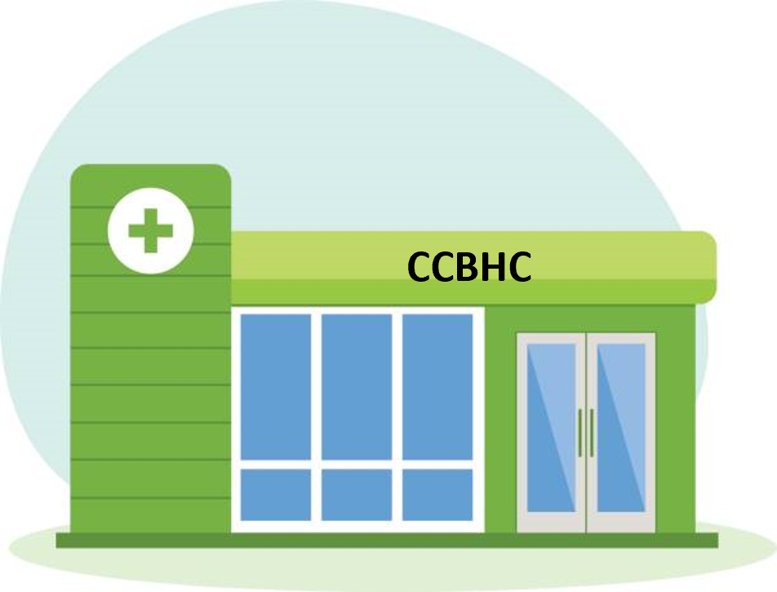
The CCBHC-DCO Relationship
A DCO is an independent organization that may fill gaps in, or supplement, CCBHCs’ required services.
CCBHC standards & requirements
CCBHC standards applicable to DCO
DCO
CCBHC PPS payment
Negotiated DCO rate
Encounter info
Encounter info
State
Data sharing
Data sharing
Collaboration & integration

Slide 13
Care Coordination Partnerships
SAMHSA criteria list required and optional partnerships; states can refine requirements based on local/state needs
Required partnerships examples: FQHCs, hospitals, schools, child welfare agencies, juvenile and criminal justice agencies
Optional partnerships examples: homeless shelters, employment services systems, peer-operated programs, Indian Health Service or other tribal programs, specialty providers
Criteria articulate expectations for care coordination, with CCBHCs playing an active leadership role in working collaboratively with partners across sectors and ensuring clients access all needed services
CCBHC

Slide 14
The Agenda
What is CCBHC
History and national landscape
Model Components, Criteria, and Partnership
Impacts of the model
Why is CCBHC Important in Colorado
PPS Model and Federal Medicaid Match
Value Alignment
National Framework to Achieve State Goals

Slide 15
CCBHCs’ Reach (as of March 2024)
Medicaid CCBHCs reported average client increases of 33% since becoming a CCBHC.

Slide 16
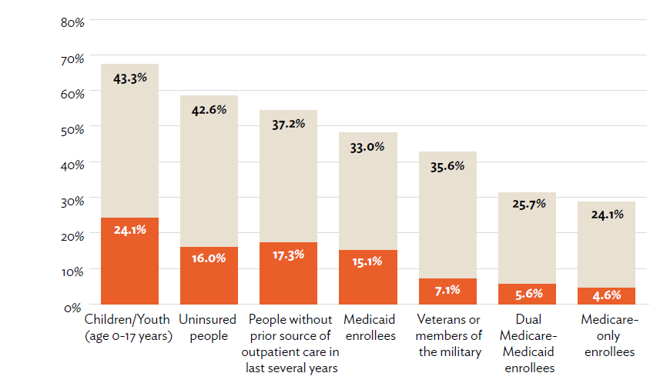
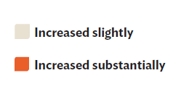
Percent of CCBHCs Reporting Increases in Clients Served, by Group

Slide 17
Reduced Wait Times for Care
More than 8 in 10 Medicaid CCBHCs and established grantees report seeing patients for routine needs within 10 days of the initial call or referral.
65% offer access within one week or less.
21% offer same-day access to routine services.
The national average between an individual’s first outreach/referral until their first appointment is 48 days.

Slide 18
Expansion of Access Points and Strategies
Many respondents reported the model has enabled them to open more flexible pathways to access, through community-based services and partnerships with other community entities.
The model also supports more flexible staffing models that improve client access and engagement.

Slide 19
CCBHC Status Supports Increased Hiring
98% of Medicaid CCBHCs and established grantees increased their number of staff positions since becoming a CCBHC.
CCBHCs reported creating 11,292 new staff positions.
This includes 3,267 newly created positions among rural CCBHCs.
A median staff increase of 15 new staff positions per clinic were created across the 346 responding Medicaid CCBHCs and established grantees.
Significantly more staff positions were created by Medicaid CCBHCs, with a median of 22 new positions per clinic, than by established grantees, with a median of 12 new positions per clinic.

Slide 20
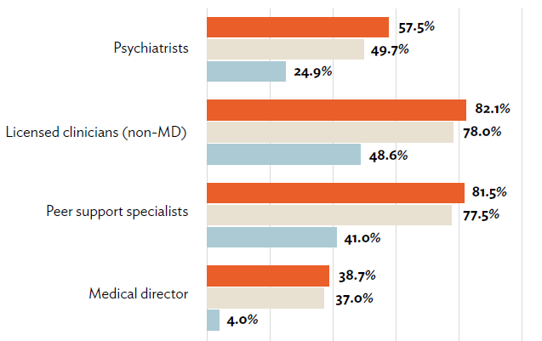
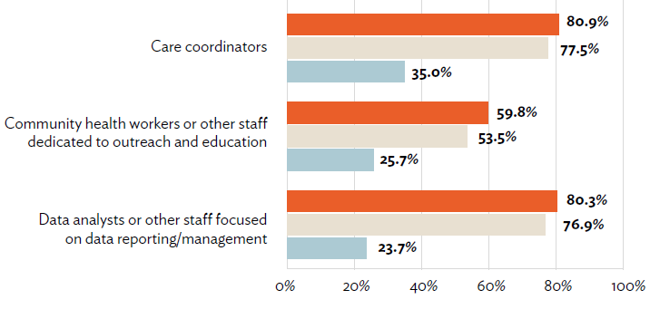
New Staff Positions Created by CCBHCs*
*See full report for data on additional types of staff positions.

Slide 21
The Agenda
What is CCBHC
History and national landscape
Model Components, Criteria, and Partnership
Impacts of the model
Why is CCBHC Important in Colorado
PPS Model and Federal Medicaid Match
Value Alignment
National Framework to Achieve State Goals

Slide 22
CCBHC Prospective Payment System (PPS)
CCBHC offers four Prospective Payment System (PPS) options, which may be paid through managed care contracts or as wraparound payment by the state.
PPS-1: Daily
One payment per client for any day in which the client receives at least one encounter. “Encounter” is defined by the state.
Optional quality bonus payment
PPS-2: Monthly
One payment per client for any month in which the client receives at least one encounter. “Encounter” is defined by the state.
Quality bonus payment
*Optional special populations stratified rate
PPS-3: Daily
*Special crisis services PPS rates
Optional quality bonus payment
PPS-4: Monthly
Quality bonus payment
*Special crisis services PPS rates
*Optional special populations stratified rate

Slide 23
PPS makes the model work
PPS allows CCBHCs to:
Cover the real costs of direct services – incl. new requirements, new ways of doing business
Build in costs associated with indirect services, non-billable activities, and other responsibilities aimed at achieving state goals, such as:
Care coordination; Outreach and engagement; Adopting and maintaining EBP fidelity; Data collection and reporting; Technology adoption
And more…
Accommodate differences in service and staffing array, client needs, regional differences, etc. with a clinic-specific payment rate
Data from CCBHC demo shows convergence of rates with CCBHC costs over time.
States review cost reports, work with clinics to revise (not a blank check)

Slide 24
Driving value through CCBHCs
CCBHC Status
Certification = standard core requirements tailored to state needs
PPS = Medicaid reimbursement that supports costs associated with expanded access & enhanced operations
States can work backward up this chain by articulating goals, identifying what operations and service delivery changes will drive success, and ensuring those services & activities are included in criteria, PPS rates, and data collection / reporting / sharing
Enhanced Operations
Expansion of service lines (e.g., crisis response, SUD treatment)
Ability to hire and retain specialty providers, mitigate workforce shortage
Same-day access to care
High-impact, flexible staffing models targeted to patient need
Technology adoption, electronic health info exchange
Collaboration/coordination with law enforcement, schools, others
Data tracking & analytics
Population health management, data-driven care
Improved Outcomes
More clients served
Elimination of waitlists or reduction in wait times
Reduced hospitalization, ED visits, incarceration
Improved physical health

Slide 25
The Agenda
What is CCBHC
History and national landscape
Model Components, Criteria, and Partnership
Impacts of the model
Why is CCBHC Important in Colorado
PPS Model and Federal Medicaid Match
Value Alignment
National Framework to Achieve State Goals

Slide 26
Why is CCBHC Important and What is its Value in CO?
Provides national framework to demonstrate value and recognize the impact of behavioral health providers of all types
Sets a trusted standard for clients and communities
Advances work toward payment parity and value-based payment
Comprehensive model that aims to serve the whole person and provide equity in access to and quality of care
Includes flexibility to recognize unique local priorities in response to community needs assessments

Slide 27
CCBHC Reflects Colorado Values and Priorities
CCBHCs Treat the Whole Person.
Person- and family-centered
Trauma-informed
Recovery oriented
Culturally responsive
Coordinated care
CCBHCs Address Population Health Disparities.
PPS encourages investment in pop health management
Track and treat to social determinants of health
Inform risk stratification methods
Community Needs Assessments
CCBHCs Ask and Listen.
Meaningfully engage individuals and families
Individualized care planning
Client voice in Board and process improvement
CCBHCs Address Pain Points.
Reduce administrative burden
Actualize value-based care
Strong accountability standards
Reconnect system silos

Slide 28
The Agenda
What is CCBHC
History and national landscape
Model Components, Criteria, and Partnership
Impacts of the model
Why is CCBHC Important in Colorado
PPS Model and Federal Medicaid Match
Value Alignment
National Framework to Achieve State Goals

Slide 29
CCBHC Framework Aligns to New BHA Standards
Prioritize whole-person health
Health equity and enhanced CLAS standards
Screening and assessment structure
Emphasize care coordination
Community Needs Assessment
Workforce and training standards
Meaningful inclusion of client voice and Board representation

Slide 30
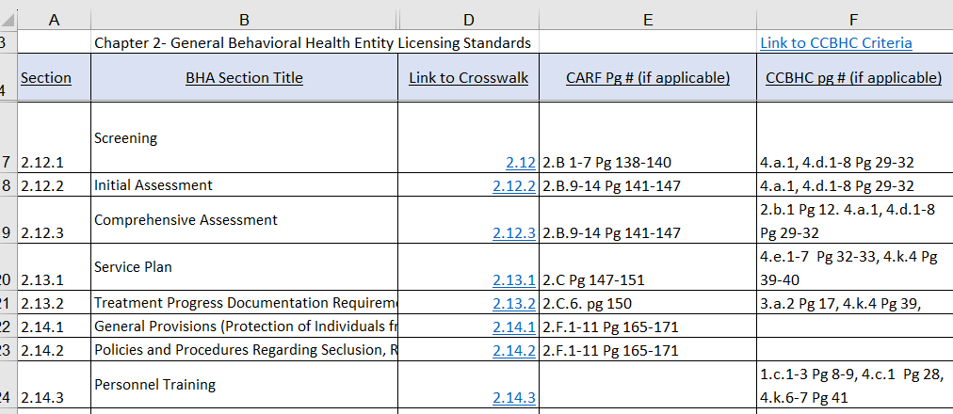
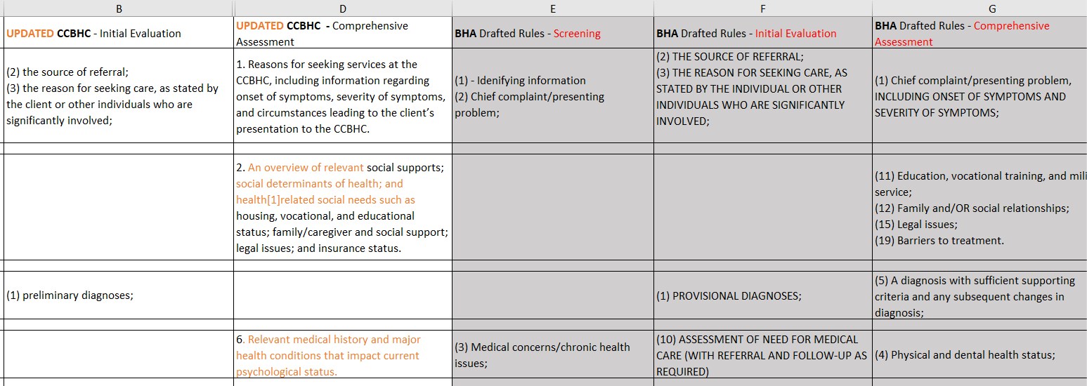
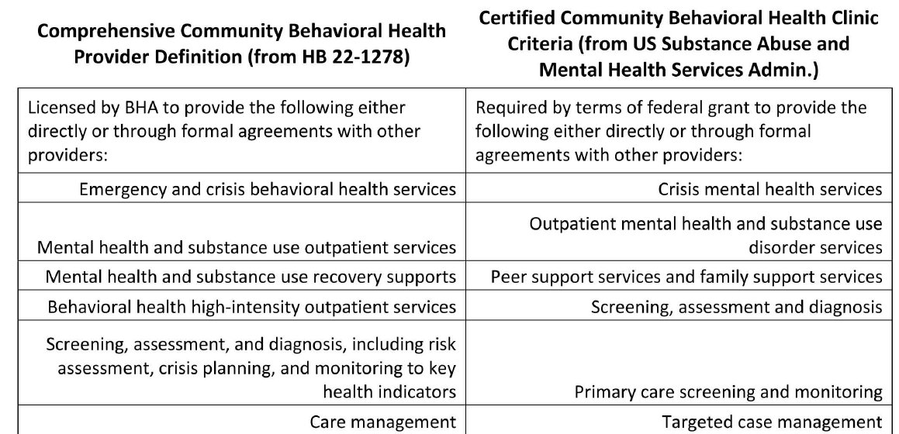
CCBHC + BHA Alignment In Action
Cross-walks of BHA regulatory elements and CCBHC Criteria

Slide 31
CCBHC Quality Measures ←→ CO RAE BHIP Measures
CCBHC Required Clinic Reported Measures |  |  |  | Colorado RAE BHIP Measures
Measure Name and Designated Abbreviation | Steward | CMS Medicaid Core Set (2023) |  | Measure Name and Designated Abbreviation | Steward | CMS Medicaid Core Set (2023)
Time to Services (I-SERV) | SAMHSA | N/A |  | Engagement in outpatient substance use disorder (SUD) treatment | NCQA | Yes (IET-AD)
Depression Remission at Six Months (DEP-REM-6) | Minnesota Community Measurement | N/A |  | Follow-up within 7 days after an inpatient hospital discharge | NCQA | Yes (FUH-CH, FUH-AD)
Preventive Care and Screening: Unhealthy Alcohol Use: Screening and Brief Counseling (ASC) | NCQA | N/A |  | Follow-up within 7 days after an emergency department visit | NCQA | Yes (FUA-CH, FUA-AD)
Screening for Social Drivers of Health (SDOH) | CMS | N/A |  | Follow-up within 30 days after a positive depression screen | HCPF | Similar (CDF-CH, CDF-AD)
Screening for Clinical Depression and Follow-Up Plan (CDF-AD and CDF-CH) | CMS | Adult and Child |  | Behavioral health screening or assessment for foster care members | HCPF | No
https://www.samhsa.gov/certified-community-behavioral-health-clinics/guidance-and-webinars https://hcpf.colorado.gov/accountable-care-collaborative-public-reporting

Slide 32
Colorado’s Planning Grant
BHA and HCPF collaborated on stakeholder process and drafting a proposal
Proposal submitted Sept 11
Stakeholder engagement continuing through 2024
Anticipate Planning Grants to be awarded Dec 1, 2024, with Dec 31, 2024 start date
If Planning Grant is awarded, CCBHC certification process would be implemented Oct 2025
Demonstration application would be submitted Dec 2025 and notification would occur in March 2026
https://hcpf.colorado.gov/ccbhc

Slide 33
Questions & Discussion

Slide 34
Rebecca Farley David
Senior Advisor, Public Policy & Special Initiatives
202-684-3735
RebeccaD@TheNationalCouncil.org
Sara Reid
Director of Quality and Program Development
Chair, CBHC CCBHC Workgroup
303-413-6271
sreid@mhpcolorado.org

Slide 35
CCBHCs Measure and Report
Measure | Tell the story | Demonstrate the impact | Understand opportunities
Process measures like access, utilization, and evidence-based practice fidelity
Outcome measures like symptom improvement, quality of life, and daily functioning
Client satisfaction and staff satisfaction
Consistent and comparable dataset
Utility at individual-client and population health levels, locally and nationally
Ensure transparency and accountability
Inform continuous quality improvement
Data lives at the provider level and thus can be analyzed in an agile and timely way, as well as shared in aggregate across the state and nation
Reduce data collection and reporting burden by using an existing standard, shared set of clinical quality indicators and behavioral health outcome measurement tool

Slide 36
CCBHC Behavioral Health Outcome Measurement
National Outcome Measure set (NOMs) is a clinical interview administered at baseline, 6-month reassessment, and discharge
Diagnosis, whether screened for trauma and suicide risk, demographics, education and employment
Overall mental health and psychological distress (nervous, hopeless, restless/fidgety, depressed, worthless, extent bothered by psychological problems)
Functioning (coping with daily life, getting along in social situations, substance use)
Housing stability (homelessness, mental health or substance use hospitalization, correctional facility, ED use)
Social connectedness (social relationships, social support, sense of belonging in community)
Quality of life (energy levels, ability to performs ADLs, satisfied with health, satisfied with self, satisfied with personal relationships)
Perception of care (staff belief in client’s recovery, feeling free to share complaints, feeling respected, likelihood of recommending the agency)

Slide 37
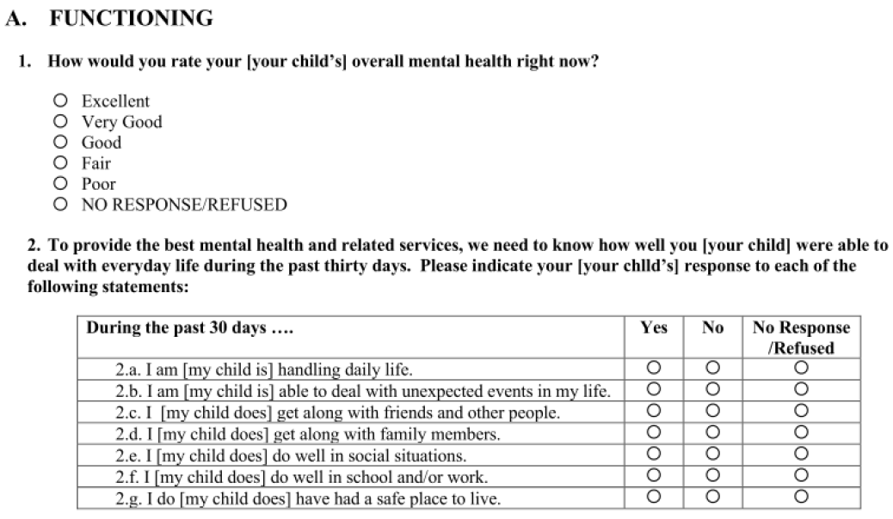
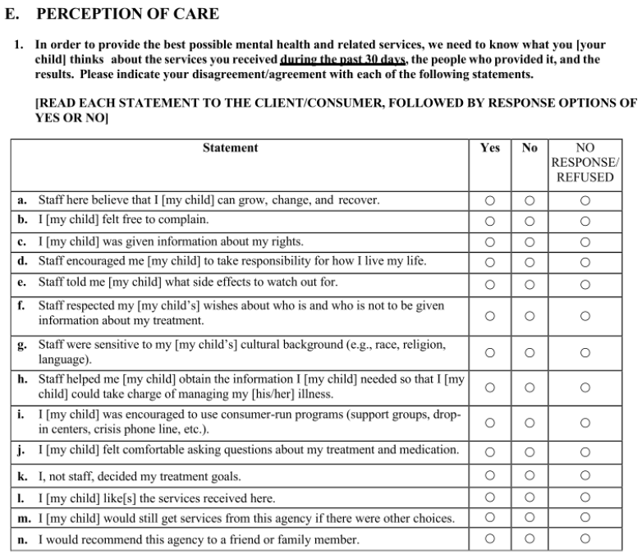
National Outcome Measure set (NOMS): A Snapshot

Slide 38
Proposed SAMHSA Unified Client-Level Performance Reporting Tool (SUPRT)
Goal: Streamline data collection, reduce scope and associated burden of questions requiring direct client response, and limit amount of client-level detail.
Some items asked directly of clients, and some gathered from alternate data sources
Estimated at 10-15min direct client interview
Colorado Considerations
Only required of active SAMHSA grantees, but provides open-source option to consider as a state
Validated, nationally-tested behavioral health outcome measurement tool covering spectrum of domains, rather than piecing together diagnostic-specific assessment tools (?)
National benchmarking, ability to compare and understand impact of CCBHC services within national context.
Client-level utility from measurement-based care perspective.
Demographic information, asked directly of clients at baseline only
Social determinants of health, asked directly of clients at baseline and annually
Standardized recovery, quality of life, and client goal measures
Behavioral health history, screening & diagnosis items, services provided to clients, using alternate data sources, at reassessment and annually
https://www.federalregister.gov/documents/2024/08/15/2024-18316/agency-information-collection-activities-proposed-collection-comment-request

Slide 39
Improved Behavioral Health Outcomes at 1 CCBHC
Clients report improvement across NOMS domains, with just over 31% improvement in Daily Functioning and nearly 27% improvement in Quality of Life.
Psychological Distress and Emergency Department utilization greatly decreased, with distress reducing by 42% and ED use decreasing by 68%.
Housing Stability greatly improved, with 92% of clients reporting stable housing after at least 6 months in care (up from 77% at baseline).
MHP uses the nationally-validated Substance Abuse and Mental Health Services Administration (SAMHSA) National Outcome Measure set (NOMS) to assess a full range of behavioral health outcomes. Key outcomes of focus include Psychological Distress, Social Connectedness, Daily Functioning, and Perception of Care. All data is directly client report. Data reflects all NOMS-Adult data available through June 2023, a total of 10,979 NOMS interviews.
5,537 Baselines | 4,328 Reassessments | 1,114 Discharges

Slide 40
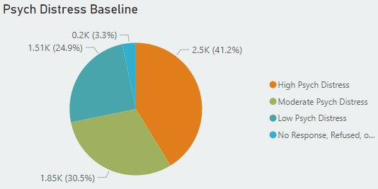
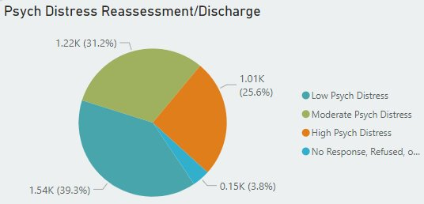
CCBHC Helps Measure Outcomes You Can Impact
Overall report of high psych distress improved by 38%, reducing from 41% at baseline to 26% at reassessment.
Across 6 domains of psychological distress, clients report reduced distress from baseline to reassessment. The 3 domains related to depression (i.e., Hopeless, Depressed, Worthless) show an average 48% reduction in high distress ratings.
Domains related to anxiety (i.e., nervousness and restlessness) show an average 30% reduction in high distress ratings.
The NOMS asks clients to rate how often they have felt these emotions during the past 30 days: “none of the time (0), "a little of the time (1)," "some of the time (2)," "most of the time (3)," or "all of the time (4).“ 0-7 = Low, 8-12 = moderate, 13-24 = high.
Data reflects 5/2019 – 3/2024. Approx 7500 Baseline, 5100 Reassessment.

Slide 41
Access
State decisions and approaches:
Identify critical access gaps based on needs assessments (e.g., by population, region, type of need, etc.)
Work with CCBHCs and other stakeholders to develop goals related to access and engagement (e.g., timeliness of access, care transitions, jail or ED diversion, etc.)
Work with CCBHCs and other stakeholders to identify highest-impact services/activities/settings for increasing access (e.g., mobile units, services embedded in schools, rapid response teams, etc.)
Set clear expectations for CCBHCs around access activities and strategies; ensure inclusion in PPS rate
What are our current most challenging access gaps?
What changes in access would be most meaningful to individuals and families?
How should providers demonstrate access expansions?

Slide 42
Workforce
State decisions and approaches:
Specify which staff disciplines will be required for certification (may include positions required for all CCBHCs and positions that are allowable based on community needs)
Work with CCBHCs to established shared expectations regarding recruitment (scale and reasonable timeline)
Work with CCBHCs to ensure adequate and reasonable salary costs are included in cost reports
Work with CCBHCs to understand and agree on staffing models or other strategies that support pipeline development (e.g., supervision) and retention (e.g., retention bonuses)
What are our biggest workforce gaps currently?
What trends do we see influencing the workforce of the future in Colorado?
What role can CCBHCs play in strengthening the pipeline, improving retention, and otherwise addressing workforce challenges?

Slide 43
Partnerships
State decisions and approaches:
Identify priority partnerships aimed at closing gaps across systems
Determine required* and encouraged/allowable care coordination partnerships
Establish expectations for how CCBHCs interface with partners
Determine how the state will work with target partner orgs to require/support/incentivize collaboration
Determine state role* in data collection and sharing across systems (e.g., statewide data warehouse, etc.)
Where do you see gaps or pain points in collaboration across systems?
What’s working well that should be scaled up?
What would collaboration look like in an ideal world?
What activities or investments would be needed to make this happen?
*The SAMHSA CCBHC Certification Criteria outline basic requirements, but states may refine and add to these.

Slide 44
PPS
State decisions and approaches:
Select PPS model and use of QBPs
Determine special populations for stratification of payment rate by client risk level in monthly model
Ensure inclusion of services or activities targeted to states’ access and quality goals
Define “qualifying visit”
Determine whether PPS will flow through managed care or as a wraparound payment
Determine frequency of rate re-calculations (“rebasing”) within CMS guidelines
Does a daily or monthly model stand out as being a better fit for us?
What might we want to consider in PPS design to incentivize services or activities of highest priority for our state?
What supports will clinics need to adapt to new ways of being paid and monitoring organizational financial health?

