Slide 1
If you are looking for: Proactive Distress Planning You are in the right place!

Slide 2
Proactive Distress Planning: A Precursor to Crisis Safety Planning for Suicide Prevention
Erin Ralston, LPC
Aurora Mental Health and Recovery
Notes:
My name is Erin Ralston, I am a licensed counselor and Clinical Director at Aurora Mental Health and Recovery. The division I work for encompasses our Access team, Residential Services, Homeless Services, Outpatient SUD and Forensic Services. This project came about as we were implementing Zero Suicide at AMHR and the ongoing work I have done around suicide prevention. I am a suicide attempt survivor and a suicide loss survivor. Both of which have shaped my desire to shift how we are responding to suicide crisis. So here we go!

Slide 3
Learning Objectives
Be challenged to think about how they can be creative in their own work as it relates to the full spectrum of suicide prevention.
Understand the necessity and limitations of traditional safety planning within suicide prevention as connected to a reactive state.
Increase knowledge about theories not commonly employed in safety planning including neurobiology and cultural theory.
Learn how to utilize a holistic safety plan to engage the client’s whole person in the planning process to increase successful utilization.

Slide 4
01
Is Suicide Prevention Working?

Slide 5
Yes, and…
Why do people die by suicide?
Is it always ‘bad’ to have thoughts of suicide?
How do we identify the other 50%
Notes:
I don’t think anyone would argue that the current work around suicide prevention is not working, however, it is limited and limiting.
Why do people die by suicide?
Is it always ‘bad’ to have thoughts of suicide?
How do we identify the other 50%?
For years, the American Foundation for Suicide Prevention and other organizations have been stating that 90% of people who die by suicide have a diagnosable and potentially treatable mental health condition, even if they don’t realize it or are not obtaining treatment. Yet last year, the Center for Disease Control CDC (see chart below) said that 54% of people who die by suicide had no known mental health conditions.
The original data was a study review and focused on psychological autopsy while the CDC utilize the National Violent Death Reporting System data. Now neither we can assume is entirely accurate but even if we split the difference, the focus on mental illness as a marker to prevent suicide will be limiting.

Slide 6
02
Alternatives to the Medical Model of Mental Health Care
Notes:
Based on the medical model, mental illness should be treated, in part, as a medical condition. This is simplified of course, the medical model can serve an effective purpose but for this presentation we are specifically looking at what is not as helpful.
The medical model looks at what is 'wrong' with the person, not what the person needs. We believe it creates low expectations and leads to people losing independence, choice and control in their lives. This is where we get the words like illness, disease, disorder, condition, etc.
So let’s look at a couple alternatives to get those creative wheels going…

Slide 7
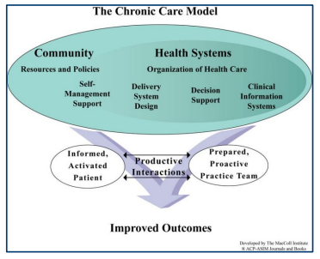
Chronic Disease Model
…Coordinated, proactive healthcare team that works closely with clients and their families.
Outcome is healthier clients and more satisfied providers.
Notes:
The Chronic Care Model (CCM) is a framework for improving the quality of chronic disease care. It's based on the idea that better patient outcomes come from a coordinated, proactive healthcare team that works closely with patients and their families.
The Chronic Care Model (CCM) identifies the essential elements of a health care system that encourage high-quality chronic disease care. These elements are the community, the health system, self-management support, delivery system design, decision support and clinical information systems. Evidence-based change concepts under each element, in combination, foster productive interactions between informed patients who take an active part in their care and providers with resources and expertise. The Chronic Care Model can be applied to a variety of chronic illnesses, health care settings, and target populations. The bottom line is healthier patients, more satisfied providers, and cost savings.

Slide 8
Neurobiology of Addiction
Assert that, after repeated contact with addictive substances, learning and brain changes occur.
Addiction Cycle
Brain Regions
Dopamine and Reward Systems
Genetic Factors
Stress and Negative Emotions
Notes:
these theories assert that, after repeated contact with addictive substances, learning and brain changes occur. These changes would affect cognitive, emotional, and behavioral spheres and may persist despite prolonged abstinence, explaining the chronicity of the disorder
Neurobiological theories of addiction are scientific models that explain addiction as a chronic disease caused by a combination of biological and environmental factors. These theories are based on decades of research on humans and animals. Some key aspects of the neurobiology of addiction include:
The addiction cycle A model that describes addiction as a repeating cycle of three stages: intoxication, withdrawal, and preoccupation. The cycle can vary in length and intensity, but it tends to amplify over time.
Brain regions affected The basal ganglia, extended amygdala, and prefrontal cortex are particularly important in the development and maintenance of addiction. These areas are involved in reward, movement, learning, and processing.
Dopamine and the reward system When someone first takes a drug, the reward system receives a burst of dopamine. Over time, the brain adapts to the high levels of dopamine by reducing the number of dopamine receptors available. This can lead to a need to take more of the drug to achieve the desired high.
Genetic factors Genome-wide association studies have identified genetic loci associated with addiction risk. Some of these loci are associated with a general risk of addiction, while others are associated with a specific drug.
Stress and negative emotions Stress-driven negative emotions can create a motivation for drug seeking through negative reinforcement. This is sometimes called "the dark side of addiction".
These findings suggest that people addicted to substances experience an overall reduction in the sensitivity of the brain's reward system (especially the brain circuits involving dopamine), both to addictive substances and also to natural reinforcers, such as food and sex.

Slide 9
Neurobiology of Addiction - Suicide
Addicted to Suicide?
Chronic Suicide Risk
Suicide Risk as a Neurobiological Coping Skill
Relapse from a suicide prevention perspective
Notes:
Addicted to Suicide
Chronic Suicide Risk
Suicide Risk as a Neurobiological Coping Skill
How do we engage conversation about suicide risk when the suicidal thoughts act as a preservative?
Relapse from a suicide prevention perspective

Slide 10
03
Suicide Prevention Relies on a Reactive Response
Notes:
Primarily due to the complicating factors about how suicide research is conducted, there continues to be a reliance on a reactive response, when a person is identified to have suicide risk, we intervene. Crisis assessment, suicide risk assessment, screenings, psychoeducation, and safety planning. We have some upstream prevention based interventions, like Sources of Strengths that is used in a number of school systems. Upstream prevention tends to focus on the collective, casting a net wide in hopes that we catch as many as we can, this is good, but there is gap between those nets, and that downstream individual treatment provided in our mental health systems.

Slide 11
Are Safety Plans Effective?
Notes:
We know that suicide prevention is often reactive to the client who is in crisis, including the safety planning process at the point where the client endorses active suicidal ideation. Often clients are prompted to complete a measure or series of questions to identify suicide risk, and one of the responses to the clients ‘level of risk’ is to complete a safety plan. While effective safety planning includes reviewing the plan in subsequent sessions and adjusting to ensureit is usable for the specific client, we also know that safety plans are completed in settings that do not provide ongoing care – such as emergency departments, walk in centers, with crisis response teams, and in crisis centers.
The other common issue with safety planning that we are intending to impact is the overall lack of cultural responsiveness. The field of suicide prevention has begun to work on diversity; however, research is still running behind. As we continue to push this agenda, we took careful measures in this distress plan process to create space for the client to identify themselves, and utilize those components of their own culture, ethnicity, identify, self, that were most important to them. Overall, we are saying that this process should be culturally responsive, linguistically appropriate, and accessible.
Review safety plan effectiveness research
Review limitations of traditional safety planning primarily reactive reliant on the client in active crisis to engage effectively
Review limitations in suicide research overall (focus on psychological pain and diversity)

Slide 12
04
What is Distress Planning?

Slide 13
Distress Planning is…
Planning for periods of distress or planning ahead of indicated risk to identify clear mechanisms that will support the client in managing those distress periods.
Reduce suicide risk behavior as the crisis response is (partially) replaces with practiced behavior.
Utilizes client strengths while not in crisis, to be applied when needed later.
Notes:
What is distress planning? Or proactive safety planning
Distress planning is intended to be client centered, trauma informed, and equity driven. We will utilize foundational components of learning theory, harm reduction, psychological pain, and motivational interviewing to engage both the initial planning process but also the ongoing follow up. (we are working from the lens of least restrictive interventions)
Goal: reduce suicide risk behavior as the crisis response is replaced with practiced behavior
Suicide Safety Planning at its best includes the ongoing review cycle, however, that can get stuck when safety plans are made with providers who the client does not see again, in the hospital, in the crisis center, or with a crisis response team. Due to the learning in our field, safety plans remain at the front of the mind
How did this pilot come about?
Suicide care pathway

Slide 14
05
Foundational Theories
Notes:
When thinking through this pilot, we wanted to ensure that we covered a few theories that do come up in suicide prevention, harm reduction and psychological pain, and recognize that there were some missing, of those that we felt were missing and would be impactful we included Cone of Learning Experience and Cultural Theory (of Suicide) so let’s look at each of those.

Slide 15
Harm Reduction
Harm reduction is grounded in justice and human rights, it focuses on positive changes and on working with people without justice coercion discrimination, or requiring that people stop using drugs as a precondition of support.
Notes:
Harm reduction incorporates a spectrum of strategies that includes safer use, managed use, abstinence, meeting people who use drugs “where they're at,” and addressing conditions of use along with the use itself.
Drug consumption rooms, information on safer drug use, needle and syringe programs, OD and reversal programs, housing!
Harm reduction is key in substance use response, but can be applied also to suicide prevention. It is easily transferable to non suicidal self injury, gradual reduction of harm with the aim of reducing those behaviors to the point they can be replaced with healthy coping mechanisms… which is tied into the brain learning components we talked about earlier.
Include reasons swiss cheese model

Slide 16
Psychological Pain
A complex area of study that considers the psychological, biological, and sociological factors that contribute to pain. Includes:
Psychological behaviorism Theory of Pain
Biopsychosocial Model of Pain
Suicide As Escape From Self
Psychache
Notes:
Psychological behaviorism theory of pain
This theory considers pain as an emotional response that is influenced by many factors, including biology, learning, cognition, personality, and social context. The theory also considers the placebo as a stimulus that can elicit a positive emotional response.
Biopsychosocial model of pain
This model states that pain is influenced by a variety of factors, including culture, family, environment, and nociceptive stimuli. It also considers how these factors affect a person's emotions, behaviors, and cognition.
Suicide as escape from self
This theory, proposed by Roy F. Baumeister, suggests that a painful awareness of one's inadequacy can lead to negative emotions and a strong desire to escape.
Psychache
This term, introduced by Edwin Shneidman, refers to psychological pain and is considered a central factor in suicidal behavior.

Slide 17
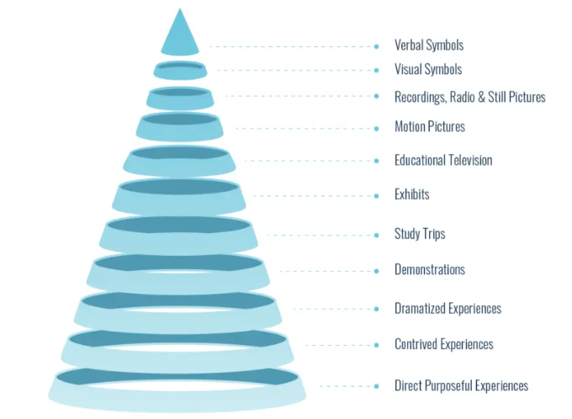
Edgar Dale’s Cone of Learning Experience
Notes:
Edgar Dale’s Cone of Experience helps L&D professionals to plan learning experiences that take advantage of the most effective learning environments. This 11-stage model places multimedia elements into categories based on their ‘concreteness’.
The corrupted version of this cone would tell us that from top to bottom we retain the least of what we read, more of what we hear, more of what we see, more of what we see and hear together, then more of what we say and write together and then the most of what we do
When a learner moves from direct and purposeful experiences to verbal symbols, the degree of abstraction gradually grows. And as a result, learners become spectators rather than participants.
So when we are thinking about teaching coping skills, teaching crisis management, how a client learns the safety plan, if we employ more diversity in learning experience, we will find more information retention.

Slide 18
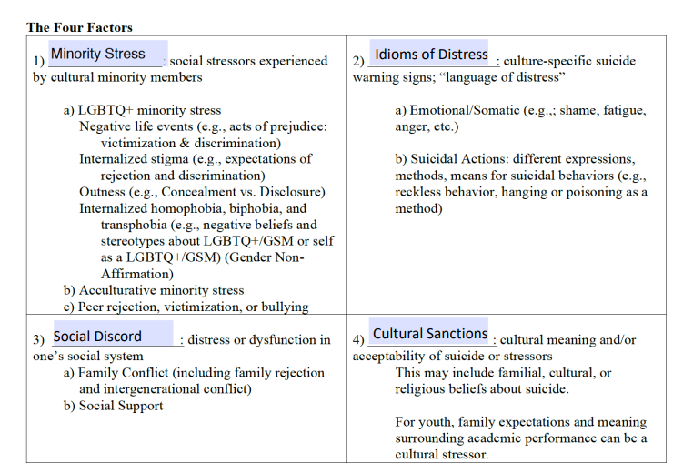
Cultural Theory and Model of Suicide
Notes:
This model is from Chu, first published in 2010 and again recently in 2021.

Slide 19
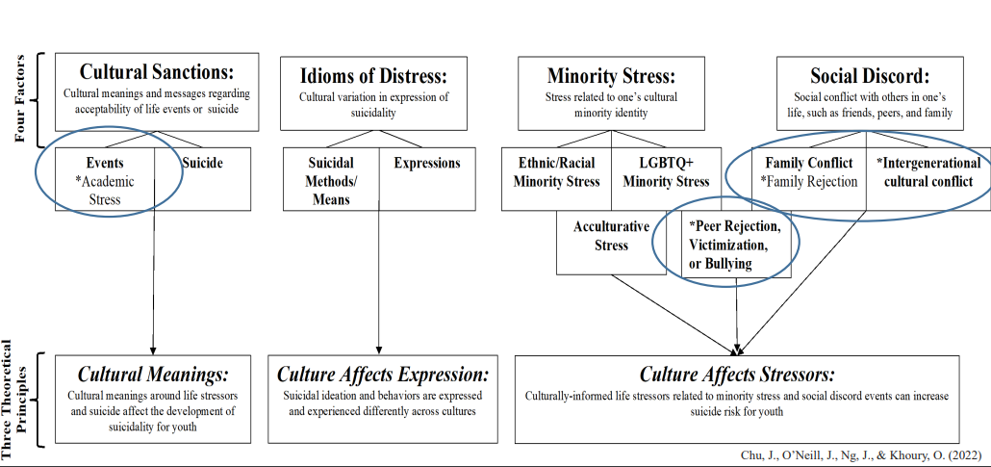
Cultural Theory and Model of Suicide
Notes:
This model is from Chu, first published in 2010 and again recently in 2021.

Slide 20
06
Creating a Holistic Distress Plan

Slide 21
Engagement with the Whole Client
Client Led
One initial session, plus follow ups
No expectation that it had to be completed to a specific amount or degree
Utilize a ‘Day in the Life” Narrative
Embedding harm reduction
Embedding cultural responsiveness
Notes:
Client led, meaning we guide them through different possible components, we modeled the suggestions on the standard Stanley Brown Safety Plan, including the following suggested items:
Things they can do on their own or alone
Things they can do with other people
Who they can talk to when they need to talk with someone
When they get stuck, try a narrative of the day, literally walk through it, and take notes of what they do and who they talk with
When they get stuck use what you have and give homework about how they can build the plan over time
Then we practice!
How do they know when they are in distress? Emotion logs etc
Do each individual item and see if they are pleasant or not, if not, cross them off and pick new ones.
Practice talking with the named individuals, is that helpful or not.

Slide 22
Focus on Common Clinical Skills
Motivational Interviewing
Cognitive Behavioral Therapy
Solution Focused Brief Therapy
Notes:
All things you have heard of I am sure
MI is useful in plan creation, working through the client presenting ideas and intentions for their management of the plan
Cognitive Behavioral Therapy – presents a number of skills to support managing distress, helpful partner therapy to the distress planning process.
Solution Focused Brief Therapy was used in two ways, first to resolve any pending issues during the planning process that were not related to the distress planning itself, so that the client was then able to focus on the distress planning without distraction. As well as in the practice phases, to support the client in determining if the item didn’t work truly or needed adjustments. One example is that the client was keen on going for walks, and found them less effective when joined by another client. He was supported in resolving that issue with the other client so he was able to go for walks that felt helpful (alone).

Slide 23
Developing Practice Based on Learning Style
First we must know the learning styles.
Provided brief overview and then tested with the clients which they felt worked best for them.
Adjusted the ‘homework’ as we learned more about what worked best for clients
More directive approach by presenting observations to clients about their learning styles
Notes:
I am not sure why, as looking back it was not based in any logic or facts, but I thought the clients would have a sense of how they learn best. SO we did spend more time learning those styles and needs than I anticipated. Practice was the best place to do that…

Slide 24
07
Additionally Supportive Treatment Components

Slide 25
Pairs Well With the Distress Planning Process
Benefits of insight development versus psychoeducation
Engaging in group therapy (models such as Stages of Change, Relapse Prevention, and Suicide Attempt Survivor present value)
Engagement of lived experience – Peers for the win!
Notes:
Benefits of insight development versus psychoeducation
Engaging in group therapy – suicide attempt survivor and stages of change group models
Builds community and connection (related to interpersonal theory of suicide)
Allows client processing of shared and other emotional responses that are not well attenuated in society
Encourages acceptance within each client
Engagement of lived experience in suicide prevention
But how can we integrate lived experience across levels of care, programs, and organizational leadership

Slide 26
08
Initial Pilot Data

Slide 27
Initial Pilot Data
Identified Clients
Data
Client Feedback
Notes:
Due to other priorities we utilized a small pool of 10 clients to test the idea and feasibility of planning and practice. These are clients who were enrolled in one of our residential units, and working with a therapist, and for most, medication management, with AMHR. All clients had a diagnosis of severe mental illness that included periods of distress, either suicide related or such that would cause the client to have repeated hospitalizations.
One client left before the study period ended. Of the other 9, there was a reduction of ‘crisis’ periods in the three studied months, as compared to the three months before. We used a combination of client reporting, and shift notes from the residential program as those are written three times a day and an effective monitoring of the clients levels of distress.
8 of the clients provided feedback, all of which was positive, talking about how it helps to plan ahead, feeling more in control of their response, appreciating when staff could remind them of using their planned activities, and it was noted by one client, ‘this is like life management right?’

Slide 28
Limitations and Next Steps
Small pilot
Stigma of suicide and safety planning
Still casts a specific net of those who have identified risk – why not distress planning for everyone who starts treatment.
Next steps…
Notes:
Even if that risk is low or risk is not directly related to suicide, mental health treatment is difficult, why not have distress planning – for hard sessions, for trauma management, for that time when you or the provider have to cancel so you don’t see them for a longer time, it builds in a buffer of client directed supports for the duration of the treatment process.
Next Steps – work toward a ‘form’ option for the distress planning. While our intention is to leave that as open ended as possible so that clients can identify how best they will remember, the consistency needed on the provider side would support a general form. This would include the areas to cover in the plan as well as the focus on harm reduction/cultural theory, and learning styles of the client.
We will continue building plans with more clients, and begin training more providers to do so. AMHR is currently rolling out a specific Suicide Care Pathway as I mentioned earlier so this will be done second to that effort, we do not want to stress our providers more than is reasonably effective.

Slide 29
Questions?
Thank you for joining us today!
Erin Ralston
erinralston@auroramhr.org

