Slide 1
The Evolving Federal Landscape for CCBHCs: Updates and Opportunities
Rebecca Farley David, Senior Advisor
September 19, 2025

Slide 2
Today’s Agenda
CCBHCs: Where We’ve Come
Today’s Federal Policy Landscape
Strategic Considerations for CCBHCs
Notes:
Full description: How will the national political and policy landscape affect Colorado’s Certified Community Behavioral Health Clinic implementation? Join this session to hear from the National Council for Mental Wellbeing about the latest developments in Washington, their likely impact on current and future CCBHC efforts, and emerging opportunities for providers to make the most of the fast-evolving landscape. This presentation will also cover strategic considerations for cross-sector partnership and messaging strategies to drive investment.
Learning Objectives:
Describe recent federal policy developments affecting CCBHC implementation
Analyze the impact of the federal policy environment on Colorado’s CCBHC effort
Identify strategies to ensure implementation success and make the most of opportunities ahead

Slide 3

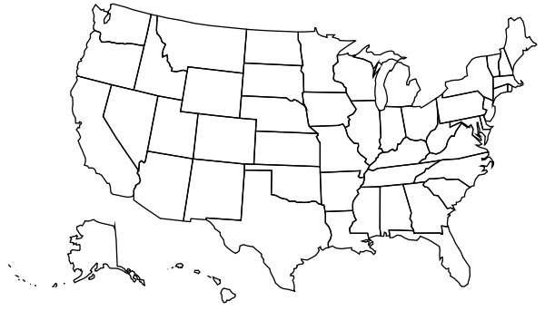

The CCBHC model turns “bright spots” into a national and statewide standard of care… transforming access and outcomes for the communities CCBHCs serve.
Federally Defined
State Driven
Locally Achieved

Slide 4
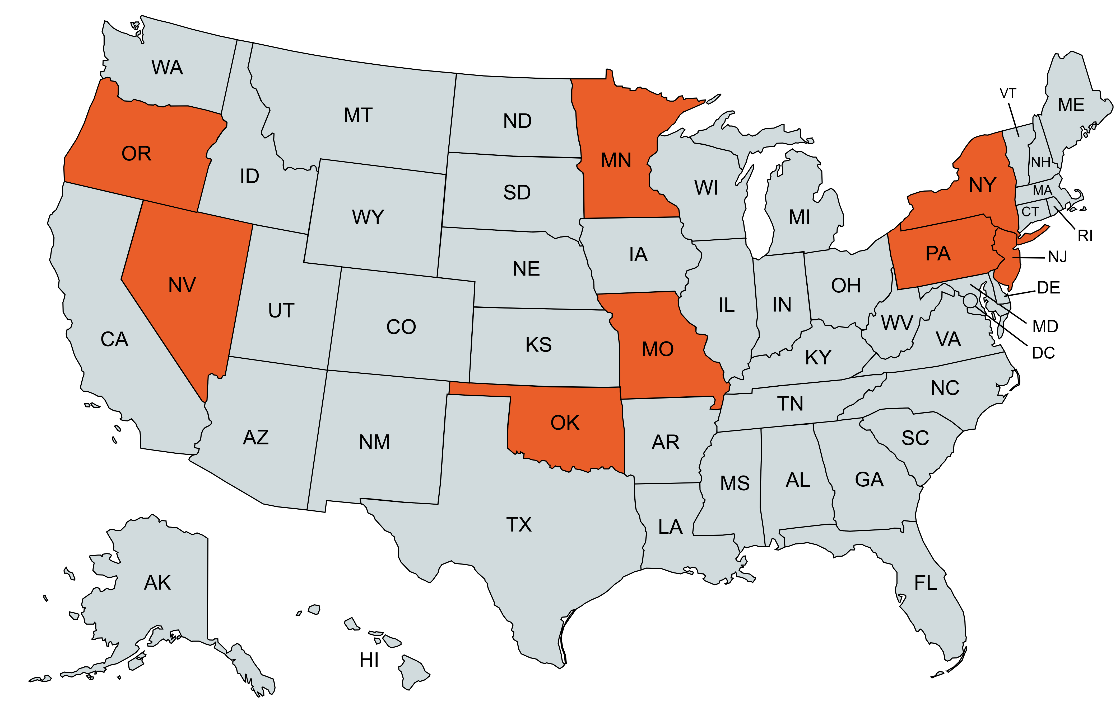
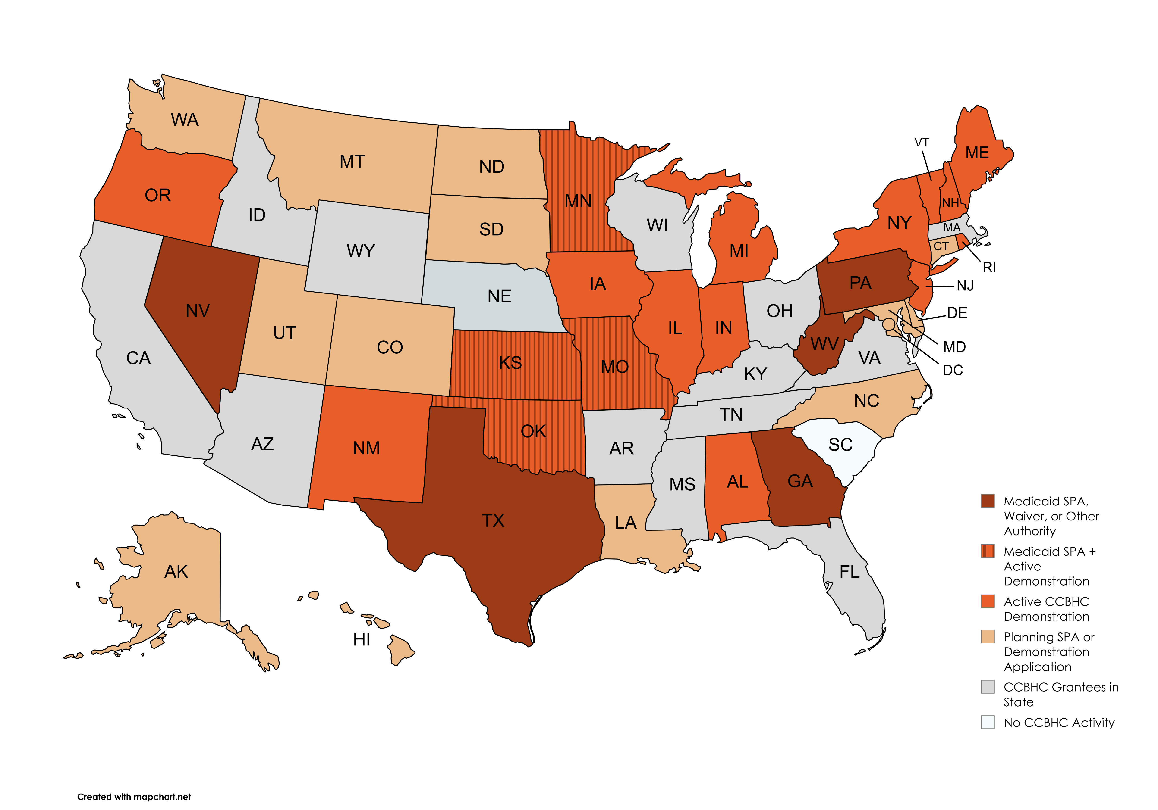
How it started (2017)
8 States
66 CCBHCs

Slide 5
“Now that we’ve seen what service delivery can be like, it would be impossible to go back.”
“This model shows that when you’re given the financial flexibility to do the right thing, you get results that previously would have been unfathomable.”

Slide 6
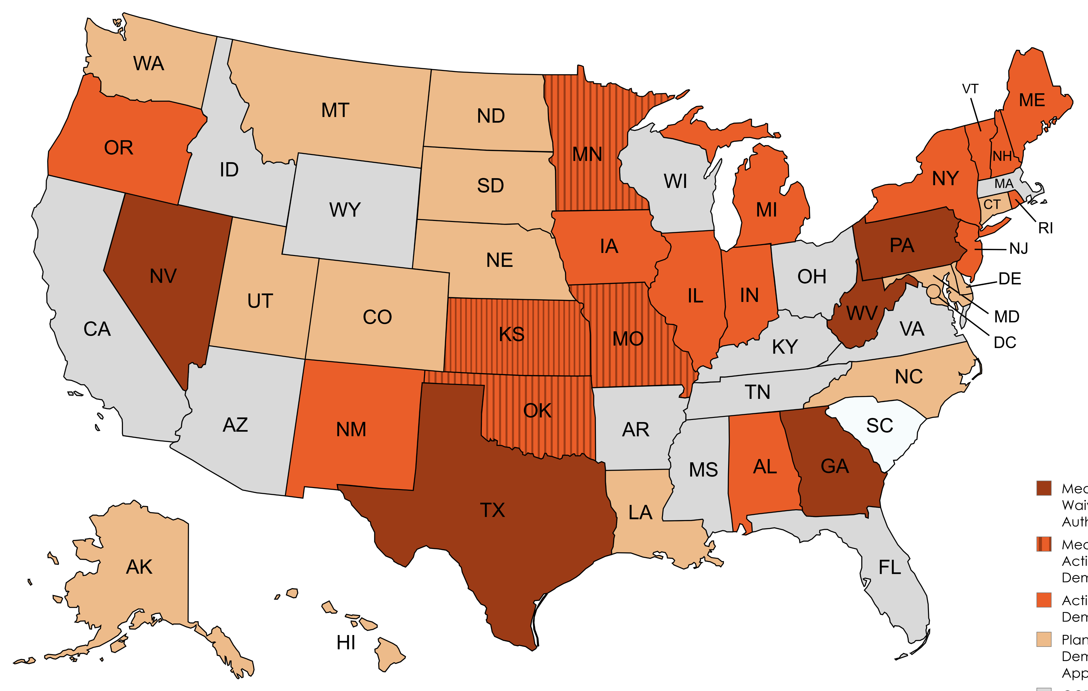
How it’s going
Today, there are more than 500 CCBHCs serving 40% of U.S. counties.

Slide 7
Timeline for Demonstration Decisions and Launch
Dec. 2025:
Demo planning grant period ends
Spring 2026:
Demo applications due
Early Summer 2026:
10 demo states selected
July 1 until launch: Finalize certifications, PPS rates, other necessary steps for launch
Session #603: Certified Community Behavioral Health Clinics &
Colorado (Today at 3:30, Peak 11/12)

Slide 8
State and federal actions have enabled CCBHCs’ growth to date
Staunch bipartisan support through 4 Democratic and Republican administrations
Billions invested to date
Ongoing congressional support over 15 years (and counting)
Every demo state has remained in the demo or “graduated” to a CCBHC SPA*
Desire to participate in the demo has been consistently higher than available slots
States pursuing SPAs to implement CCBHC when demo is not available to them
*Or other Medicaid authority

Slide 9
Today’s federal landscape for CCBHCs
Demonstration Expansion |  | Grant Funding |  | Administration Actions
Demonstrations to end in 6 states on 9/30/5; all 6 have SPAs in place or plans to submit a SPA Next round of 10 demonstration states to be selected by 7/1/26 Selected states anticipated to have up to 12 months to launch their demos |  | Consensus on level CCBHC-E grant funding for FY26 across House, Senate, Trump Administration New grant cycle in FY2026 looks likely regardless of how final FY26 appropriations bills are resolved Senate proposal to expand TA audiences |  | Emerging HHS and SAMHSA agendas reflect numerous areas of alignment with CCBHC Continued support for CCBHC-E grants and demonstration Mention of CCBHCs as a solution in executive order on homelessness CMS guidance on new CCBHC state Medicaid option expected
Notes:
Demo expansion
Approps and grant cycle
Continued admin support for CCBHCs
HR 1
State budget pressures

Slide 10

Changes ahead
HR 1 (OBBBA)
>
Considerations for CCBHCs
Medicaid cuts
Beneficiary impacts: work requirements, cost-sharing
Financing limitations: provider taxes, state directed payments
Provisions with greatest expected impact on community BH providers start going into effect 1/1/27 (SFY27)
Rural Health Transformation Program (RHTP)
$50B over 5 years
Half distributed equally among states; half according to application scoring and rural factors
Increasing MH/SUD access called out as allowable use of funds
Strategies for maximizing enrollment
Universal eligibility screenings
Proactive disability determination
Partners, technologies supporting screening & enrollment navigation
Staffing and delivery redesign
Access redesign for greater engagement
Clinical innovations, staffing models, or tech facilitating most efficient use of WF
(Ensure inclusion in CCBHC cost report)
Collaboration opportunities with State
Notes:
Alignment with allowable uses
Information sharing supporting technical score
Opportunities to collaborate on reduction in administrative burden?

Slide 11
Other strategic considerations
States are entering a period of financial uncertainty, with significant budget pressures likely as HR 1’s Medicaid cuts go into effect.
Cuts taking effect 1/1/27 fall within SFY27, starting 7/1/26… meaning budget planning is beginning soon/now.
States will need access to strong data demonstrating impact and cost-effectiveness of key programs.
We anticipate…
>
High performance paired with advocacy and collaborative state engagement is more important than ever
Data-driven impact messaging will be critical
CCBHCs’ impact falls across many sectors, creating natural allies
Innovative community partnerships may contribute to demonstrated efficiency or impact

Slide 12
Data-driven impact messaging starts with stakeholder priorities
Increased access to care
  Specific populations of interest (e.g., youth)
  Specific services of interest (e.g., substance use)
Cost savings
Cross-sector connections (e.g., law enforcement, primary care, child/youth-serving systems)
Oversight, accountability and transparency
Other?

Slide 13
Access: Data Examples
Increase in number of people served by CCBHC(s)
  Increases among special populations (e.g., youth, veterans)
Decrease in wait times for routine care (I-SERV)
  Increase in open or same-day access slots
Mobile crisis and crisis stabilization availability
  Services available where they did not previously exist, or expanded to fill gaps
  Timeliness of crisis response
Increase in delivery of highly effective services that have not historically been widely available or utilized (e.g., medication-assisted treatment for opioid use disorder, etc.)
  Increase in number or percent of CCBHC clients receiving service
  Increases among special populations
Expansion of services delivered in key community-based settings (e.g., supportive housing sites, schools, etc.)
Notes:
Data is effective at both state and clinic level

Slide 14
Cost Savings: Data Examples
Reduction in number of hospital/ED visits
Reduction in frequency of hospital/ED visits
Reduction in duration of hospital/ED visits
Reductions in any of the above:
  For behavioral health reasons
  For physical health reasons
  Among established CCBHC clients
  Among new CCBHC clients
Additional data and messages to consider:
Calculate projected savings based on average cost of hospital/ED visits
Highlight savings in other sectors even if not quantifiable (e.g., law enforcement, schools, child welfare…)

Slide 15
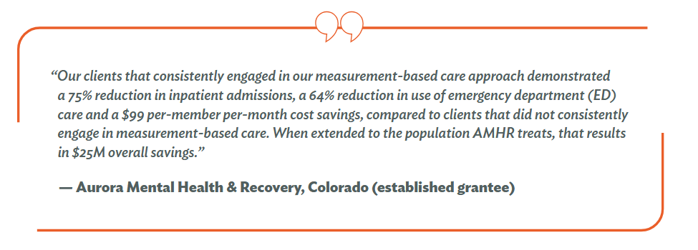
https://www.thenationalcouncil.org/resources/2024-ccbhc-impact-report/

Slide 16
Making your message “stick”
What it means (impact)
…and always pair data with stories
What you achieved (outcomes)
What you did (process)

Slide 17
Engaging your community allies
“I don’t know the letters, but I want more of it!”
—MO Sheriff
What other sectors see benefits from the CCBHC model? | Law enforcement Schools Hospitals/emergency departments Other health care providers Courts
Can you… | Quantify impact? Tell stories that resonate with key stakeholders? Engage representatives from partner orgs as spokespeople?
Notes:
What other sectors see benefits from the CCBHC model?

Slide 18
Sample methodology for estimating police department savings
“The number of minutes and number of miles saved are calculated based on the difference between the nearest [CCBHC crisis stabilization unit] and [state psychiatric] hospital, multiplied by the number of trips. Trips are tied to specific admissions across several [admission] logs... Cost savings are based on a per mile reimbursement rate of $0.54 and an average hourly officer salary rate of $20.53.
“The estimated cost of the saved mileages was $434,710.15 and $283,970.55 in officer time, for a total savings of $718,680.70.”
https://nri-inc.org/media/qa2k0wdf/grand-model-evaluation_june2022_v2.pdf

Slide 19

Our proactive CCBHC agenda
CCBHC prospective payment in Medicaid state plan option
Permanence for CCBHCs in every state
Inclusion of CCBHCs in Medicare
National data infrastructure
Strengthening the workforce pipeline
Maintaining and expanding grant funding
Taking implementation excellence to the next level
And more…

Slide 20
Our vision is that one day, every person in the U.S.
will be able to access comprehensive, high-quality care
delivered by a CCBHC and its community partners.

