Slide 1




Avoid the Data Collection Black Hole
A Panel Discussion on Actionable Use of CCBHC Clinical Quality Measures
A panel of current grantees:
Julia Lamb, MS-HSA, Aurora Mental Health & Recovery
Andrea Raasch, LCSW, Jefferson Center for Mental Health
Sean Hansen, MS, Denver Health
Facilitated by Sara Reid, MA, Clinica Family Health & Wellness

Slide 2
Learning Objectives
Build a strong understanding of what the CCBHC clinical quality measures are and the value of population-level quality measure data
Learn strategies for analyzing and reporting on the measure data, both internally and externally
Learn about what elements of the measures can be impacted by CCBHC providers and what successful strategies might be
Build confidence in how to use data, rather than just collect it – and walk away with specific ideas for how to analyze CQM data to drive lasting quality improvement

Slide 3
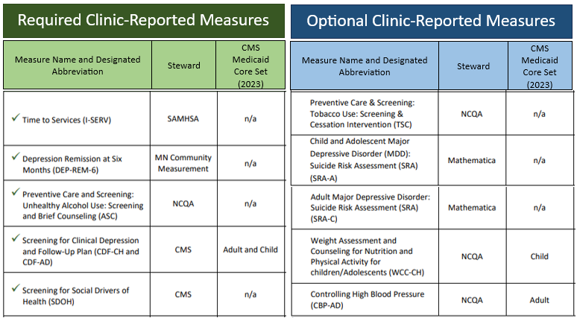
What are the CCBHC clinical quality measures?
CCBHC Clinical Quality Measure Specifications

Slide 4
Challenges and Solutions
Multiple reporting requirements
Single, validated shared set of clinical quality measures
Consistent, effective clinical quality measurement, with clear benchmarks, to inform provider- and system- level improvements
Complex measures lacking clear and consistent data definitions
Statewide and national agreements on data definitions
Customizations and deviations from national measure specifications
Alignment to national standards and shared benchmarks

Slide 5
Quality Measures Implementation Workflow
#1
Tech Spec and SAMHSA Webinar Review
#2
Clarify Definitions/Data
#3
Data Assessment (Current collection)
#4
Develop and Modify Workflows
#5
Communication Plan for Rollout
#6
Audit Plan for Tracking/Correction
#7
Quality Improvement

Slide 6
JCMH Communication Plan
Presented at Leadership Meeting
  What is CCBHC
  Quality measures
  Upcoming workflow changes
Live training for employees, recorded for later access
Office hours to answer questions
Audit Plan identified and implemented
Support materials available on Quality Measures SharePoint
  Workflow handout
  Provider talking points for client engagement
    Person & Family Advisor Board (PFAB) identified client preferences for communication
  Support for supervisors
  Frequently asked questions
  Training videos for ASC

Slide 7
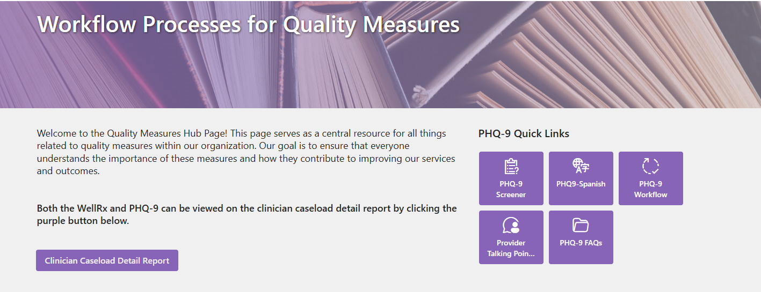
JCMH Quality Measures SharePoint

Slide 8
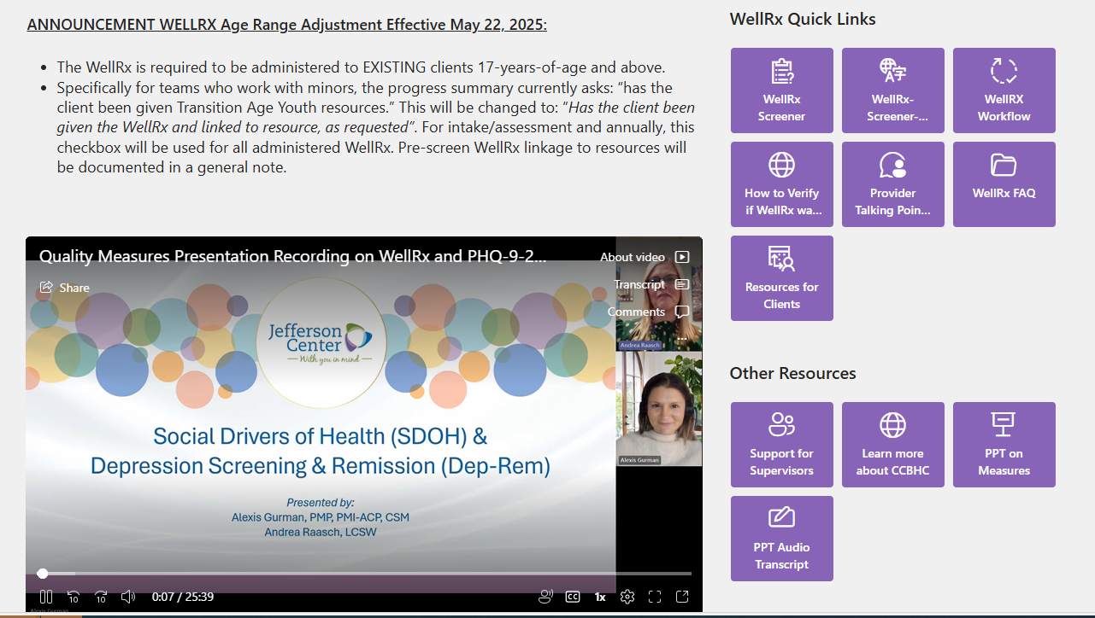
JCMH Quality Measures SharePoint

Slide 9
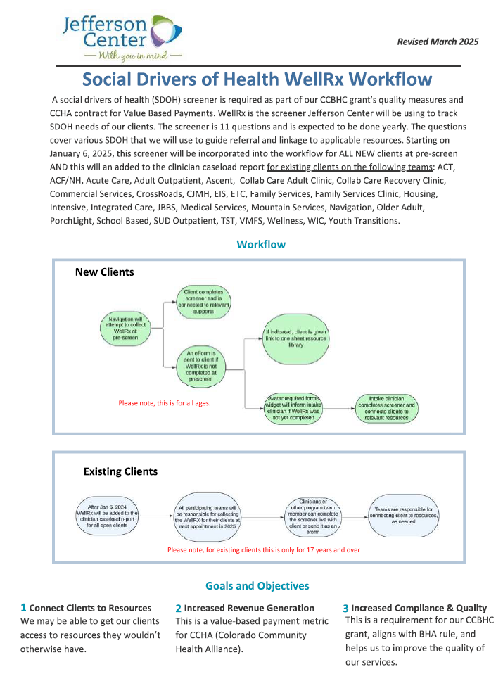
JCMH
Workflow Handout

Slide 10
AMHR Parallel Processes for Implementation
Vendor: Build Dashboards
Population Health Management: Put the CQM Data to Work
AMHR: Data Management, Workflow & EHR Modification, Communication & Training

Slide 11
AMHR Data Collection and Management
Collection, Data Definitions, and Storage
Who Collects the Data?
What Are the Associated Workflows?
Gap Analysis and Plan
Technological
Workflow Changes, Additional Training, Etc.
Communication and Training
Tip Sheets and MyWeb
Training and Skill Building
Where Does the Data Live?
The Why

Slide 12
AMHR Data In Action: Care Pathway
Health Related Social Needs (HRSN) Screening
Case Management
Care Coordination
Short-Term & Task-Based Interventions
Long-Term, Holistic, & Systemic Support
Needs Addressed, Access Expanded, & Outcomes Improved
Sustainable Solutions for Better Outcomes & Quality of Life
In Depth
Assessment

Slide 13
AMHR Making it Meaningful
I-SERV
Access
Process Improvement
DEP-REM 6
High or Low Remission Rates
Intervention Changes
Operational Changes
SDoH
Needs, Intervention, and Utilization
Informed Response to Needs

Slide 14
AMHR Lessons Learned
Project Requirements, Tracking, and Definitions in One Place
Build and Adapt Dashboards That Stand Alone
(High Level and Drill-Down)
Start as Early as Possible
Avoid Checkboxes (Example CDF Follow Up Plan Documentation)

Slide 15
DH Approach for CQMs
Determine requirements
Identify required data elements and build into EHR
Iterate and validate data / process
Develop SOW, logistics, and operational workflow
Staffing: hiring & onboarding, and adjusting FTE and/or responsibilities
In
parallel

Slide 16
DH Clinician Buy-In & Value Add
  CCBHC Reporting = Heavy Lift
    Staff stress & burnout risk
    Complex, time-consuming requirements
  Finding Value for Clinicians
    Increased funding = more staff/resources
    Identify disparities & hidden issues
    Expand CCBHCs to more communities
    Connect data to real patient stories
  Turning Burden into Opportunity
    ISERV requirement → initial challenge
    Outcome: cleared year-long waitlist
    Optimized scheduling & intake
  Support & Optimization
    Automated processes → less manual work
    Reduced stress, more time for patients

Slide 17
More Information and Resources
CCBHC Technical Specifications
CCBHC Data Reporting Templates | SAMHSA
Colorado CCBHC Demonstration Planning Grant information
National Council for Mental Wellbeing CCBHC resource hub
SAMHSA CCBHC Quality Measure Guidance and Webinars
SAMHSA CCBHC Criteria (March 2023 update)

Slide 18
THANK YOU!
Andrea Raasch, Jefferson Center for Mental Health
Julia Lamb, Aurora Mental Health & Recovery
Sean Hansen, Denver Health
Sara Reid, Clinica Family Health & Wellness

