Slide 1
Flexible Framework for Helping Clients on the Autistic Spectrum
Autumn L Matsutani, MA, CRC, LPC, NCC

Slide 2
Goal
Update your framework for:
  clinical judgements,
  treatment planning,
  language when talking about and with clients on the autistic spectrum
Gain a better understanding of and confidence when working with clients on the autistic spectrum
FOR TODAY

Slide 3
Quick History of Mental Health Care for Autistic People
“The Autistic Brain: Thinking Across the Spectrum” by Temple Grandin
1943: “Autism” entered the psychiatric lexicon
1968: DSM-II removed any mention of autism from DSM-I
  “Autistic” was used to describe symptoms of schizophrenia twice in the DSM-I
1970s: Psychiatry had a paradigm shift from looking for causes to looking at effects.
  Tried to classify symptoms in a “rigid and orderly and uniform fashion” (pg. 13
1972: Gay Rights Movement challenged the DSM’s classification of homosexuality as a mental illness and as something that required a cure. “They won that battle, raising the question of just how trustworthy any diagnosis in the DSM was.”
1980: DSM-III was published and described a specific “checklist of symptoms that didn’t overlap with the other symptoms of schizophrenia” and other differential diagnoses. (pg. 14)
1987: DSM-III-R changed the name to autistic disorder
1994: DSM-IV added Asperger syndrome (ASD Level I today)
2013: DSM-V updated the language to describe Autism spectrum disorder to distinguish levels of support needs.
  Many autistic people still have issues with how diagnostic criteria are defined since symptoms are determined by what is observably different than neurotypical (NT)/typically developing (TD) people.

Slide 4
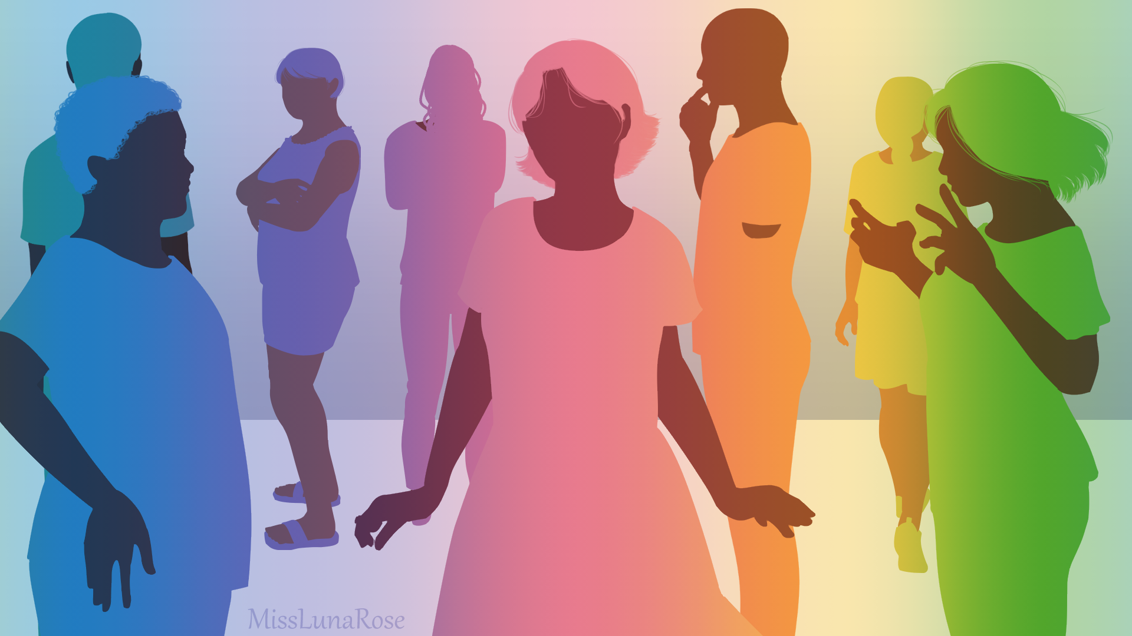
What is autism spectrum disorder?
“Autism spectrum disorder (ASD) is a neurological and developmental disorder that affects how people interact with others, communicate, learn, and behave. Although autism can be diagnosed at any age, it is described as a “developmental disorder” because symptoms generally appear in the first 2 years of life.”
(NIMH, 2024)

Slide 5
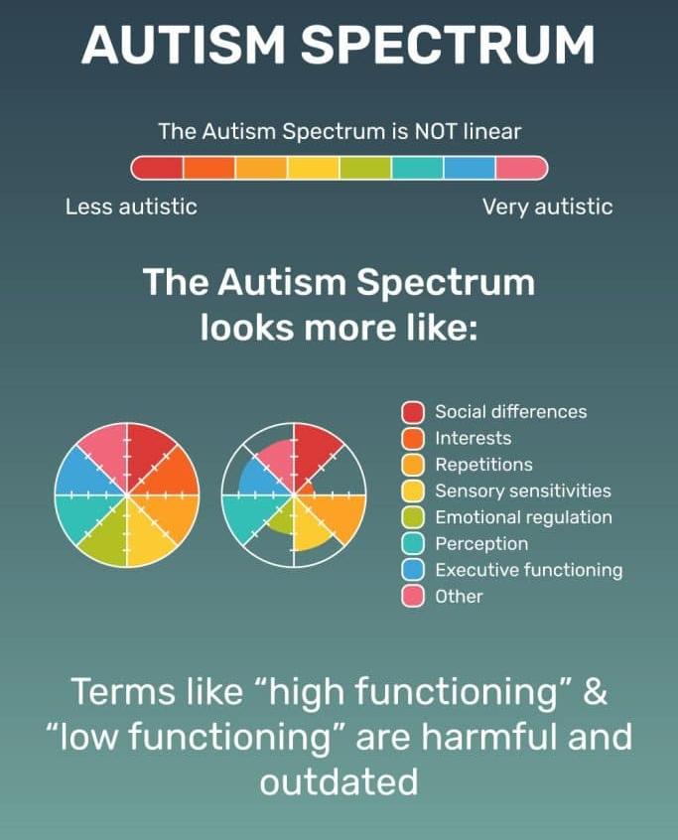
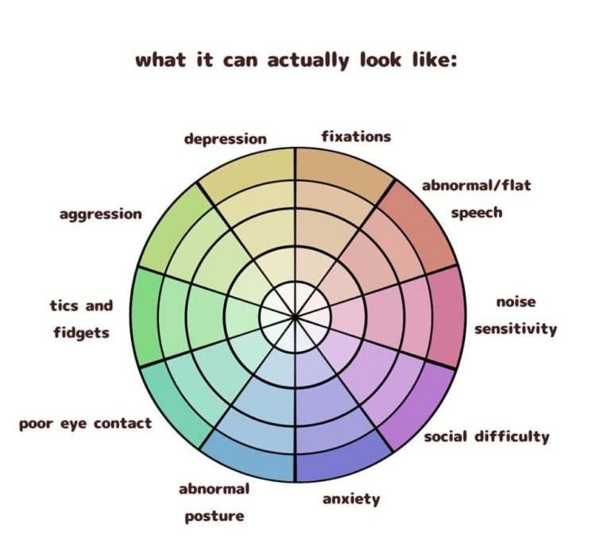
What we mean by “spectrum”
The word “spectrum” in ASD can easily be misinterpreted as a range from having a little bit of autism to having a lot of autism. This is NOT true and can be more accurately understood as a wheel with many sections and levels of intensity:
Bigger image on next slide

Slide 6
What can these variabilities look like in clients?
Clinicians take note of which areas are most impactful towards the client’s health

Slide 7
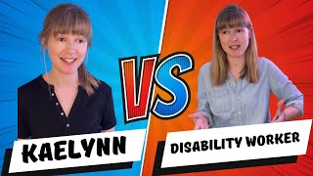
Before we talk about language…

Slide 8
Avoid This | Use This
Person with Autism | Autistic person Autist On the Autism spectrum
Identifies as having autism | Is Autistic
“Special needs” “Differently abled” “Handi-capable” | “Is disabled Has a disability
Normal | Neurotypical (NT) Allistic Non-Autistic
Low functioning High functioning | Has high support needs Has low support needs
Female Autism Asperger’s High-functioning Autism | Masked Autism
Mute Dumb | Nonverbal Loses speech
Euphemisms, language that minimizes challenges, language that belittles or condescends | Direct language about what a person can or can’t do, and what kind of support they need
L
A
N
G
U
A
G
E
I
S
IMPORTANT
From page 48 from Dr. Devon Price’s “Unmasking Autism” (2022).

Slide 9


Slide 10
Traits Commonly Associated with Masked Autism
Emotional
Strikes others as emotionally immature and sensitive
Prone to outbursts or crying jags, sometimes over seemingly small things
Has trouble recognizing or naming one’s feelings
Ignores or suppresses emotions until they “bubble up” and explode
May become disturbed or overwhelmed when others are upset, but uncertain how to respond or support them
Goes “blank” and seems to shut down after prolonged socializing or when overstimulated
Psychological
Reports a high degree of anxiety, especially social anxiety
Is perceived by others as moody and prone to bouts of depression (See Comorbidities in later slide)
Fears rejection intensely and tries to manage how other people feel to avoid it
Has an unstable sense of self, perhaps highly dependent on the opinions of others

Slide 11
Traits Commonly Associated with Masked Autism
Social
Is a social chameleon; adopts the mannerisms and interests of the groups they’re in
May be highly self-educated but will have struggled with social aspects of college or their career
Can be very shy or mute, yet can become very outspoken when discussing a subject they are passionate about
Struggles to know when to speak when in large groups or at parties
Does not initiate conversations but can appear outgoing and comfortable when approached
Can socialize, but primarily in shallow, superficial ways that may seem like a performance. Struggles to form deeper friendships
Has trouble disappointing or disagreeing with someone during a real-time conversation
Behavioral
Uses control to manage stress: follows intense self-imposed rules, despite having an otherwise unconventional personality
Is usually happiest at home or in a familiar, predictable environment
Seems youthful for their age, in looks, dress, behavior, or interests
Prone to excessive exercise, calorie restriction, or other eating disordered behaviors
Neglects physical health until it becomes impossible to ignore
Self-soothes by constantly fidgeting, listening to repetitive music, twirling hair, picking at skin or cuticles, etc.
From pages 55-56 of “Unmasking Autism” by Dr. Devon Price

Slide 12
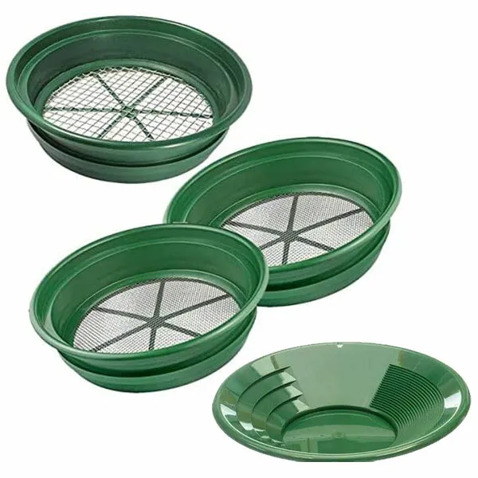

What is different about an autistic brain?

Slide 13
Common Mistakes Clinicians Make
Assuming
Sugar-coating
Indirect communication
Focusing on “curing” ASD/helping the client be “less autistic”
Focusing on differences the clinician can see rather than what the client feels
Focusing on suppressing symptoms
“Everyone is a little autistic.”
“You don’t look autistic.”

Slide 14
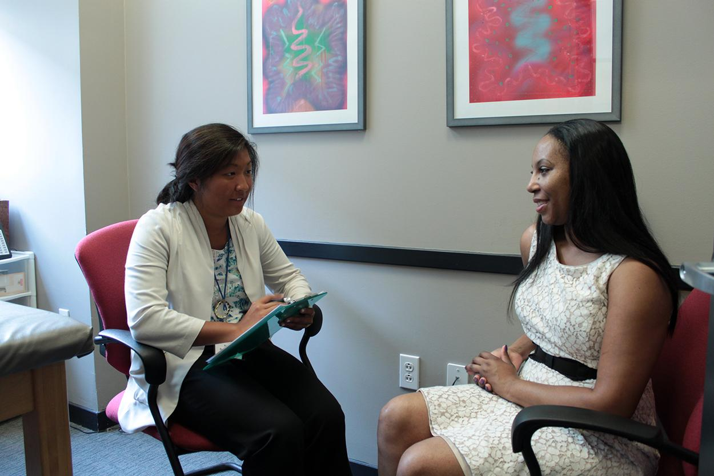
Treatment Planning
Common therapeutic goals and skills for clients with ASD at any level include:
Self-advocacy skills
Communication skills in relationships
Communication skills with emotions
Self-care skills
Emotion identification skills
Emotion regulation skills
How to stop masking
Navigating self-disclosure of symptoms
Resource acquisition and referrals
Vocational and occupational therapy
Reducing impact from chronic trauma
Learning ways to self-accommodate
Understanding their autism & the impacts of their symptoms

Slide 15

Fostering Strengths
Identify the client’s strengths, interests, motivations, and supports
Focus on growing and adding to a client’s supports and strengths
Care feels more validating and holistic when helpers are able to identify and strengthen positives that already exist
WITHIN CARE

Slide 16
Common Comorbidities
Mental Health
Posttraumatic stress disorder
ADHD (all types)
Borderline personality disorder
Schizophrenia and related disorders
OCD and Anxiety disorders
Depressive disorders
Avoidant-restrictive food intake disorder
(American Psychological Association, 2013; Romero et al., 2016)
Substance Use
People with ASD are nearly nine times more likely than non-autistic peers to report using recreational drugs (such as marijuana, cocaine and amphetamines) to manage unwanted symptoms, including autism-related symptoms (The Lancet Psychiatry, 2021).

Slide 17
Physical Health
Ehlers-Danlos Syndrome
Cerebrospinal Fluid Leaks
Genetic disorders
Fragile X syndrome, Down syndrome, Duchenne muscular dystrophy, neurofibromatosis type I, and tuberous sclerosis complex
Metabolic disorders
Mitochondrial disorders, disorders of creatine metabolism, selected amino acid disorders, disorders of folate or vitamin B12 metabolism, and selected lysosomal storage disorders
Endocrine disorders (e.g., hypothyroidism)
Neurological disorders
Congenital abnormalities of the nervous system, epilepsy, macrocephaly, hydrocephalus, cerebral palsy, migraine/headaches, paralytic muscular disorders like Duchenne muscular dystrophy, increase in sympathetic and a decrease in parasympathetic activity, and dysautonomia
Immune dysfunction
Neuroinflammation, immune deficiency and dysfunction
GI disorders
Chronic constipation, chronic diarrhea, eosinophilic esophagitis, gastroesophageal reflux and/or disease, nausea and/or vomiting, chronic flatulence, abdominal discomfort, ulcers, colitis, inflammatory bowel disease, food intolerance, and/or failure to thrive
Feeding disorders
Selective eating, difficulty swallowing, abnormal behaviors during meals such as ritualistic behaviour, throwing tantrums or gagging and vomiting
Allergic disorders
Asthma, nasal allergies, atopic diseases (immunoglobulin E-mediated), food allergies and
intolerances
Toileting problems
Al-Beltagi, M. (2021)

Slide 18
Common Healthy Autistic Behaviors
Intense studying of a new favorite topic
Not noticing sounds or social signals when focusing on an engrossing task
Needing to know exactly what to expect before entering an unfamiliar situation
Sticking to a very rigid schedule, and rejecting deviations to that schedule
Taking a long time to think before responding to a complex question
Spending hours or days alone sleeping and recharging after a socially demanding event or stressful project
Needing “all the information” before coming to a decision
Not knowing how they feel, or needing a few days to figure out how they feel about something
Needing a rule or instruction to “make sense” before they can follow it
Not putting energy toward expectations that seem unfair or arbitrary, such as wearing makeup or elaborate grooming
From page 243 of “Unmasking Autism” by Dr. Devon Price

Slide 19
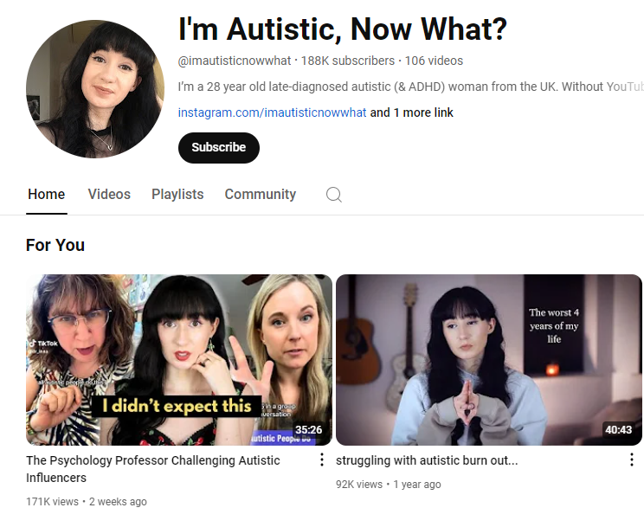
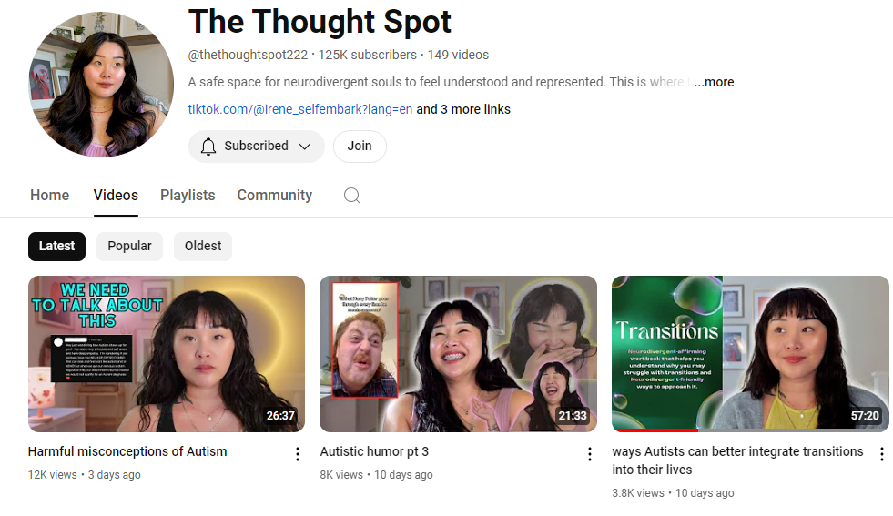
Content Creators with Resources for Autistic People

Slide 20
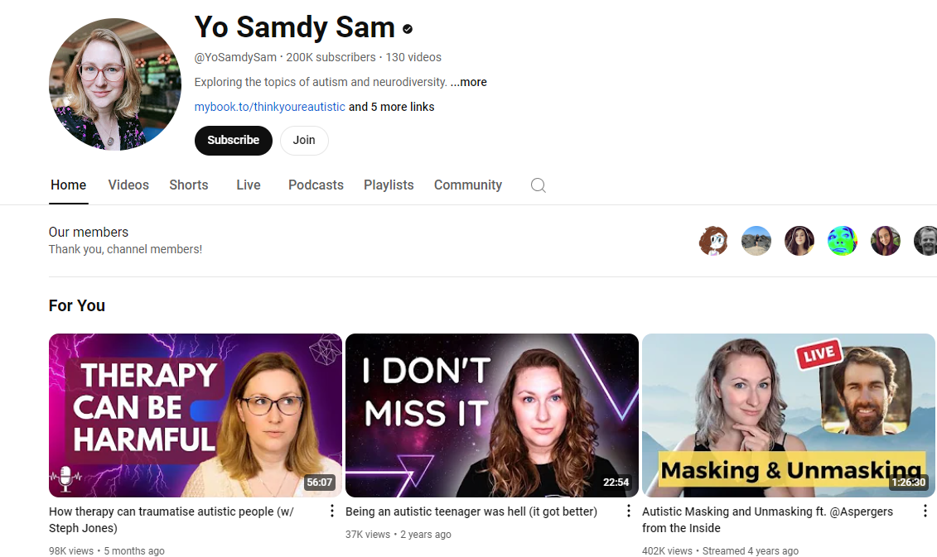
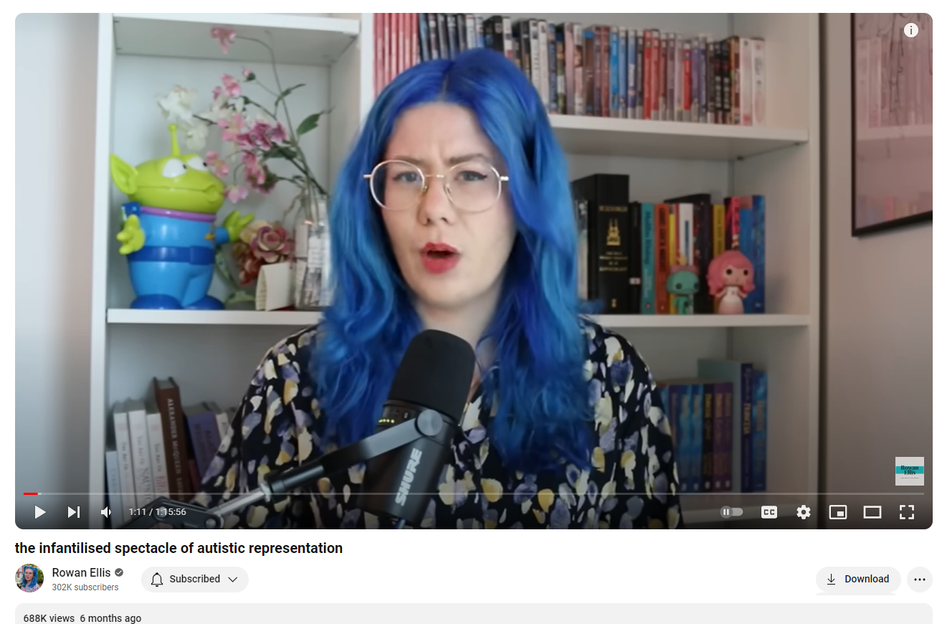
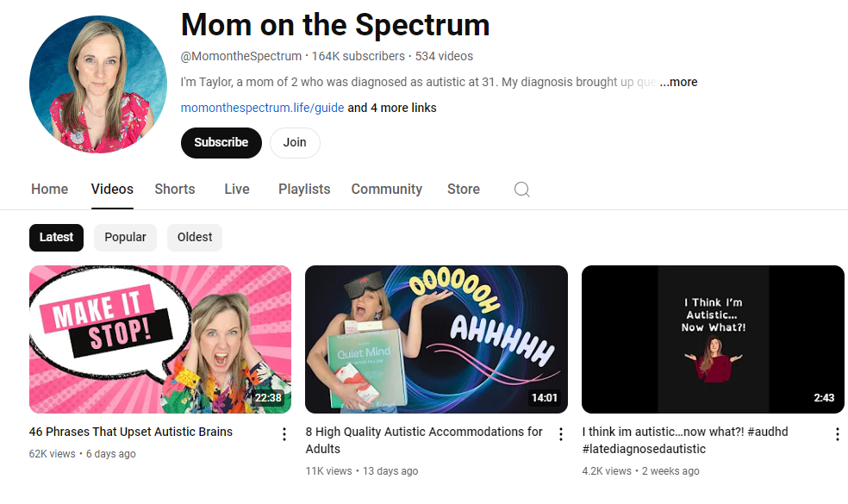

Slide 21
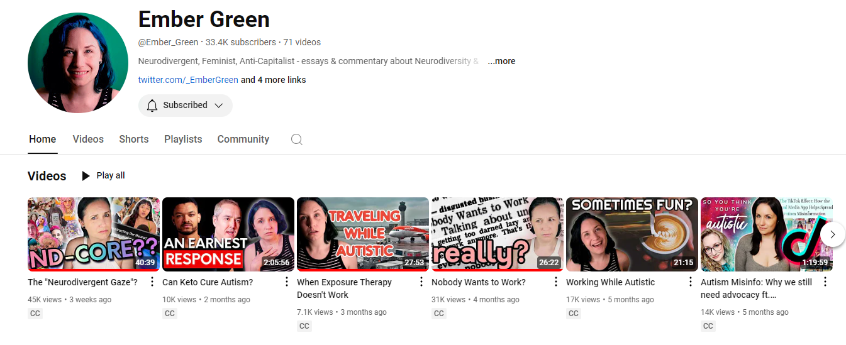
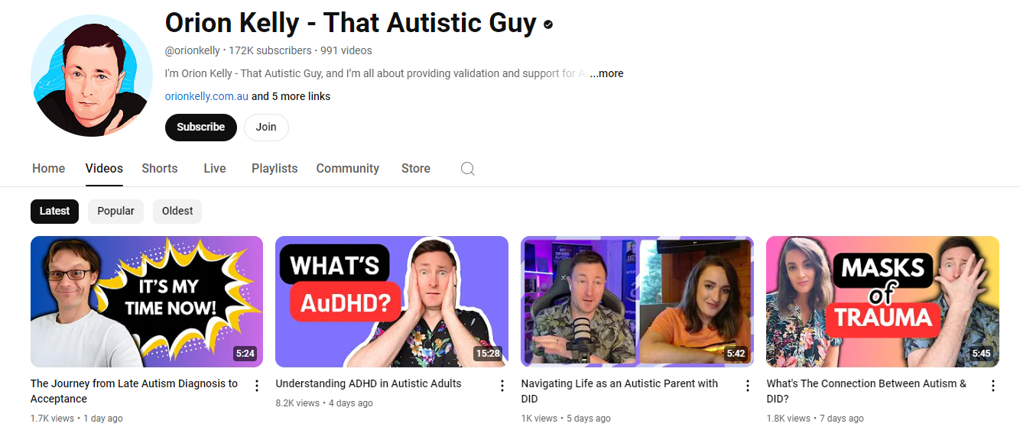

Slide 22
References
Al-Beltagi, M. (2021, May 9). Autism medical comorbidities. World journal of clinical pediatrics. https://www.ncbi.nlm.nih.gov/pmc/articles/PMC8085719/
American Psychiatric Association. (2013). Diagnostic and statistical manual of mental disorders (5th ed.). https://doi.org/10.1176/appi.books.9780890425596
Grandin, T & Panek, R. The autistic brain: Thinking across the spectrum. Houghton Mifflin Harcourt.
Price, D. (2022) Unmasking autism: The power of embracing our hidden neurodiversity. Monoray.
Romero M, Aguilar JM, Del-Rey-Mejías Á, Mayoral F, Rapado M, Peciña M, Barbancho MÁ, Ruiz-Veguilla M, Lara JP. Psychiatric comorbidities in autism spectrum disorder: A comparative study between DSM-IV-TR and DSM-5 diagnosis. Int J Clin Health Psychol. 2016 Sep-Dec;16(3):266-275. doi: 10.1016/j.ijchp.2016.03.001. Epub 2016 Jun 3. PMID: 30487870; PMCID: PMC6225088.
U.S. Department of Health and Human Services. (2024, February). Autism spectrum disorder. National Institute of Mental Health. https://www.nimh.nih.gov/health/topics/autism-spectrum-disorders-asd
Weir, E, Allison, C, & Baron-Cohen, S. Understanding the substance use of autistic adolescents and adults: a mixed methods approach. The Lancet Psychiatry (2021).

