Slide 1
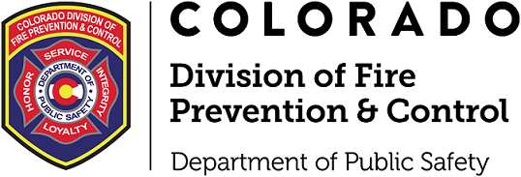
Division of Fire and Prevention and the World of BHEs
Pete Anderson
Residential Health Care Unit Chief
Craig Montoya
Plan Reviewer
Fire & Life Safety Section
Division of Fire Prevention and Control
Colorado Department of Public Safety

Slide 2
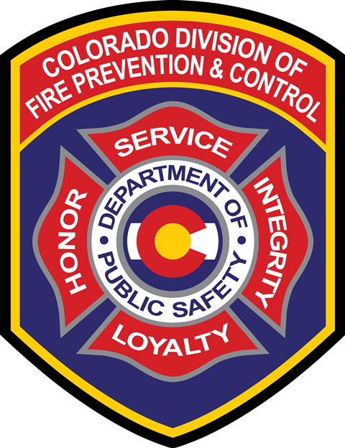
FR
Fire & Life Safety Section
Fire Prevention Branch Organizational Structure
Section Leadership
Chris Brunette - Section Chief
Branch Leadership
Chief JT McLeod - Branch Chief
01
Health Care Unit (Acute)
Chief Pete Anderson
Unit Chief
Team Members
• Inspectors
02
Health Care Unit (Residential)
Chief Bryan Adams
Unit Chief
Team Members
• Inspectors
03
Plan Review Unit
Chief Mike Garitano
Unit Chief
Team Members
• Plan Reviewers
04
Suppression & Schools Unit
Chief Bryan Kendall
Unit Chief
Team Members
• Inspectors

Slide 3
Topics of Discussion
01
DFPC Overview
02
What do BHEs look like and who does DFPC regulate?
03
Inspections Plans of Corrections, Revisits, COCs
04
Permits & Plan Reviews - When & how to get them
05
Help! - How to get it when you need it
06
Q & A

Slide 4
Legislative Changes
Initial legislation that created BHA and DFPC’s role in Behavioral Health in the state.
Colorado House Bill 22-1278
Effective January 1st, 2024
Colorado House Bill 22-1278
Effective August 12, 2026
This made changes to how DFPC completes inspections and who needs an inspection through us.

Slide 5
Local Jurisdiction Inspections
If you are a level 1 or 2 ASAM, you are a business occupancy and under new legislation, you will have to receive a fire inspection from a qualified local jurisdiction.
DFPC has to receive the inspection report from either the local jurisdiction or the facility.
Any deficiency that is marked on the report will need to be fixed prior to issuing a COC.

Slide 6
Qualified Local Jurisdiction
“Qualified Fire Department” means a fire department that has Certified Fire Inspectors at the appropriate level for the fire prevention-related task being performed and provides fire protection service for the Business Entity’s buildings and structures.

Slide 7
Relationship between DFPC and BHA
FR
Colorado Behavioral Health Administration (BHA)
• Licensing Oversight: Issues licenses upon receipt of a Certificate of Compliance (COC) and conducts necessary inspections.
• Regulatory Requirements: Mandates annual license fees to ensure operational compliance and standard maintenance.
• Assessment Standards: Utilizes ASAM (American Society of Addiction Medicine) criteria for comprehensive facility ratings.
Colorado Division of Fire Prevention and Control
Licensing and Certification
Issue Certificate of Compliance (COC) for BHE licenses.
Conduct Life Safety Code (LSC) inspections for licensure.
Issue results from COC inspections.
Manage annual COC invoicing.
Permitting and Inspections
Permit and review LSC-related work within BHE facilities.
Conduct construction-phase inspections to verify building safety.

Slide 8
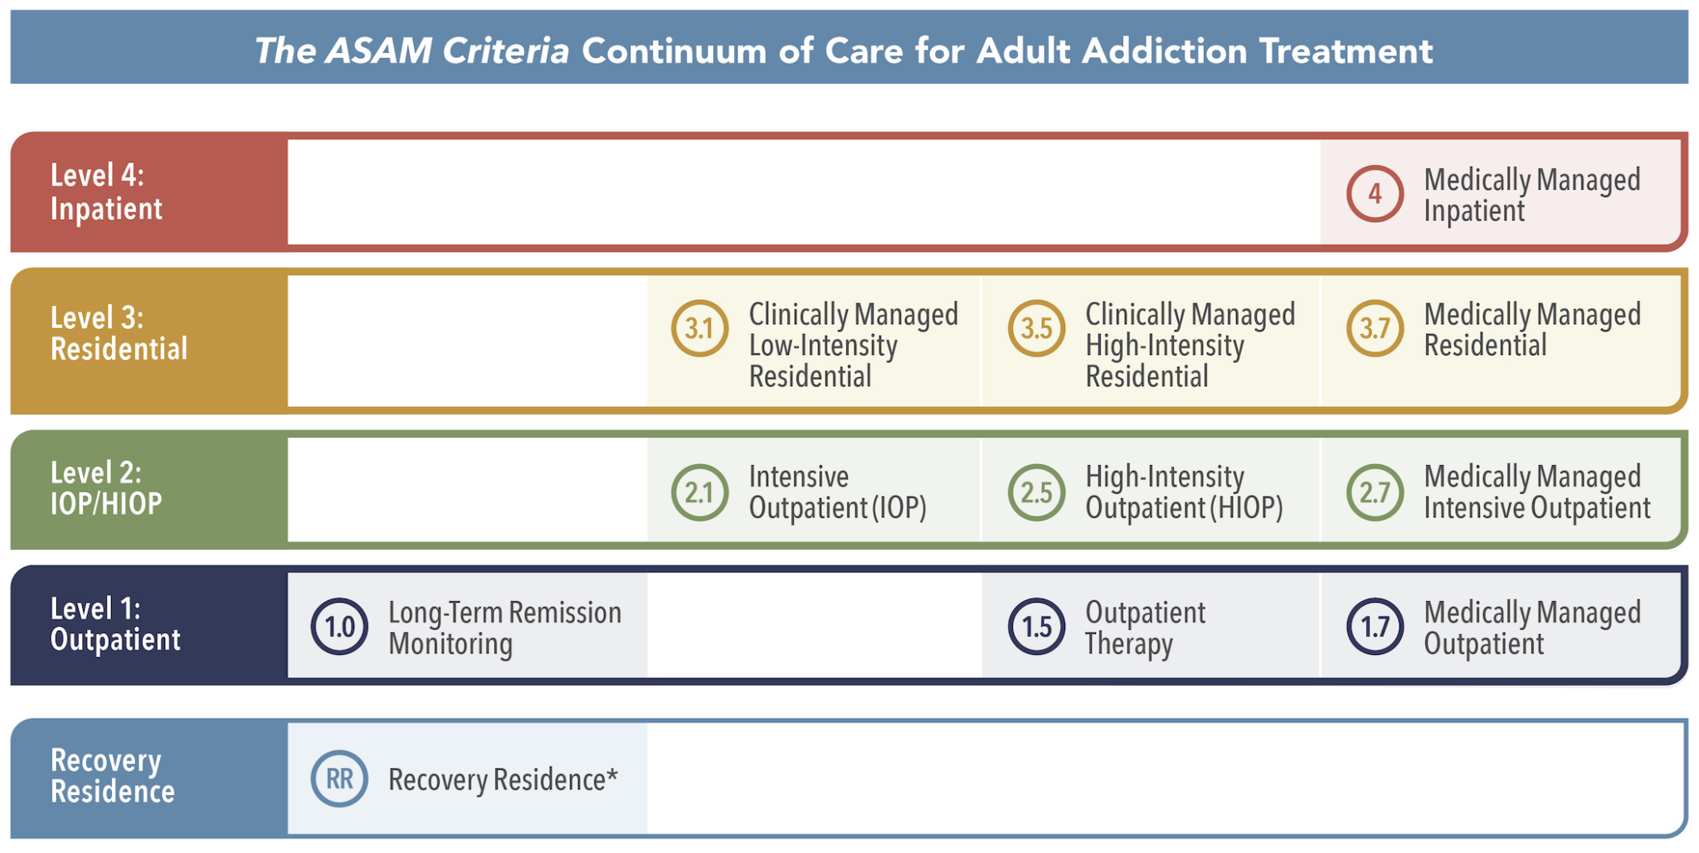
ASAM Ratings and DFPC
DFPC has purview with Level 3 and higher.
Any level 1 or 2 is considered a business occupancy for DFPC and the fire inspections will be completed by the “Qualified Fire Department.”

Slide 9
COC Surveys
Every BHE requires a COC survey on a 3-year cycle
Evaluates compliance with NFPA 101 and approximately 70 other referenced NFPA codes, similar to a certification or accreditation Life Safety Code (LSC) survey
Findings are detailed on a DFPC form as a list of violations
All violations must be corrected before a COC can be issued

Slide 10
Plan of Correction & CoC Process
Step-by-step workflow for facility inspection, reporting, and certification
FR
01
Inspection
DFPC Inspector conducts an onsite inspection at the facility.
02
Report
DFPC Inspector provides onsite contact an inspection report.
03
Correction
The facility is responsible for correcting all violations noted.
04
Submission
Facility sends correction information or documentation to the inspector.
05
Issuance
DFPC inspector determines if enough evidence was provided to issue Certificate of Compliance (CoC).

Slide 11
COC’s and Invoices
Certificate of Compliance (COC) Procedures
Issuance: The Certificate of Compliance is issued on a three-year cycle.
Confidentiality: The COC is strictly an internal document between the DFPC and BHA and is not shared with the facility.
Billing and Fee Structure
Invoicing Schedule: Invoices are distributed annually, typically in September.
Annual Fees:
  Small business occupancies: $110.00
  All other occupancies: $516.60
Late Fees: A $50.00 penalty will be applied to any invoices that are not paid by the established deadline.

Slide 12
General Survey Process for Acute Health Care
ASC, BHE, ESRD, Hospitals | Certification Surveys and Certificate of Compliance (COC) Inspections
FR
01
Preparation
Task 1 – Offsite Survey Preparation
02
Entrance
Task 2 - Entrance Conference Onsite Preparatory Activities
03
Gathering
Task 3 - Information Gathering
04
Facility Tour
Task 4 - Facility Tour
05
Analysis
Task 5 - Information Analysis and Decision Making
06
Exit
Task 6 - Exit Conference

Slide 13
Survey Readiness
Hire a contractor or qualified staff to help!
FR
✓ Fire Alarm Inspection
✓ Sprinkler System Inspection
✓ Extinguishers Tested/Installed
✓ Emergency Lighting
✓ Emergency Procedures
✓ Smoking Regulations
✓ Fire Drills Completed
✓ Fire Damper Testing
✓ Furnishings/Decorations
✓ Backflow Inspection
✓ Fire Pump Inspection
✓ Smoke Barriers Maintained
✓ Kitchen Hood Inspection
✓ Kitchen Hood Cleaning
✓ Hazardous Areas Compliant

Slide 14
Complaint Surveys
Who can have a complaint survey?
  Any licensed/certified health facility (even deemed)
Who can make an LSC complaint?
  Anyone
Are there different types of complaint surveys?
  License complaints (CDPHE Chapter 2 - 6 CCR 1101-1) and certification complaints (SOM Appendix I & L)
What happens during a complaint survey?
  Same process as other surveys, but limited scope
What happens after a complaint survey?
  Same process as a certification survey

Slide 15
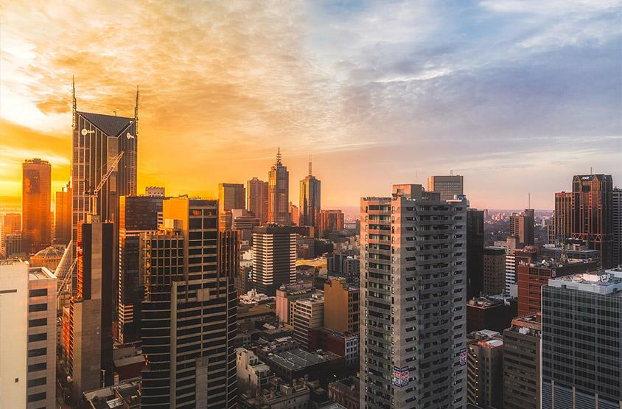
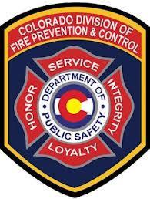
What Needs A Permit/Plan Review
Any owner or owner’s authorized agent who intends to construct, enlarge, alter, repair, move, demolish or change the occupancy of a building or structure, or to erect, install, enlarge, alter, repair, remove, convert or replace any electrical, gas, mechanical or plumbing system, the installation of which is regulated by this code, or to cause any such work to be performed, shall be permitted.
This can include:
Adding new security devices to doors, such as delayed egress.
New fire alarm control panel to replace an existing.

Slide 16
How to get a Permit or Plan Review
Consult with a design professional or code consultant knowledgeable in the Life Safety Code!
Submit engineered plans to all Authorities Having Jurisdiction.
DFPC will always be your Life Safety Official, however, it is up to the facility to determine if the Local Fire Department will require permitting IN ADDITION to DFPC
Permit Applications: https://dfpc.colorado.gov/permit-applications
Permit Questions: PermitTech@state.co.us

Slide 17
Information Construction Plan Review
Responsibilities: You and your team are legally responsible for code compliance, and official approval does not shield you from liability.
Design Professionals: You must hire a registered design professional (e.g., architect or engineer) to prepare drawings, subject to certain exceptions.
On-Site Records: A reviewed copy of the plans must be kept on the job site at all times during construction.
Adherence to Plans: Construction must match the approved plans exactly.
Plan Changes: Any changes made to construction plans midway through must be re-submitted for approval prior to building.
Shop Drawings: Shop drawings for fire alarms or sprinkler systems require approval before installation begins.

Slide 18
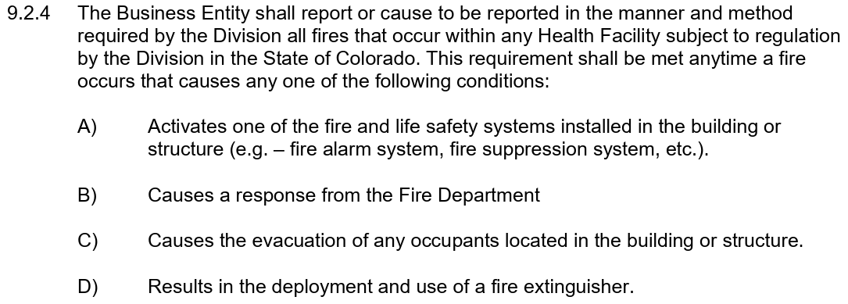
Reporting a Fire
8 CCR 1507-31 Building, Fire, and Life Safety Code Enforcement and Certification of Inspectors for Health Facilities Licensed by the State of Colorado, Part 9.2.4
https://dfpc.colorado.gov/FLSreporting-or-violations

Slide 19
Help!
BHA says you needed a COC
  https://sipa.tfaforms.net/321079
Report leadership/ownership/billing changes
  https://sipa.tfaforms.net/321151
Report Fire Watch
  https://dfpc.colorado.gov/fire-watch-fire-reporting
General inquiries
  cdps_dfpc_flsadmin@state.co.us

Slide 20
Questions?

Slide 21





Thank You.
Craig Montoya
720-512-7802
craig.montoya@state.co.us
Pete Anderson
720-880-8766
pete.anderson@state.co.us
https://dfpc.colorado.gov/FLS

